Slide 1


HOLIDAY CLIP STRIPS
2025

Slide 2
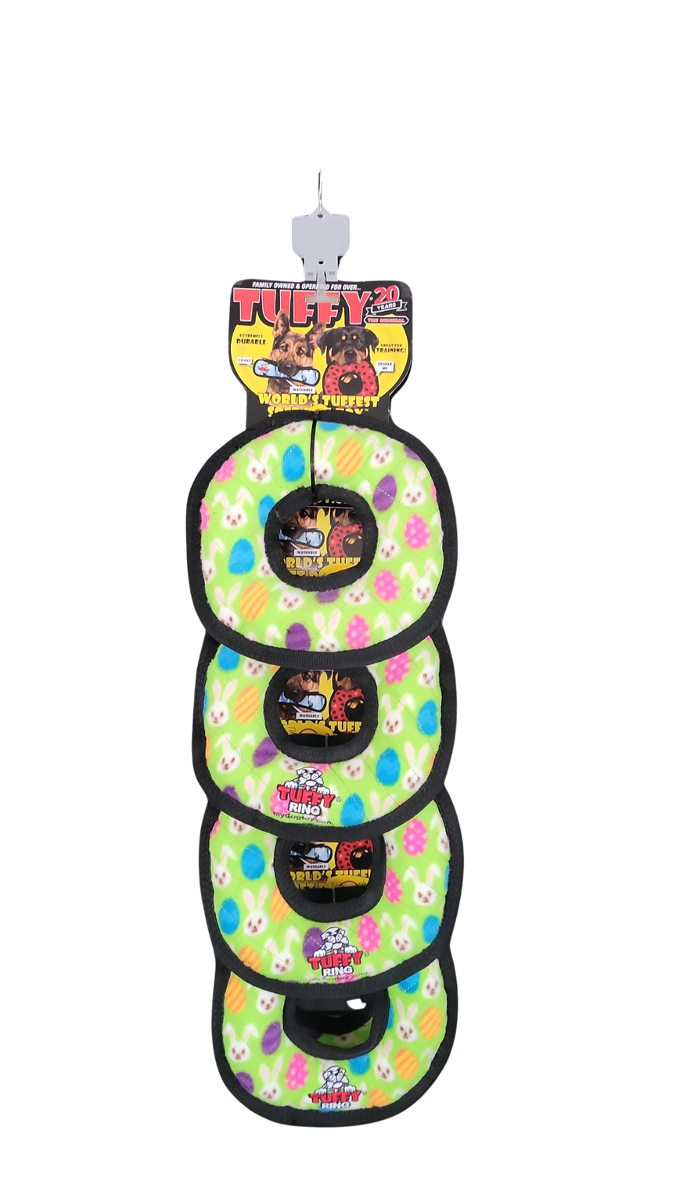
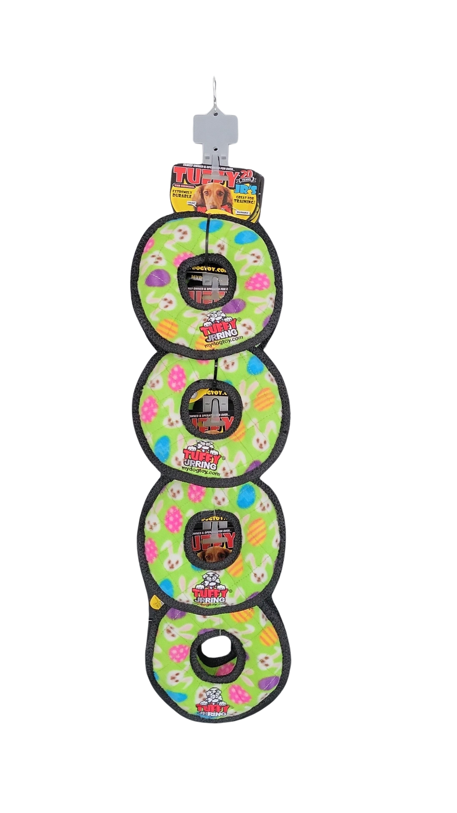
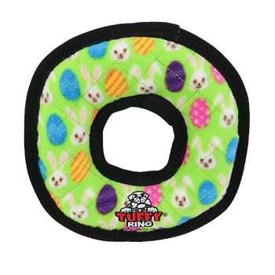
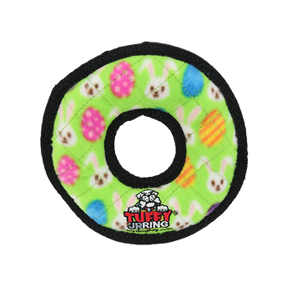
TUFFY HOLIDAY CLIP STRIPS 2025
T-H-M-R-ER-CP-8
Tuffy Holiday Medium Ring Egg - Clip Strip
8 units
Clip Strip UPC: 180181033742
H: 33.5" W: 9" D: 7"
$77.12
T-H-JR-R-ER-CP-8
Tuffy Holiday Jr Ring Egg - Clip Strip
8 units
Clip Strip UPC: 180181033735
H: 30" W: 7" D: 5.5"
$55.84
(8) T-H-M-R-ER
Tuffy Holiday Medium Ring Egg
Item UPC: 180181033490
$9.64
(8) T-H-JR-R-ER
Tuffy Holiday Jr Ring Egg
Item UPC: 180181033452
$6.98

Slide 3
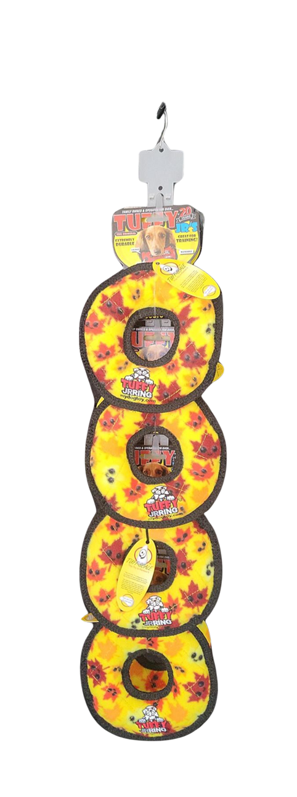
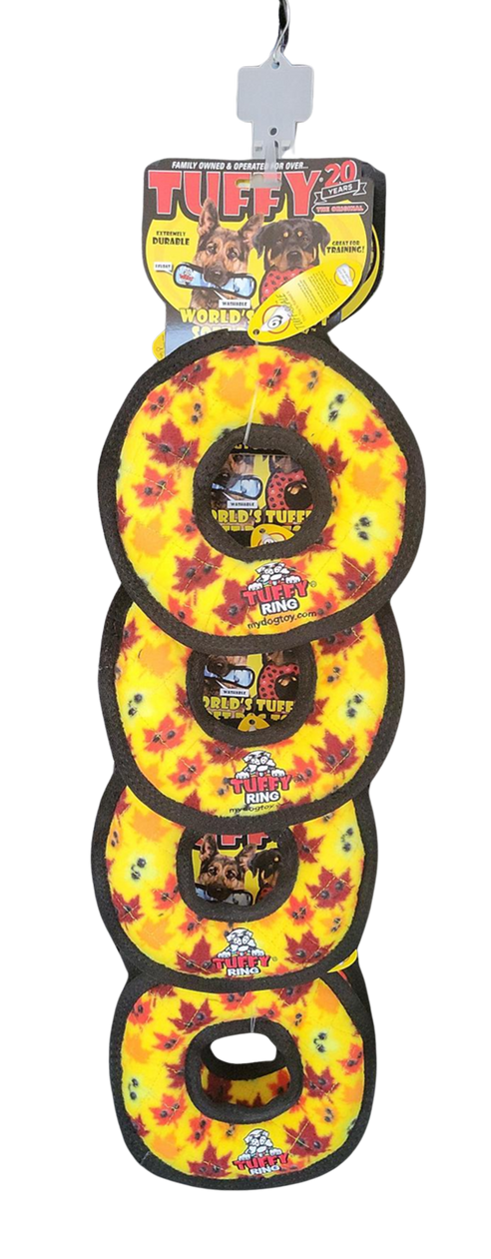
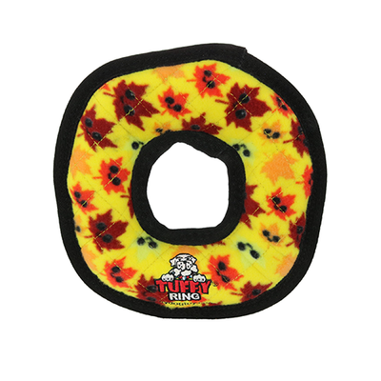
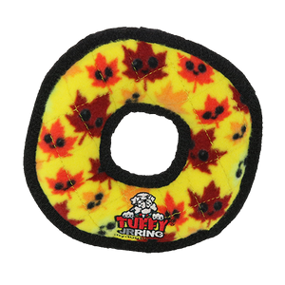
TUFFY HOLIDAY CLIP STRIPS 2025
T-H-M-R-LV-CP-8
Tuffy Holiday Medium Ring Leaves - Clip Strip
8 units
180181033704
H: 33.5" W: 9" D: 7"
$77.12
T-H-JR-R-LV-CP-8
Tuffy Holiday Jr Ring Leaves - Clip Strip
8 units
180181033698
H: 30" W:7" D: 5.5"
$55.84
(8) T-H-M-R-LV
Tuffy Holiday Medium Ring Leaves
Item UPC: 180181033469
$9.64
(8) T-H-JR-R-LV
Tuffy Holiday Jr Ring Leaves
Item UPC: 180181033421
$6.98

Slide 4
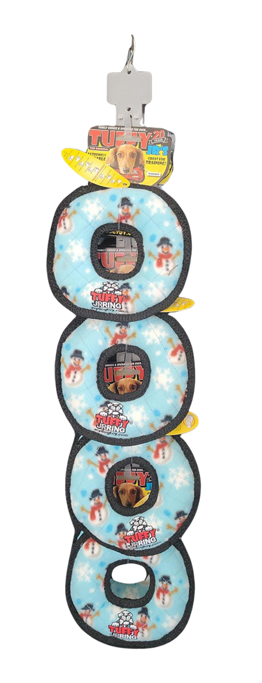
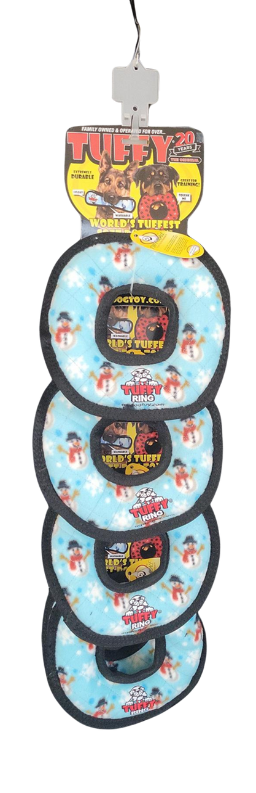
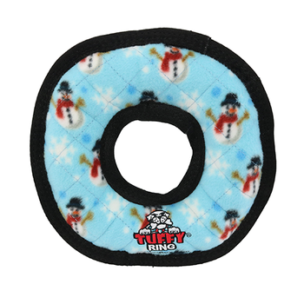
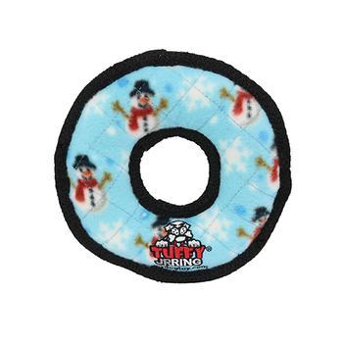
TUFFY HOLIDAY CLIP STRIPS 2025
T-H-M-R-SW-CP-8
Tuffy Holiday Medium Ring Snowman - Clip Strip
8 units
Clip Strip UPC: 180181033681
H: 33.5" W: 9" D: 7"
$77.12
T-H-JR-R-SW-CP-8
Tuffy Holiday Jr Ring Snowman - Clip Strip
8 units
Clip Strip UPC: 180181033674
H: 30" W: 7: D: 5.5"
$55.84
(8) T-H-M-R-SW
Tuffy Holiday Medium Ring Snowman
Item UPC: 180181033483
$9.64
(8) T-H-JR-R-SW
Tuffy Holiday Jr Ring Snowman
Item UPC: 180181033445
$6.98

Slide 5
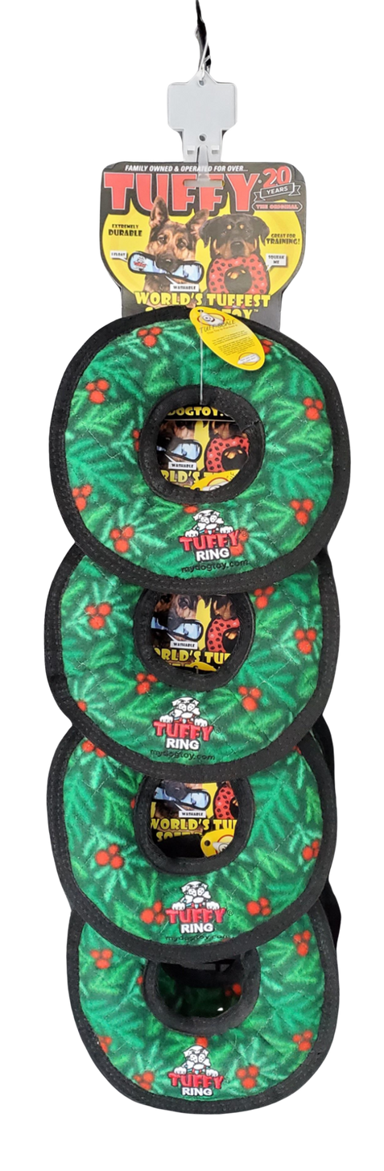
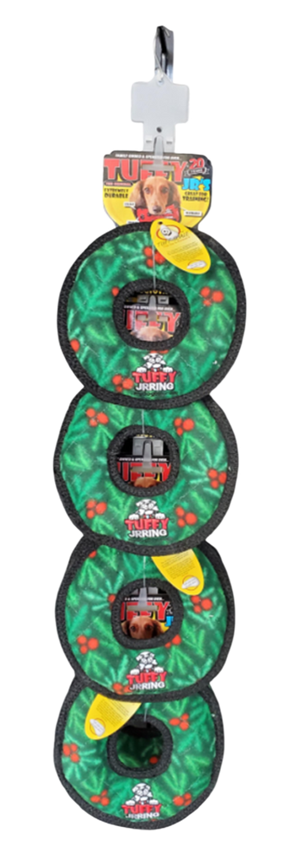
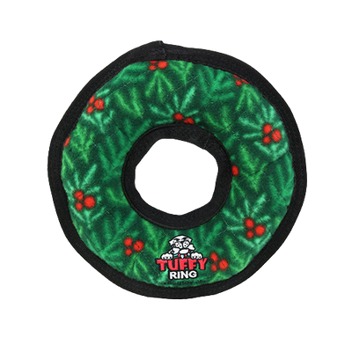
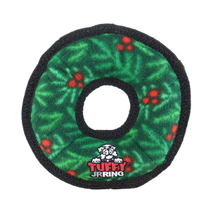
TUFFY HOLIDAY CLIP STRIPS 2025
T-M-R-WR-CP-8
Tuffy Medium Ring Wreath - Clip Strip
8 units
Clip Strip UPC: 180181033179
H: 33.5" W: 9" D: 7"
$77.12
T-JR-R-WR-CP-8
Tuffy Jr Ring Wreath - Clip Strip
8 units
Clip Strip UPC: 180181033094
H: 30" W:7" D: 5.5"
$55.84
(8) T-M-R-WR
Tuffy Medium Ring Wreath
Item UPC: 180181033025
$9.64
(8) T-JR-R-WR
Tuffy Jr Ring Wreath
Item UPC: 180181033018
$6.98

Slide 6
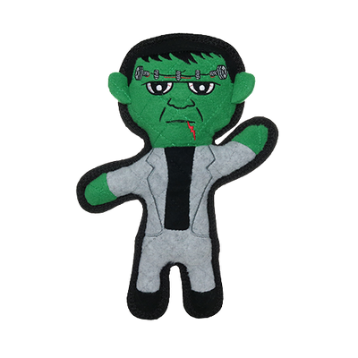
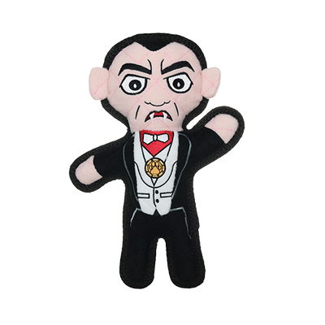
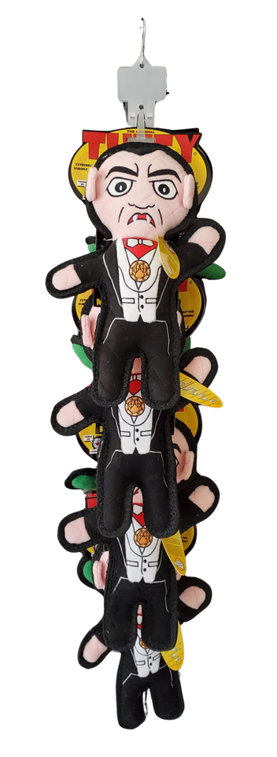
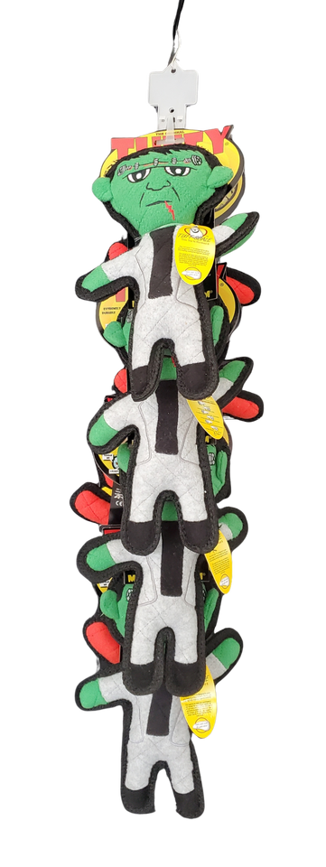
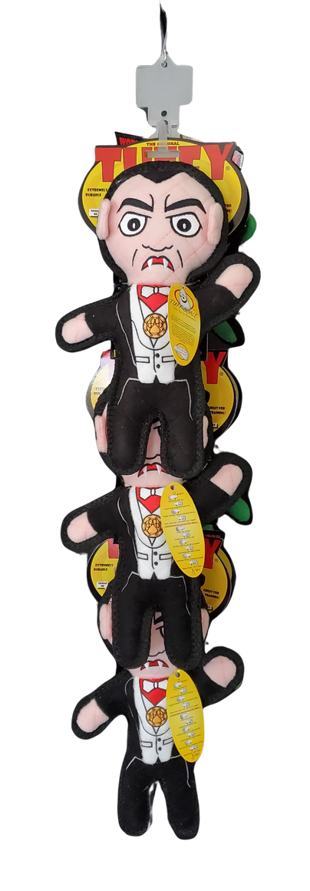
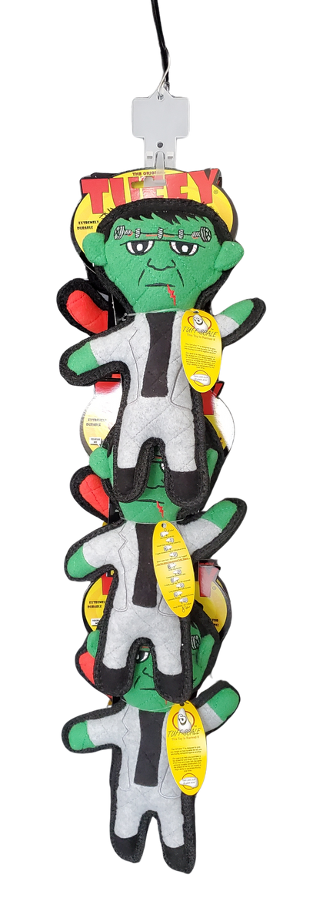
TUFFY HOLIDAY CLIP STRIPS 2025
T-H-Drac-Frnk-CP-6
Tuffy Holiday Dracula & Frankenstein - Clip Strip
6 units
Clip Strip UPC: 180181032387
H: 31" W: 8" D:8"
$77.73
T-H-Drac-Frank-CP
Tuffy Holiday Dracula & Frankenstein - Clip Strip
8 units
Clip Strip UPC: 180181031670
H: 33" W: 8" D: 11"
$103.64
(3) T-H-Dracula
Tuffy Holiday Dracula
Item UPC: 180181024283
$13.00
(4) T-H-Dracula
Tuffy Holiday Dracula
Item UPC: 180181024283
$13.00
(3) T-H-Frankenstein
Tuffy Holiday Frankenstein
Item UPC: 180181024290
$12.91
(4) T-H-Frankenstein
Tuffy Holiday Frankenstein
Item UPC: 180181024290
$12.91

Slide 7
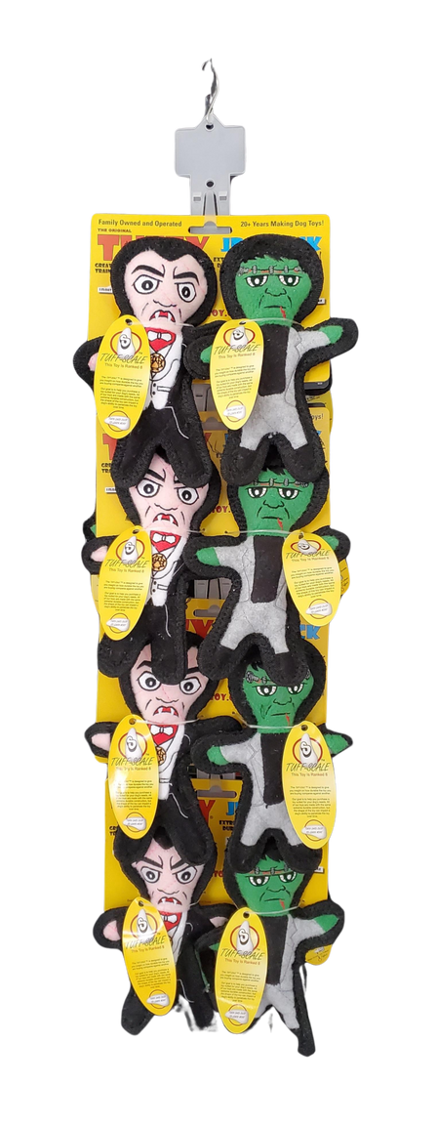
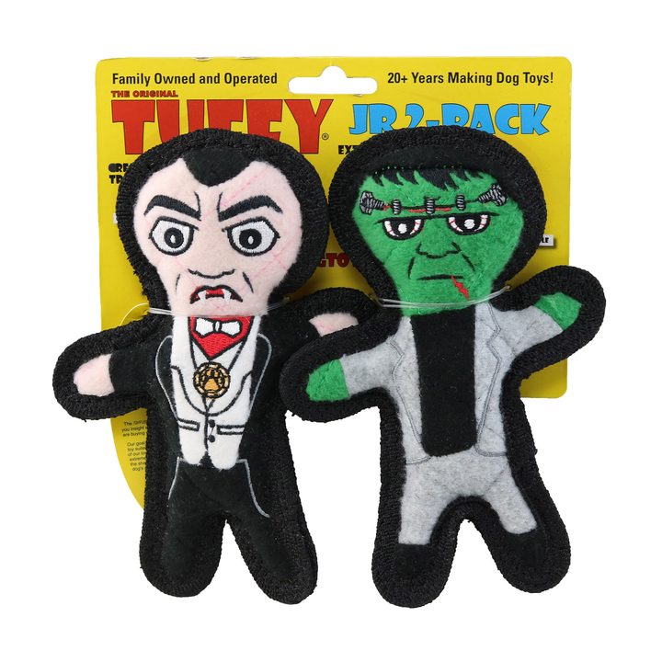
TUFFY HOLIDAY CLIP STRIPS 2025
T-JR-H-Drac-Frnk-2PK-CP-8
Tuffy Jr Holiday Dracula & Frankenstein 2 Pack - Clip Strip
8 units
Clip Strip UPC: 180181032691
H: 29" W: 8" D: 5"
$92.72
(8) T-JR-Drac-Frnk-2PK
Tuffy Jr Holiday Dracula and Frankenstein 2 Pack
Item UPC: 180181031779
$11.59

Slide 8
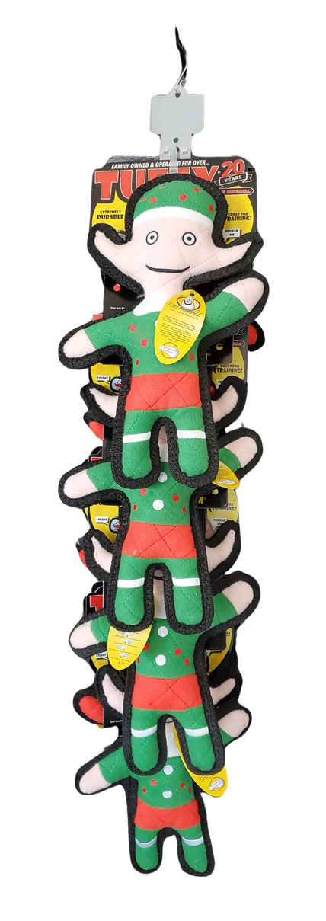
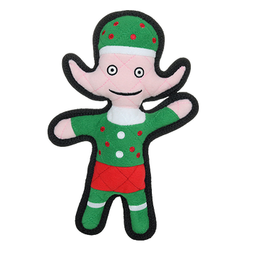
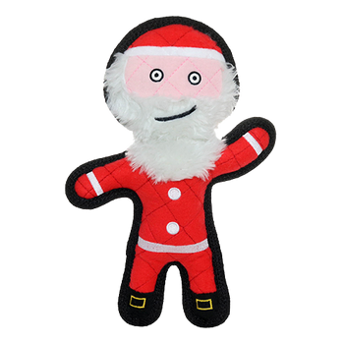
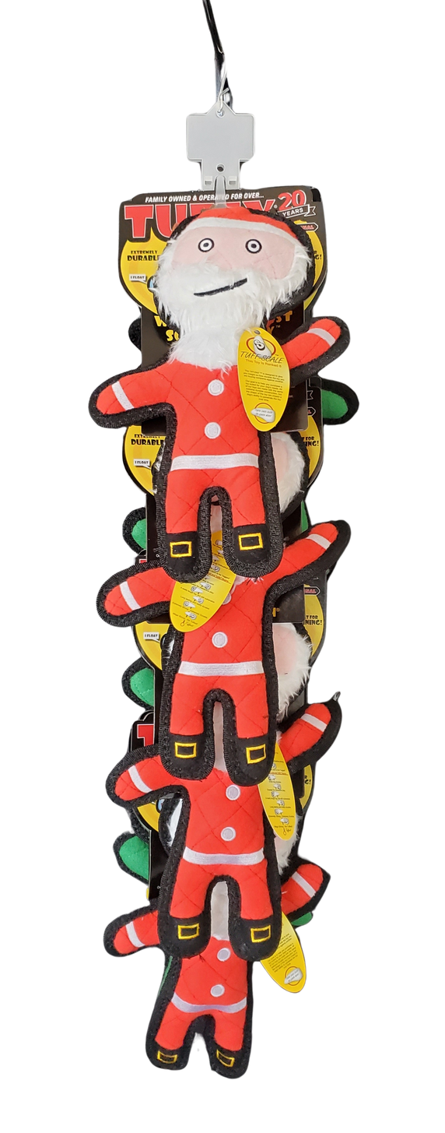
TUFFY HOLIDAY CLIP STRIPS 2025
T-H-Elf-San-CP
Tuffy Holiday Elf & Santa - Clip Strip
8 units
Clip Strip UPC: 180181031663
H: 33" W: 8" D: 10.5"
$105.84
(4) T-H-Elf
Tuffy Holiday Elf
Item UPC: 180181023767
$13.00
(4) T-H-Santa
Tuffy Holiday Santa
Item UPC: 180181023750
$13.46

Slide 9
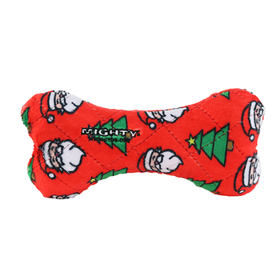
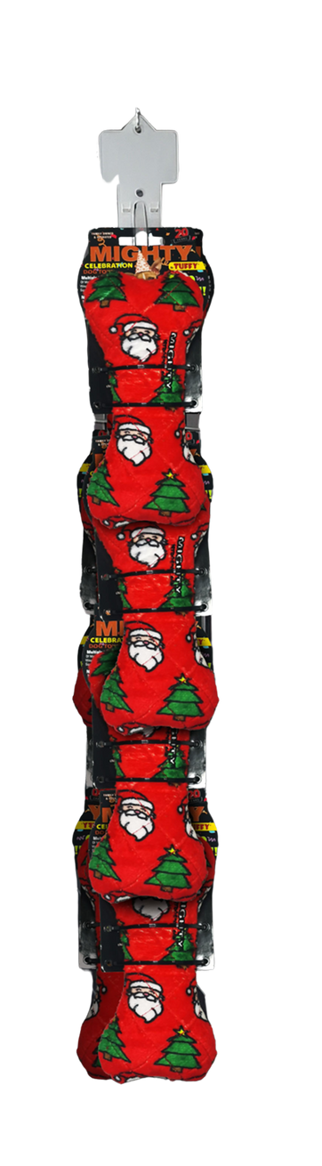
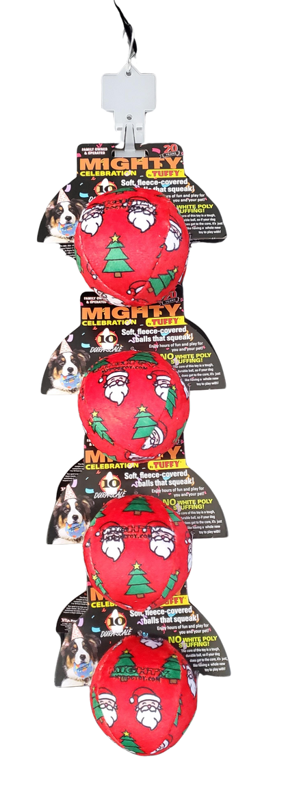
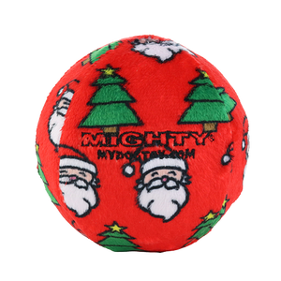
MIGHTY HOLIDAY CLIP STRIPS 2025
MT-Ball-M-CF1-CP-8
Mighty Med Ball Christmas Fleece - Clip Strip
8 units
Clip Strip UPC: 180181033162
H: 27.5" W: 7" D: 8"
$51.12
MTNS-Bone-M-CF1-CP-8
Mighty Med Bone Christmas Fleece - Clip Strip
8 units
Clip Strip UPC: 180181033087
H: 29" W: 4" D: 6.5"
$55.60
(8) MT-Ball-M-CF1
Mighty Medium Ball Christmas
Item UPC: 180181033049
$6.39
(8) MTNS-Bone-M-CF1
Mighty Medium Bone Christmas
Item UPC: 180181033032
$6.95

Slide 10
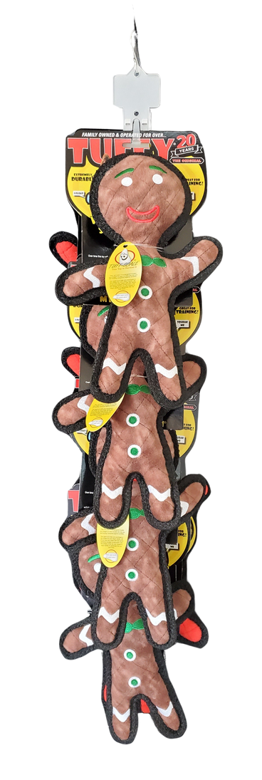
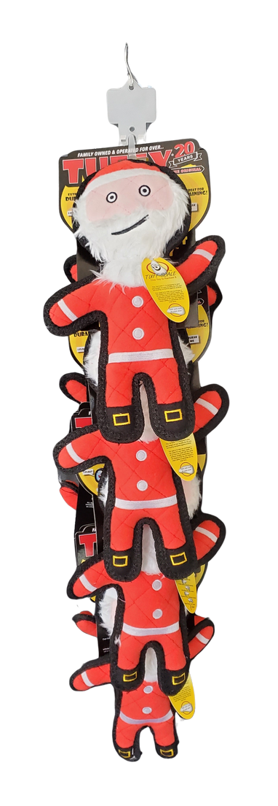
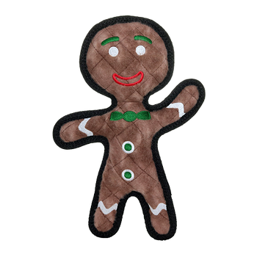
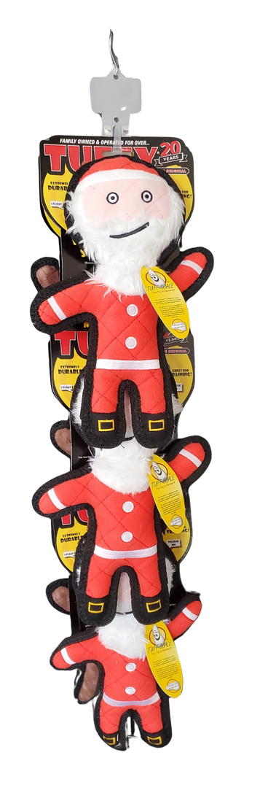
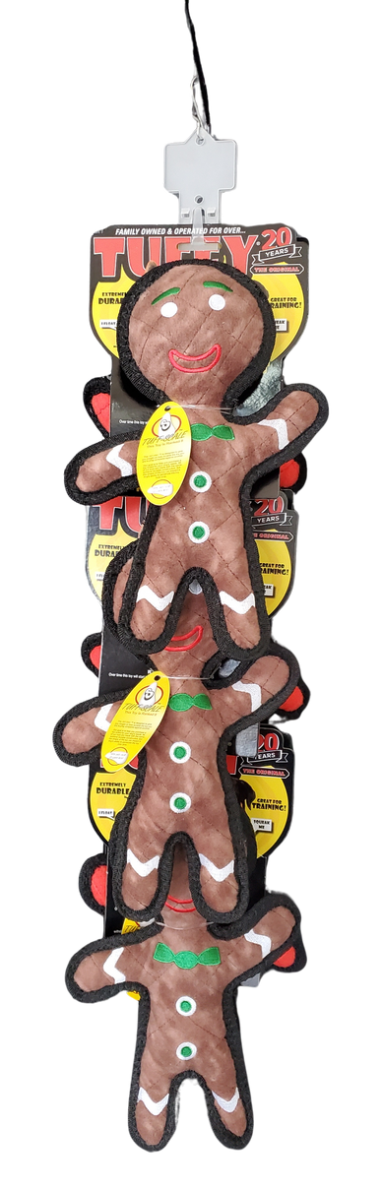
TUFFY HOLIDAY CLIP STRIPS 2025
T-H-Gin-San-CP-8
Tuffy Holiday Gingerbread Man & Santa - Clip Strip
8 units
Clip Strip UPC: 180181033056
H: 33.5" W: 8" D: 11"
$105.56
T-H-Gin-Santa-CP
Tuffy Holiday Gingerbread Man & Santa - Clip Strip
6 units
Clip Strip UPC: 180181024566
H: 31.5" W: 8" D: 8"
$79.17
(4) T-H-Gingerbread-Man
Tuffy Holiday Gingerbread Man
Item UPC: 180181023774
$12.93
(3) T-H-Gingerbread-Man
Tuffy Holiday Gingerbread Man
Item UPC: 180181023774
$12.93
(4) T-H-Santa
Tuffy Holiday Santa
Item UPC: 180181023750
$13.46
(3) T-H-Santa
Tuffy Holiday Santa
Item UPC: 180181023750
$13.46

Slide 11
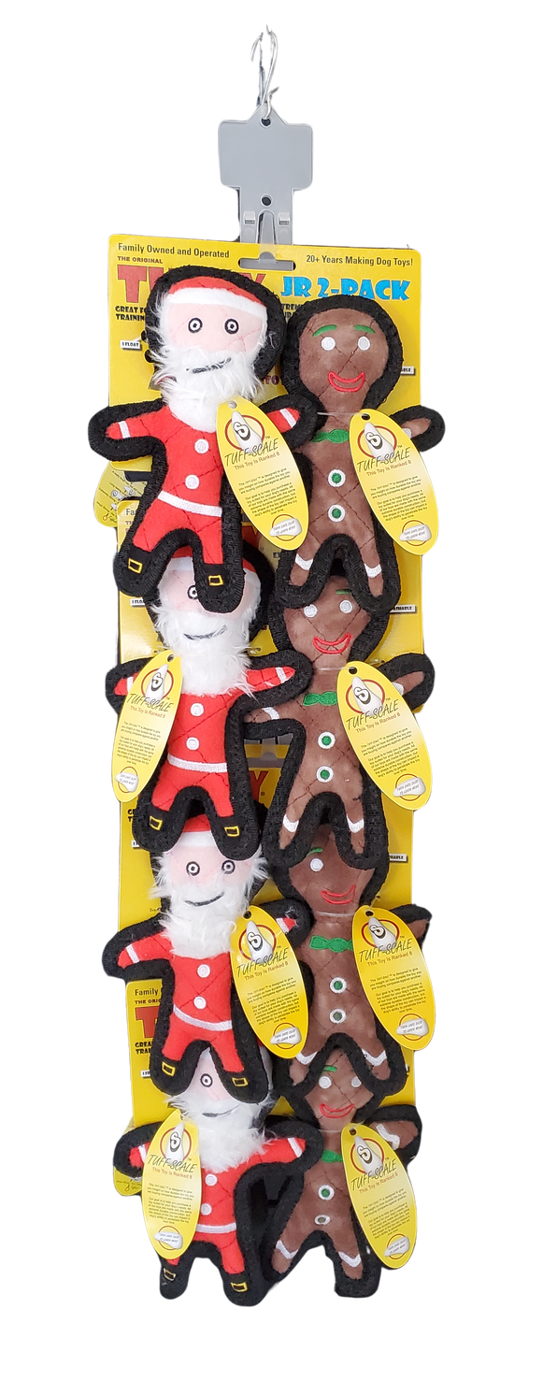
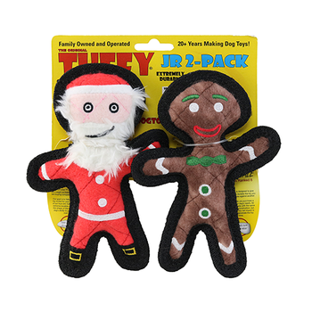
TUFFY HOLIDAY CLIP STRIPS 2025
T-H-Santa-CP
Tuffy Holiday Santa - Clip Strip
8 units
180181024382
H: 33.5" W: 8" D: 11"
$107.68
T-JR-H-Gin-San-2PK-CP-8
Tuffy Jr Holiday Gingerbread Man & Santa 2 Pack - Clip Strip
8 units
180181032684
H: 29" W: 8" D: 5"
$91.92
(8) T-H-Santa
Tuffy Holiday Santa
Item UPC: 180181023750
$13.46
(8) T-JR-Gingbrd-San-2PK
Tuffy Jr Holiday Gingerbread Man
& Santa 2 Pack
Item UPC: 180181031793
$11.49

Slide 12
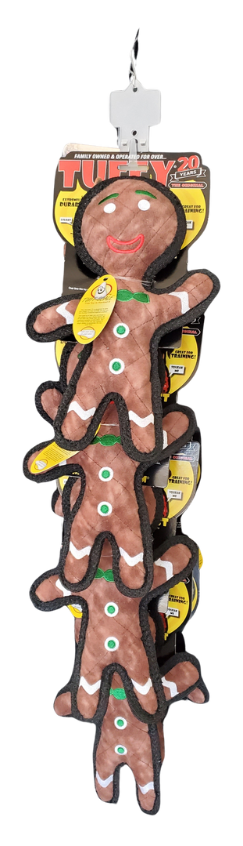
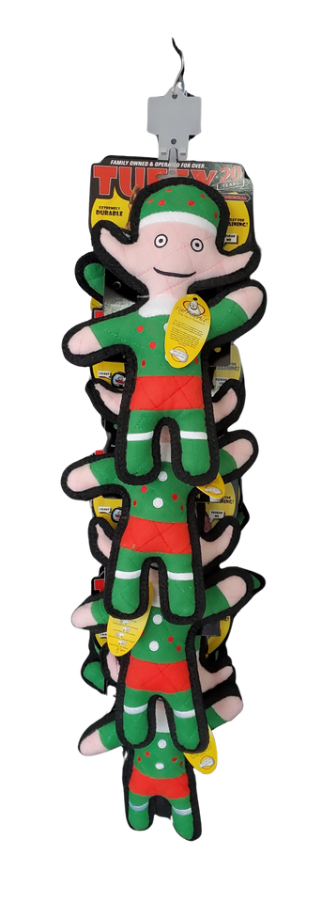
TUFFY HOLIDAY CLIP STRIPS 2025
T-H-Gingerbread-CP
Tuffy Holiday Gingerbread Man - Clip Strip
8 units
Clip Strip UPC: 180181024375
H: 33" W: 8" D: 11"
$103.44
T-H-Elf-CP
Tuffy Holiday Elf - Clip Strip
8 units
Clip Strip UPC: 180181024399
H: 33" W: 8" D: 10"
$104.00
(8) T-H-Gingerbread-Man
Tuffy Holiday Gingerbread Man
Item UPC: 180181023774
$12.93
(8) T-H-Elf
Tuffy Holiday Elf
Item UPC: 180181023767
$13.00

Slide 13
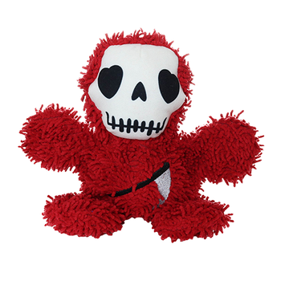
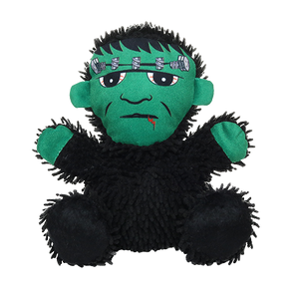
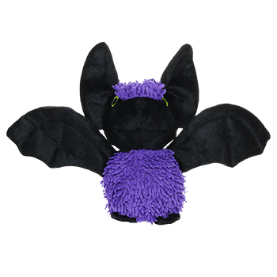
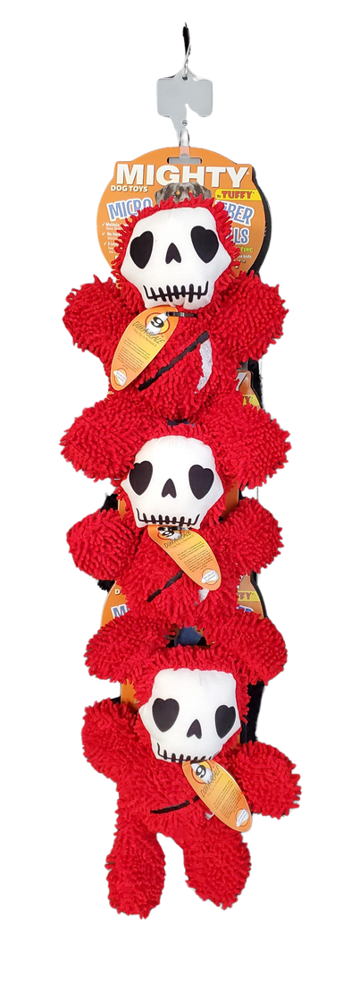
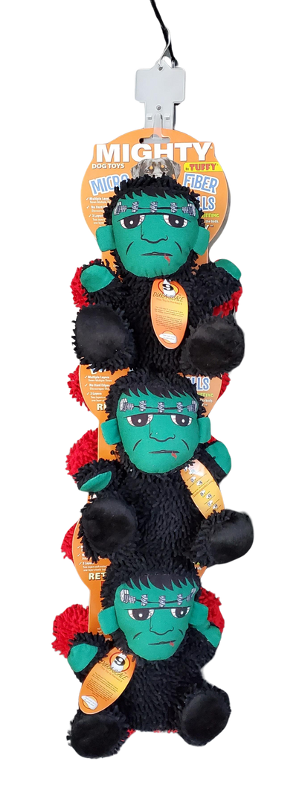
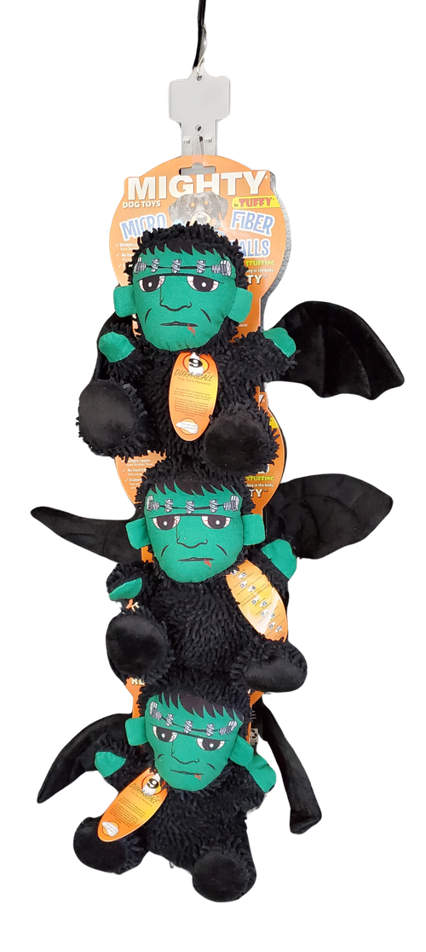
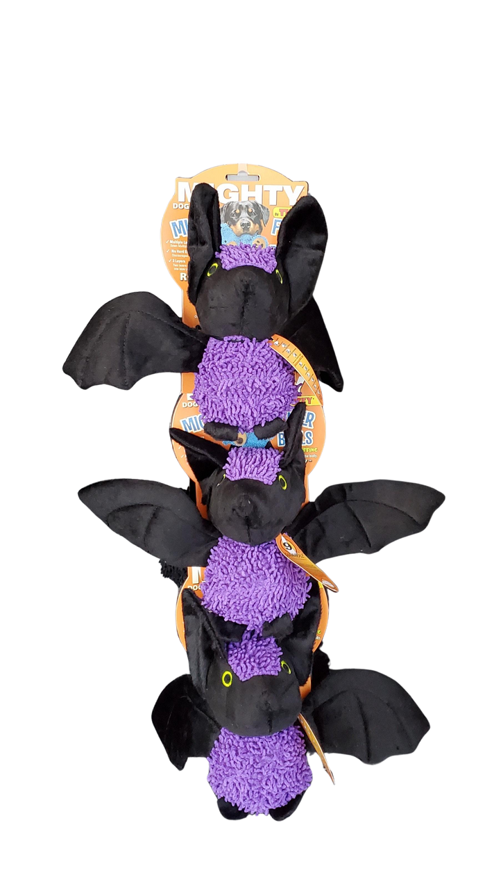
MIGHTY MICROFIBER HOLIDAY
CLIP STRIPS 2025
MT-MB-Frnk-GrmR-CP-6
Mighty MicroBall Frankenstein &
Grim Reaper - Clip Strip
6 units
Clip Strip UPC: 180181031847
H: 32.5" W: 8" D: 9"
$85.56
MT-MB-Bat-Frnk-CP-6
Mighty MicroBall Bat & Frankenstein - Clip Strip
6 units
Clip Strip UPC: 180181032660
H: 29" W: 14" D: 10.5"
$85.56
(3) MT-MicroBM-Frankenstein
Mighty Microfiber Ball Med Frankenstein
Item UPC: 180181024535
$14.26
(3) MT-MicroBM-Bat-PR
Mighty Microfiber Ball Med Bat Purple
Item UPC: 180181028144
$14.26
(3) MT-MicroBM-Grim-Reaper
Mighty Microfiber Ball Med Grim Reaper
Item UPC: 180181024528
$14.26
(3) MicroBM-Frankenstein
Mighty Microfiber Ball Med Frankenstein
Item UPC: 180181024535
$14.26

Slide 14
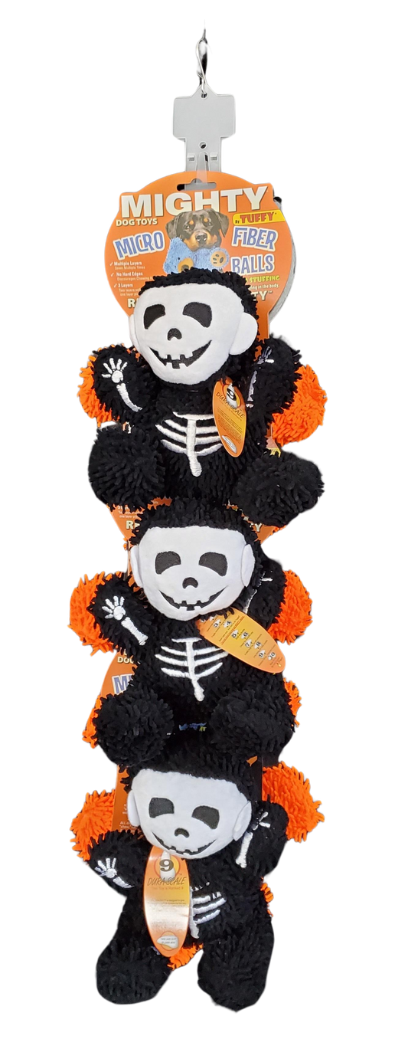
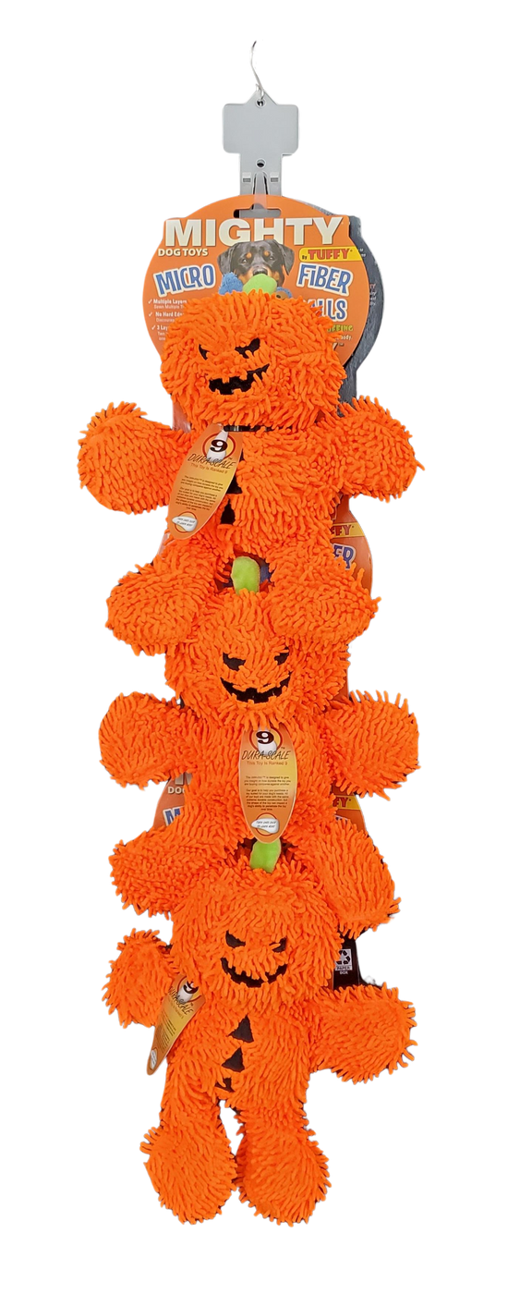


MIGHTY MICROFIBER HOLIDAY CLIP STRIPS 2025
MT-MB-Pum-Skel-CP
Mighty MicroBall Pumpkin Man & Skeleton - Clip Strip
6 units
180181031694
H: 32" W: 9" D: 10"
$85.56
(3) MT-MicroBM-Pumpkin-Man
Mighty Microfiber Ball Med Pumpkin Man
Item UPC: 180181024368
$14.26
(3) MT-MicroBM-Skeleton
Mighty Microfiber Ball Med Skeleton
Item UPC: 180181024610
$14.26

Slide 15







MIGHTY MICROFIBER HOLIDAY
CLIP STRIPS 2025
MT-MBM-GBM-Pen-BK-CP-6
Mighty Microfiber Ball Med Gingerbread Man Hat & Penguin BK - Clip Strip
6 units
Clip Strip UPC: 180181033063
H: 32" W: 9" D: 9"
$85.56
MT-MB-Snw-PenBK-CP-6
Mighty MicroBall Snowman &
Penguin Black - Clip Strip
6 units
Clip Strip UPC: 180181031854
H: 32" W: 8" D: 8"
$85.29
(3) MT-MicroBM-GBM-Hat
Mighty Microfiber Ball Med Gingerbread Man Hat
Item UPC: 180181030826
$14.26
(3) MT-MicroBM-Snowman
Mighty Microfiber Ball Med Snowman
Item UPC: 180181028168
$14.17
(3) MT-MicroBM-Penguin-BK
Mighty Microfiber Ball Med Penguin Black
Item UPC: 180181028151
$14.26
(3) MT-MicroBM-Penguin-BK
Mighty Microfiber Ball Med Penguin Black
Item UPC: 180181028151
$14.26

Slide 16






MIGHTY MICROFIBER HOLIDAY
CLIP STRIPS 2025
MT-MB-Rndr-San-CP
Mighty MicroBall Reindeer & Santa - Clip Strip
6 units
Clip Strip UPC: 180181031687
H: 32" W: 8: D: 10"
$85.56
MT-MBM-Rndr-Gngbrd-CP-6
Mighty Microfiber Ball Med Reindeer &
Gingerbread Man - Clip Strip
6 units
Clip Strip UPC: 180181032400
H: 32" W: 9" D: 10.5"
$85.56
(3) MT-MicroBM-Reindeer
Mighty Microfiber Ball Med Reindeer
Item UPC: 180181024450
$14.26
(3) MT-MicroBM-Reindeer
Mighty Microfiber Ball Med Reindeer
Item UPC: 180181024450
$14.26
(3) MT-MicroBM-Santa
Mighty Microfiber Ball Med Santa
Item UPC: 180181024351
$14.26
(3) MT-MicroBM-GBM-Hat
Mighty Microfiber Ball Med Gingerbread Man Hat
Item UPC: 180181030826
$14.26

Slide 17


MIGHTY MICROFIBER HOLIDAY CLIP STRIPS 2025
MT-MBM-Snw-Gngbrd-CP-6
Mighty Microfiber Ball Med Snowman & Gingerbread Man Clip Strip
6 units
Clip Strip UPC: 180181032677
H: 33" x W: 9" x D: 9"
$85.29
(3) MT-MicroBM-Snowman
Mighty Microfiber Ball Med Snowman
Item UPC: 180181028168
$14.17
(3) MT-MicroBM-GBM-Hat
Mighty Microfiber Ball Med Gingerbread Man Hat
Item UPC: 180181030826
$14.26

