Slide 1


CLIP STRIPS 2025

Slide 2
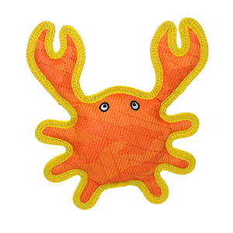
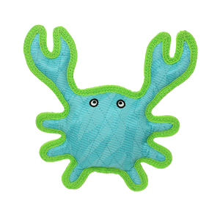
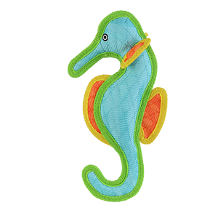
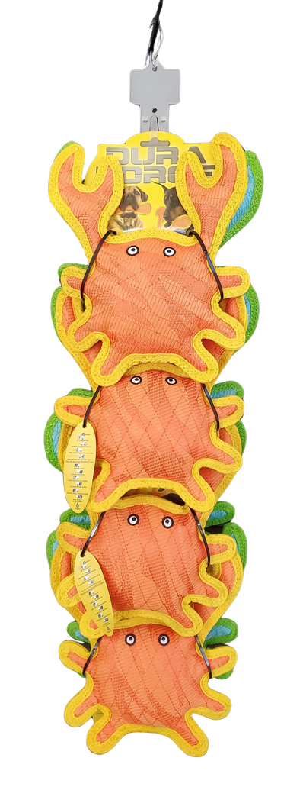
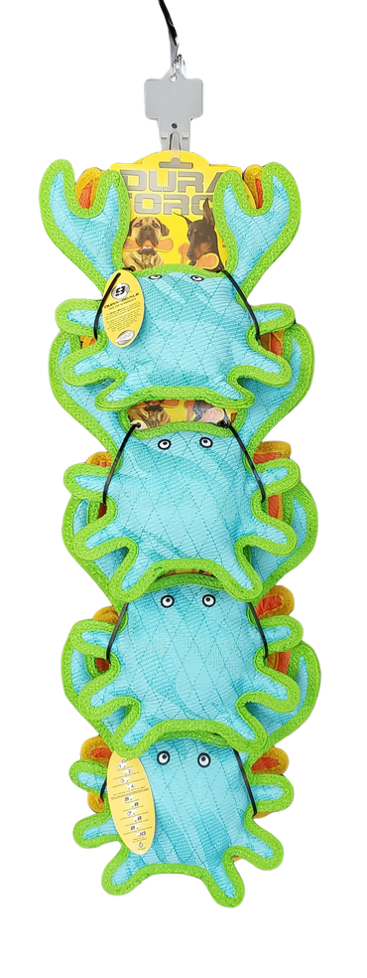
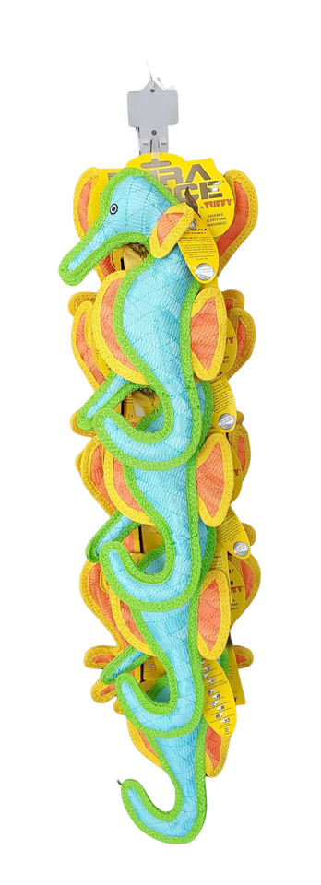
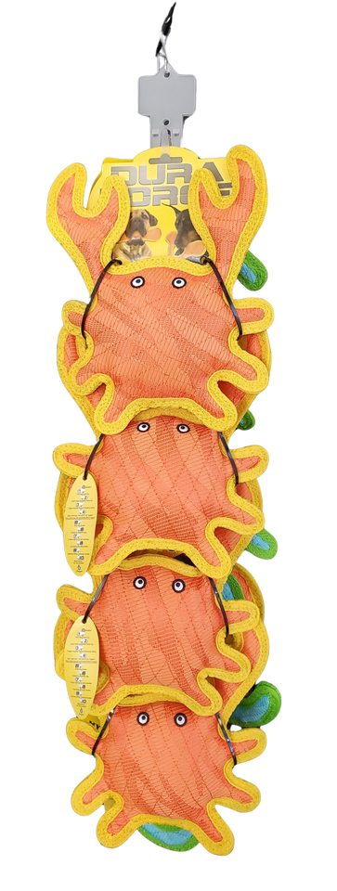
DURAFORCE CLIP STRIPS 2025
DF-CrabOY-CrabBG-CP
Duraforce Crab Orange & Crab Blue -
Clip Strip
8 units
180181032929
H: 31.5" W: 9.5" D: 7"
$89.95
DF-CrabOr-Seahorse-CP-8
Duraforce Crab Orange & Seahorse Clip Strip
8 units
180181031892
H: 35" W: 8" D: 8"
$93.84

Slide 3
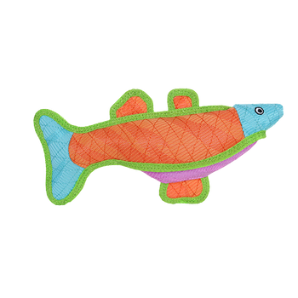
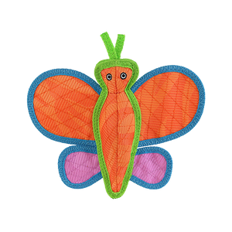
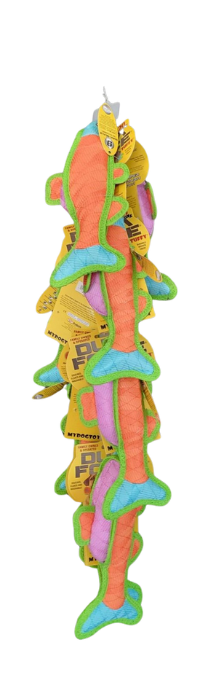
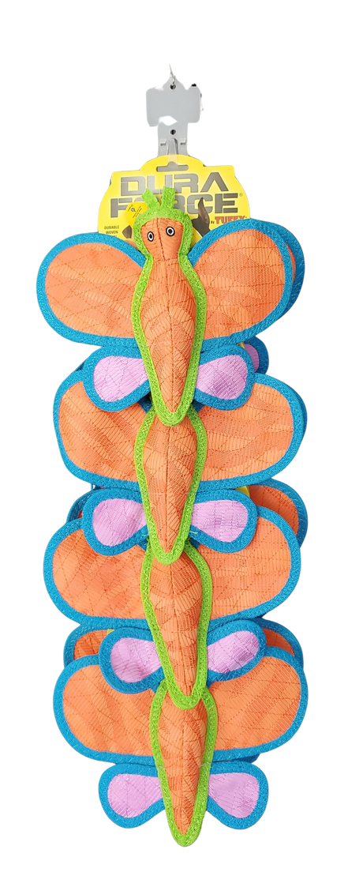
DURAFORCE CLIP STRIPS 2025
DFC-Fish-BOP-CP-8
DuraForce Fish Clip Strip
8 units
180181033551
H: 29" W:14" D: 8"
$90.16
DFC-Butterfly-O-CP-8
DuraForce Butterfly Orange Clip Strip
8 units
180181032912
H: 31" W:10.5" D: 6"
$97.76

Slide 4
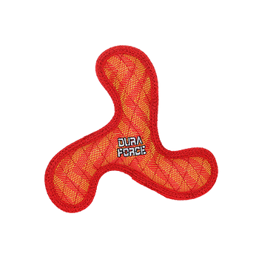
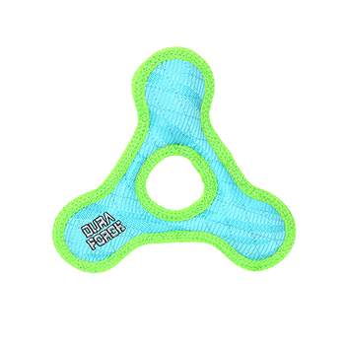
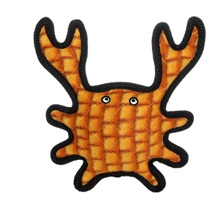
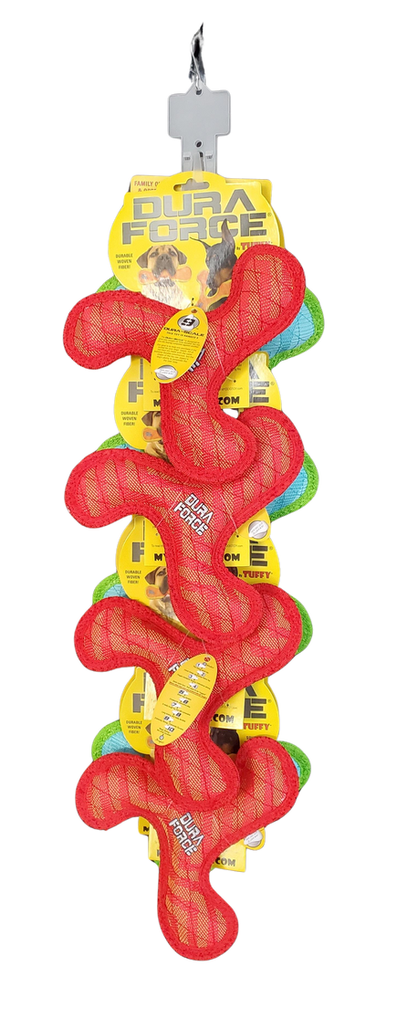
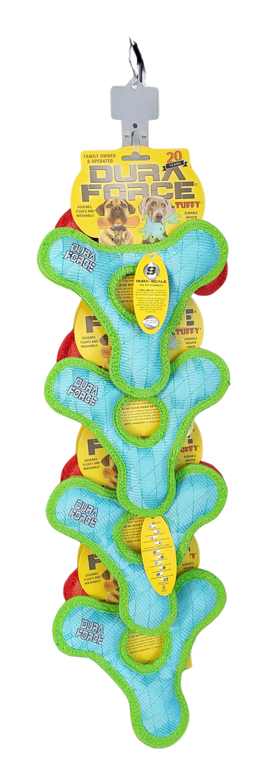
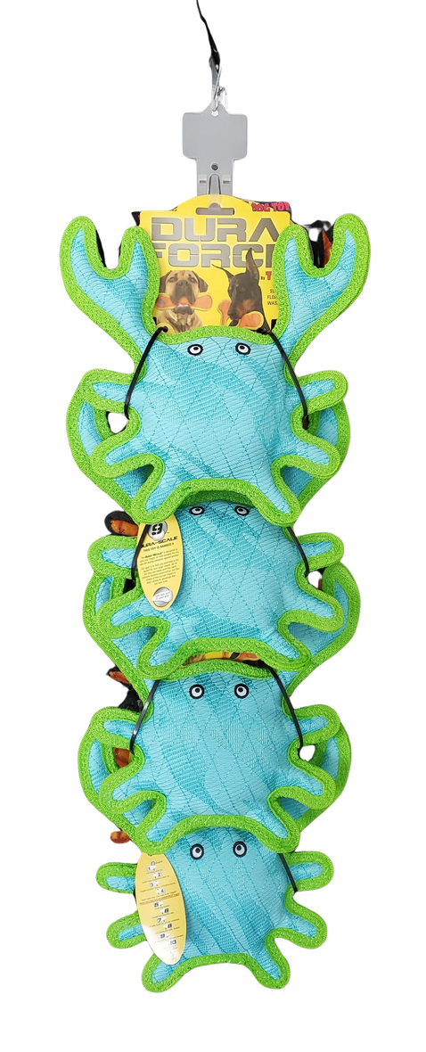
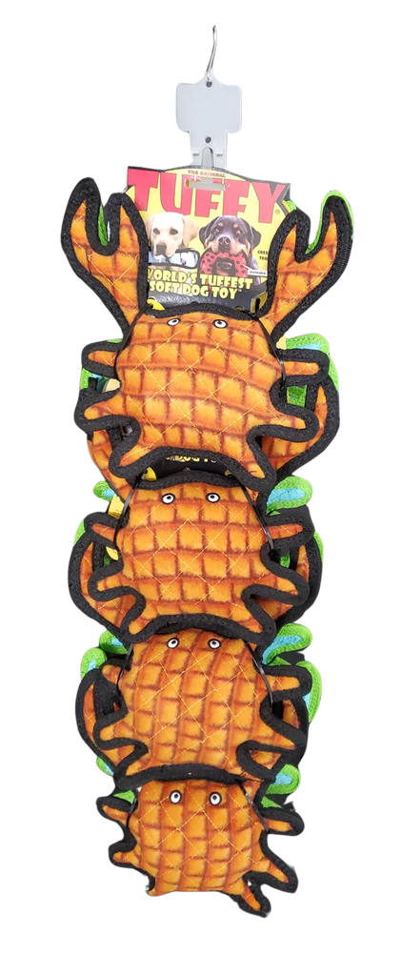
DURAFORCE-TUFFY CLIP STRIPS 2025
DFJR-BR-ZZ-TR-BG-CP-8
DuraForce Jr Boomerang Red &
Jr Triangle Blue Clip Strip
8 units
180181024542
H: 32" W: 8.5" D: 5"
$63.84
T-Crab-OR-DF-Crab-BG-CP
Tuffy Medium Crab Orange & DuraForce Crab Tiger Blue-Green Clip Strip
8 units
180181023965
H: 31" W: 9.5" D: 7"
$90.00

Slide 5
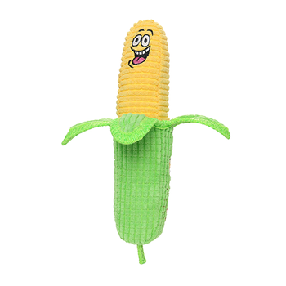
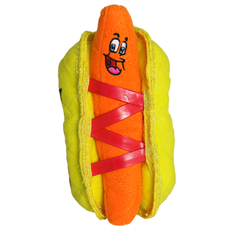
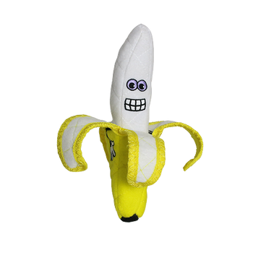
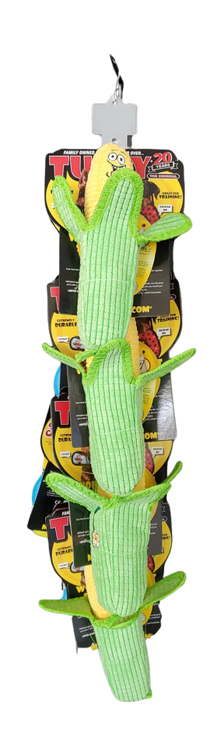
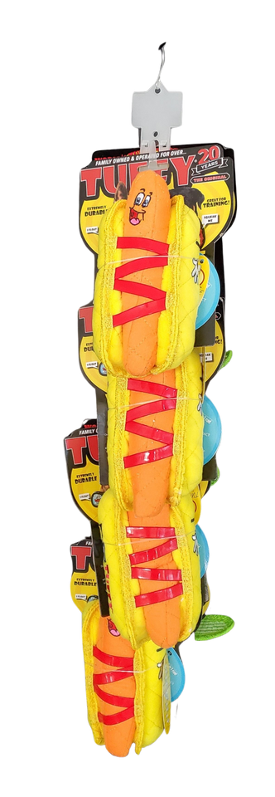
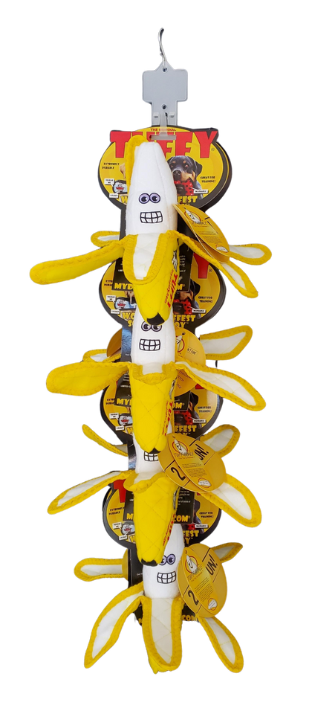
TUFFY CLIP STRIPS 2025
T-FF-Banana-CP
Tuffy Banana Clip Strip
8 units
180181021596
H: 30.5" W: 9" D: 14"
$77.20
T-Corn-HotDog-CP-8
Tuffy Corn & HotDog Clip Strip
8 units
180181031908
H: 31" W: 7" D: 10"
$91.64

Slide 6
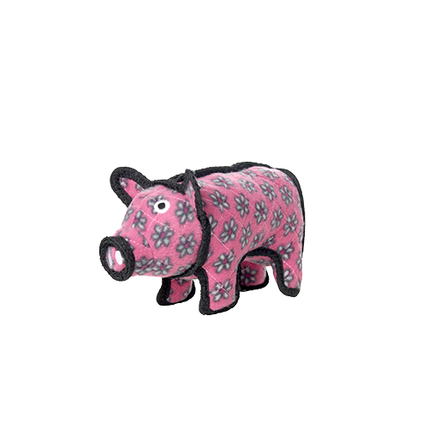
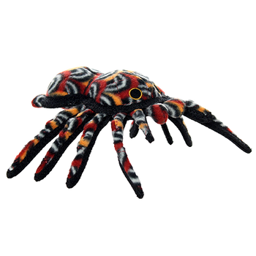
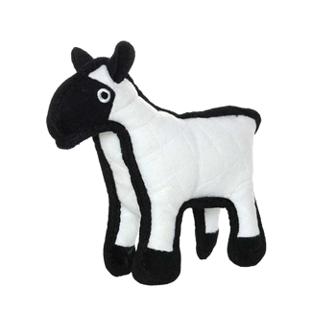
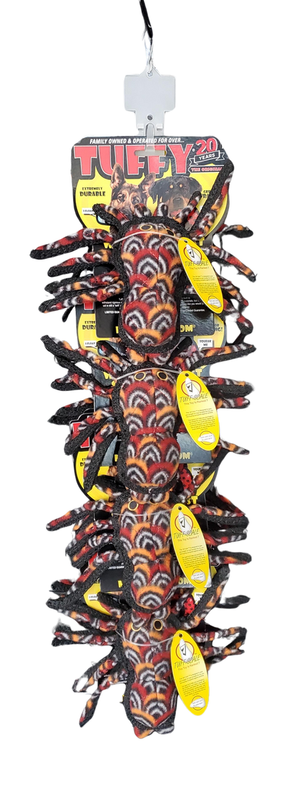
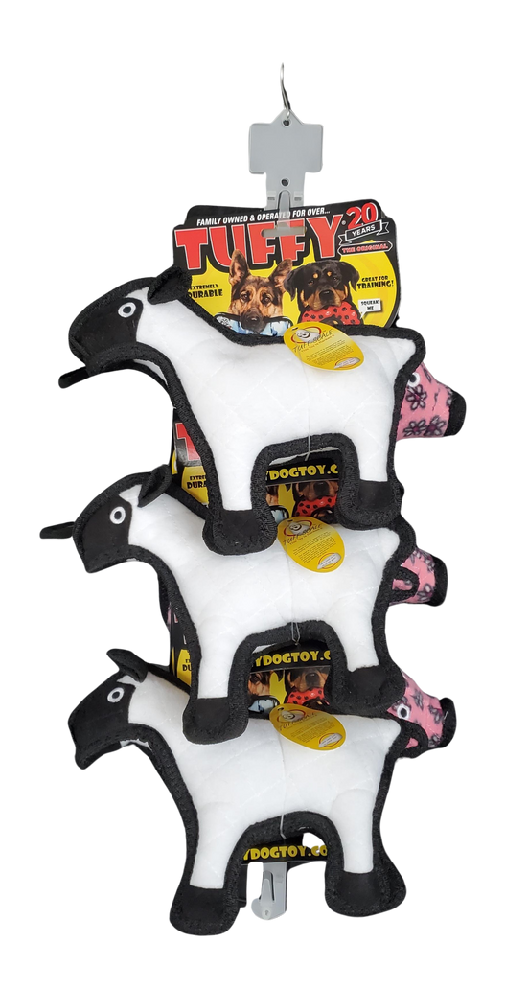
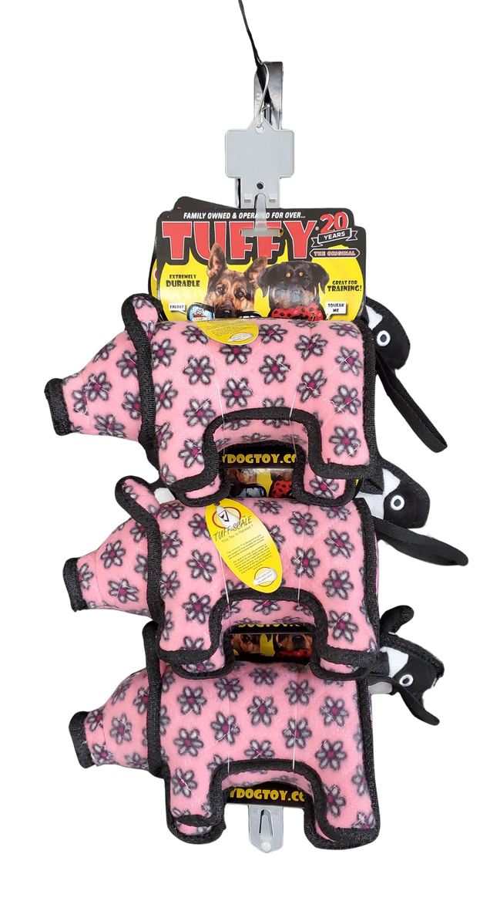
TUFFY CLIP STRIPS 2025
T-JR-Pig-Sheep-CP-6
Tuffy Junior Barnyard Pig & Sheep Clip Strip
6 units
180181032370
H: 25.5" W: 12" D: 9"
$67.92
T-DS-Tarantula-CP-8
Tuffy Desert Tarantula Clip Strip
8 units
180181032257
H: 29.5" W: 9.5" D: 7"
$94.80

Slide 7
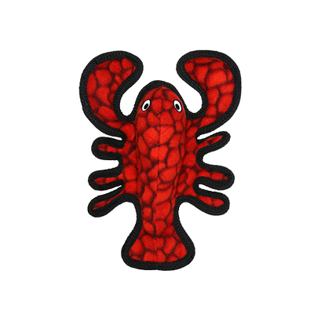
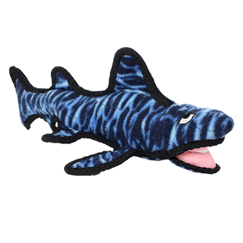
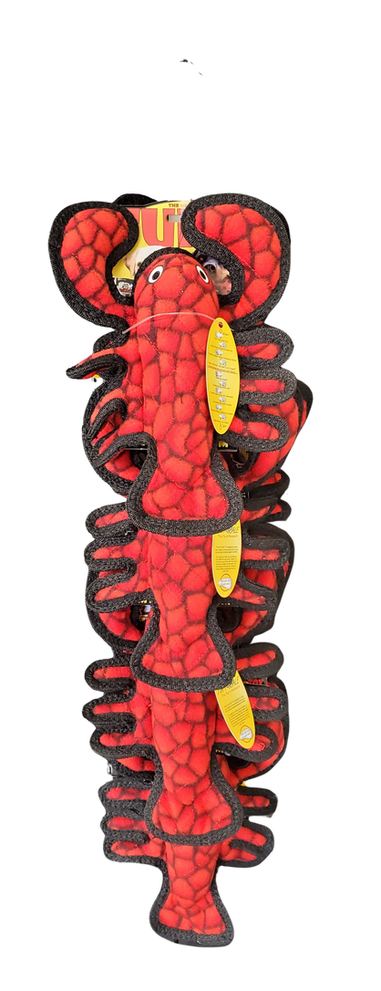
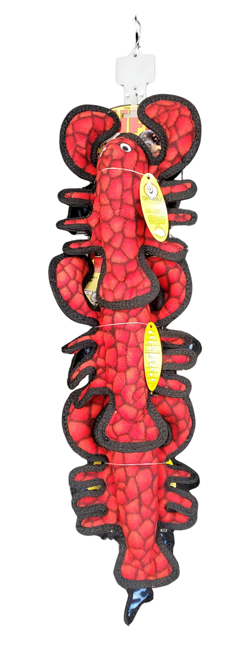
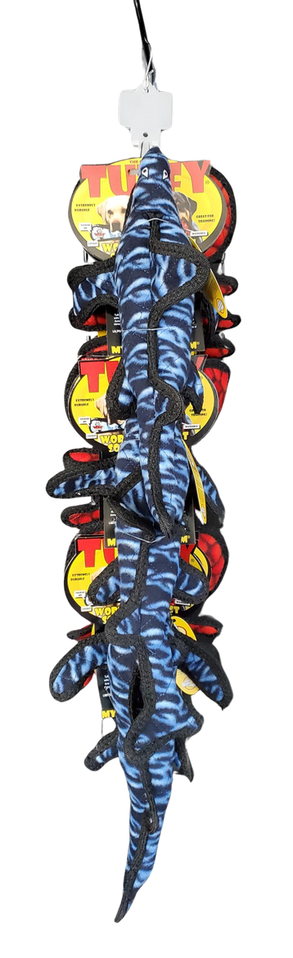
TUFFY CLIP STRIPS 2025
T-OC-JR-Lobster-CP
Tuffy Junior Lobster Clip Strip
8 units
180181021619
H: 31.5" W: 7.5" D: 10"
$77.68
T-JrLob-SharkEM-CP-6
Tuffy Jr Lobster & Shark EM Clip Strip
6 units
180181031885
H: 34" W: 8" D: 11"
$64.86

Slide 8
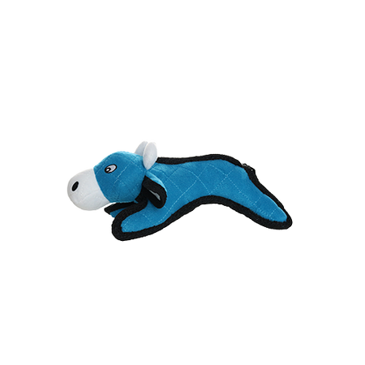
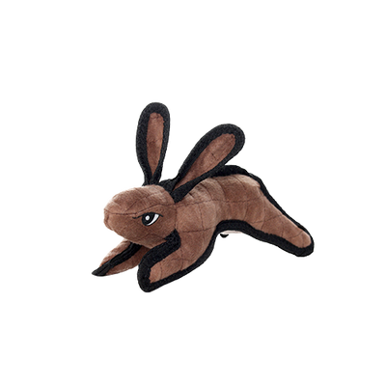
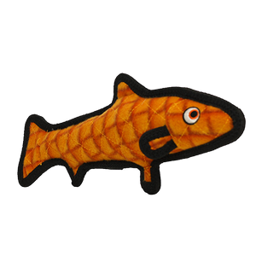
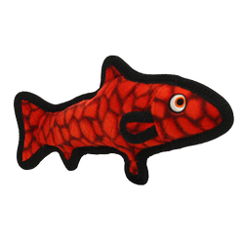
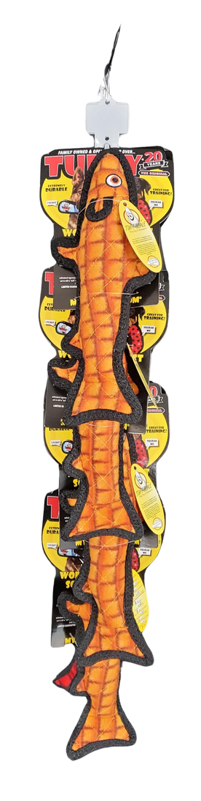
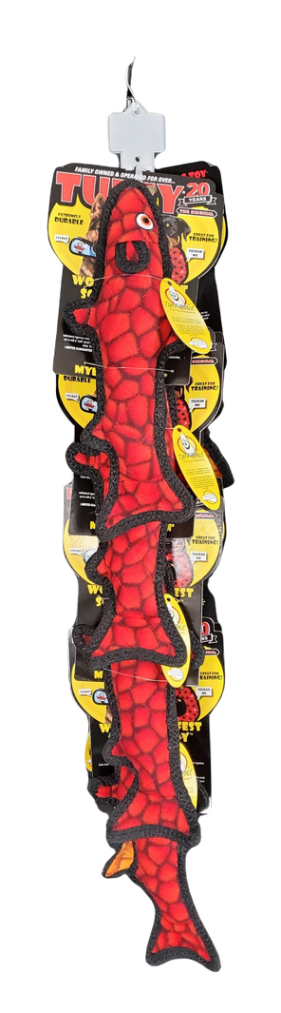
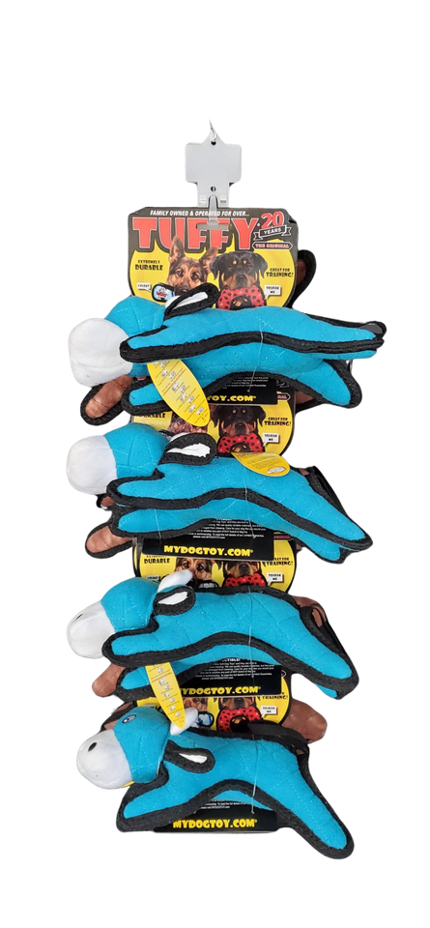
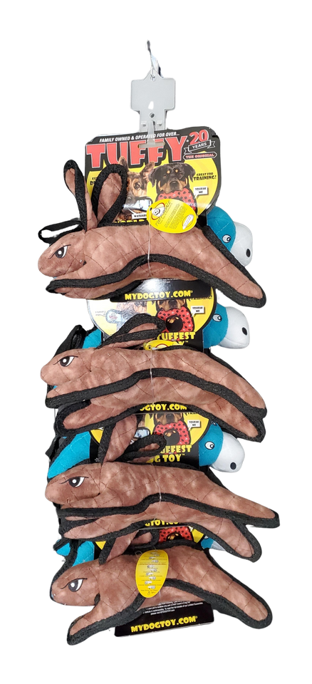
TUFFY CLIP STRIPS 2025
T-OC-Fish-OR-RD-CP-8
Tuffy Ocean Fish Clip Strip
8 units
180181033544
H: 34" W: 6.5" D: 11"
$84.16
T-JR-Cow-RabBrn-CP-8
Tuffy Junior Barnyard Cow & Rabbit Brown Clip Strip
8 units
180181032905
H: 29" W: 11" D: 10"
$74.96

Slide 9
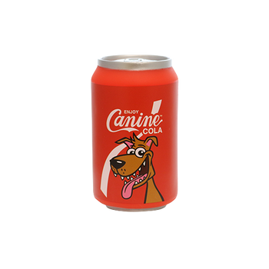
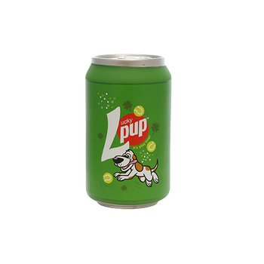
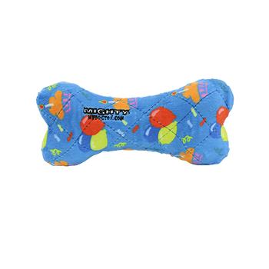
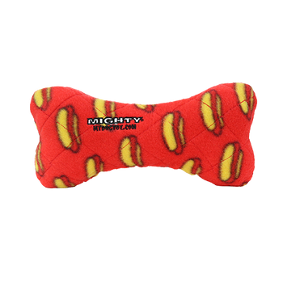
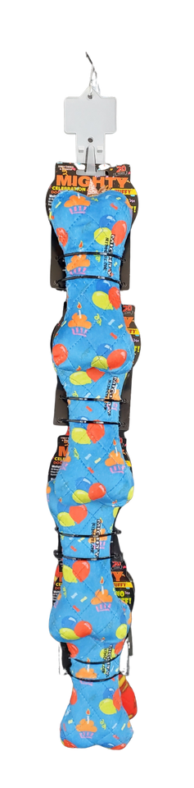
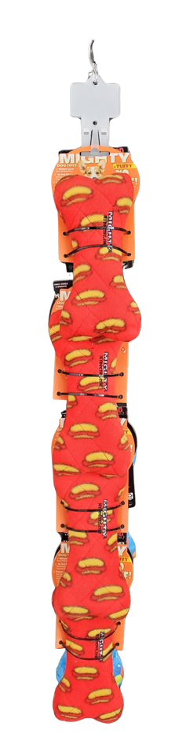
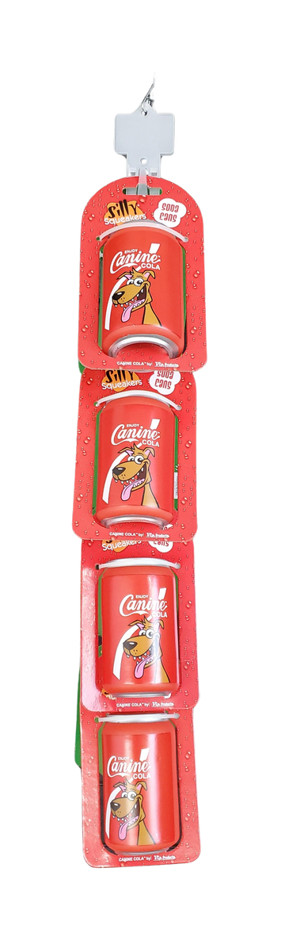

SILLY SQUEAKER CLIP STRIP 2025
MIGHTY CLIP STRIP 2025
SS-SC-CC-LP-CP-8
Silly Squeaker Soda Can Canine Cola and Lucky Pup Clip Strip
8 units
180181023903
H: 27.5" W: 4.5" D: 8"
$47.04
MTNS-BoneM-HB-RD-CP-8
Mighty Med Bone Celebration & Red Clip Strip
8 units
180181032936
H: 29" W: 4" D: 6.5"
$55.60

Slide 10








MIGHTY MICROFIBER CLIP STRIPS 2025
MTJR-Pig-Rab-CP-8
Mighty Jr Farm Piglet & Jr Nature Rabbit Clip Strip
8 units
180181032707
H: 27" W:8.5" D: 7.5"
$55.52
MTJR-Duck-Fox-CP-8
Mighty Jr Nature Duck & Jr Nature Fox Clip Strip
8 units
180181033070
H: 27.5" W: 9.5" D: 7"
$55.52

Slide 11








MIGHTY MICROFIBER CLIP STRIPS 2025
MTJR-MB-Rab-Duck-CP-8
Mighty Jr Microfiber Ball Rabbit & Duck Clip Strip
8 units
180181032714
H: 31" W: 6.5" D: 7.5"
$76.88
MT-MBM-Rab-Duck-CP-6
Mighty Microfiber Ball Med Rabbit & Duck Clip Strip
6 units
180181032394
H: 34" W: 8" D: 10"
$85.02

