Slide 1

2023 POG Book

Slide 2
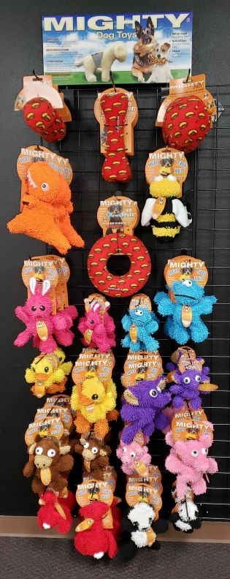
Mighty No Stuff & MicroFiber 6’ x 3’
Item Code: Rack-MTNS-Micro-6x3
Wholesale Price: $638.34
3 MT-Ball-M-RD
2 MT-Ball-L-RD
3 MT-Bone-RD
3 MT-Ring-RD
2 MT-MicroBM-Trex
3 MT-MicroBM-Bee
3 MT-MicroBM-Rabbit
3 MTJR-MicroB-Rabbit
3 MT-MicroBM-Monster
3 MTJR-MicroB-Monster
3 MT-MicroBM-Duck
3 MTJR-MicroB-Duck
3 MT-MicroBM-Elephant
3 MTJR-MicroB-Elephant
3 MT-MicroBM-Bull-OR*
3 MTJR-MicroB-Bull-OR*
3 MT-MicroBM-Pig
3 MTJR-MicroB-Pig
3 MT-MicroBM-Lobster
3 MTJR-MicroB-Lobster
3 MT-MicroBM-Panda
3 MTJR-MicroB-Panda
*Brown Bull pictured, but rack comes with Orange Bull

Slide 3
Mighty No Stuff & MicroFiber 6’ x 3’
Item Code: Rack-MTNS-Micro-6x3
Wholesale Price: $638.34
180181907449 MT-Ball-M-RD
180181907425 MT-Ball-L-RD
180181907913 MT-Bone-RD
180181909764 MT-Ring-RD
180181021824 MT-MicroBM-Trex
180181021763 MT-MicroBM-Bee
180181020636 MT-MicroBM-Rabbit
180181021121 MTJR-MicroB-Rabbit
180181020643 MT-MicroBM-Monster
180181021114 MTJR-MicroB-Monster
180181020469 MT-MicroBM-Duck
180181909924 MTJR-MicroB-Duck
180181020612 MT-MicroBM-Elephant
180181021084 MTJR-MicroB-Elephant
180181021510 MT-MicroBM-Bull-OR
180181021657 MTJR-MicroB-Bull-OR
180181020483 MT-MicroBM-Pig
180181908842 MTJR-MicroB-Pig
180181020476 MT-MicroBM-Lobster
180181908828 MTJR-MicroB-Lobster
180181020445 MT-MicroBM-Panda
180181909948 MTJR-MicroB-Panda

Slide 4
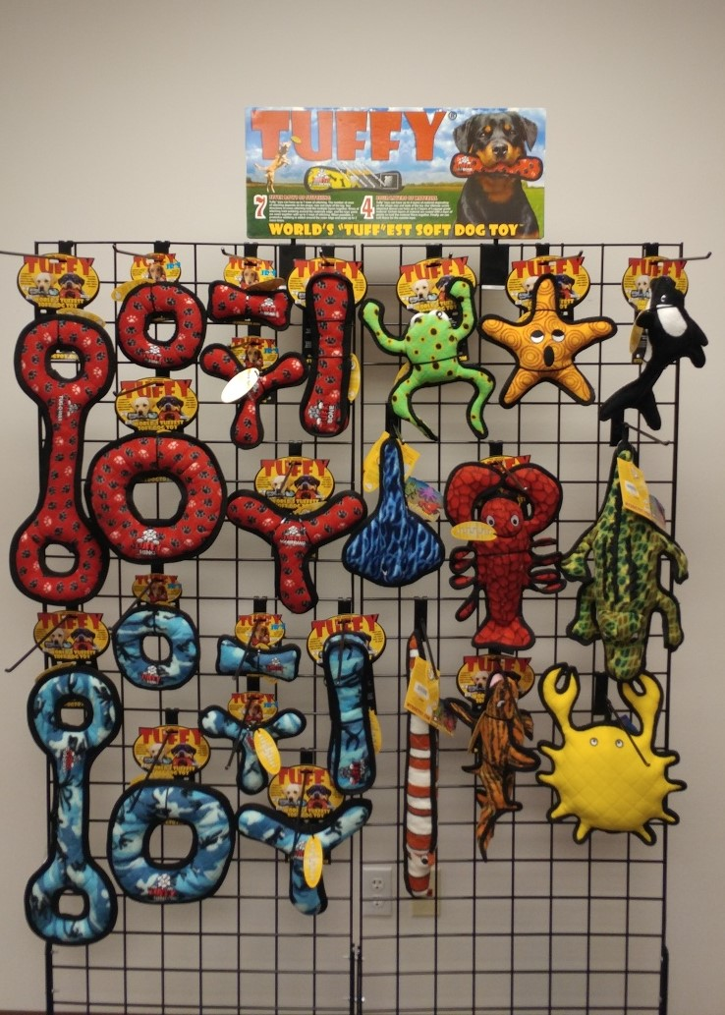
Tuffy 4.75’ x 6’
Item Code: Rack-T-5x6
Wholesale Price: $399.84 (2 of each) $599.76(3 of each)
T-U-T-RP
T-JR-R-RP
T-JR-B-RP
T-JR-BR-RP
T-U-B-RP
T-U-R-RP
T-U-BR-RP
T-U-T-CB
T-JR-R-CB
T-JR-B-CB
T-JR-BR-CB
T-U-B-CB
T-DS-Phrog-Leap
T-OC-Starfish
T-OC-Killer-Whale
T-OC-Stingray
T-OC-Larry-Lobster
T-OC-Alligator
T-OC-Eel
T-OC-Tiger-Shark
T-OC-Crab
T-U-R-CB
T-U-BR-CB

Slide 5
Tuffy 4.75’ x 6’
Item Code: Rack-T-5x6
Wholesale Price: $399.84(2 of each) $599.76 (3 of each)
180181005015 T-U-T-RP
180181011016 T-JR-R-RP
180181020117 T-JR-B-RP
180181016011 T-JR-BR-RP
180181002014 T-U-B-RP
180181001017 T-U-R-RP
180181006012 T-U-BR-RP
180181005046 T-U-T-CB
180181011047 T-JR-R-CB
180181020124 T-JR-B-CB
180181016042 T-JR-BR-CB
180181002045 T-U-B-CB
180181907944 T-DS-Phrog-Leap
180181009013 T-OC-Starfish
180181907555 T-OC-Killer-Whale
180181008016 T-OC-Stingray
180181020148 T-OC-Larry-Lobster
180181020018 T-OC-Alligator
180181010019 T-OC-Eel
180181906978 T-OC-Tiger-Shark
180181020292 T-OC-Crab
180181001048 T-U-R-CB
180181006043 T-U-BR-CB

Slide 6
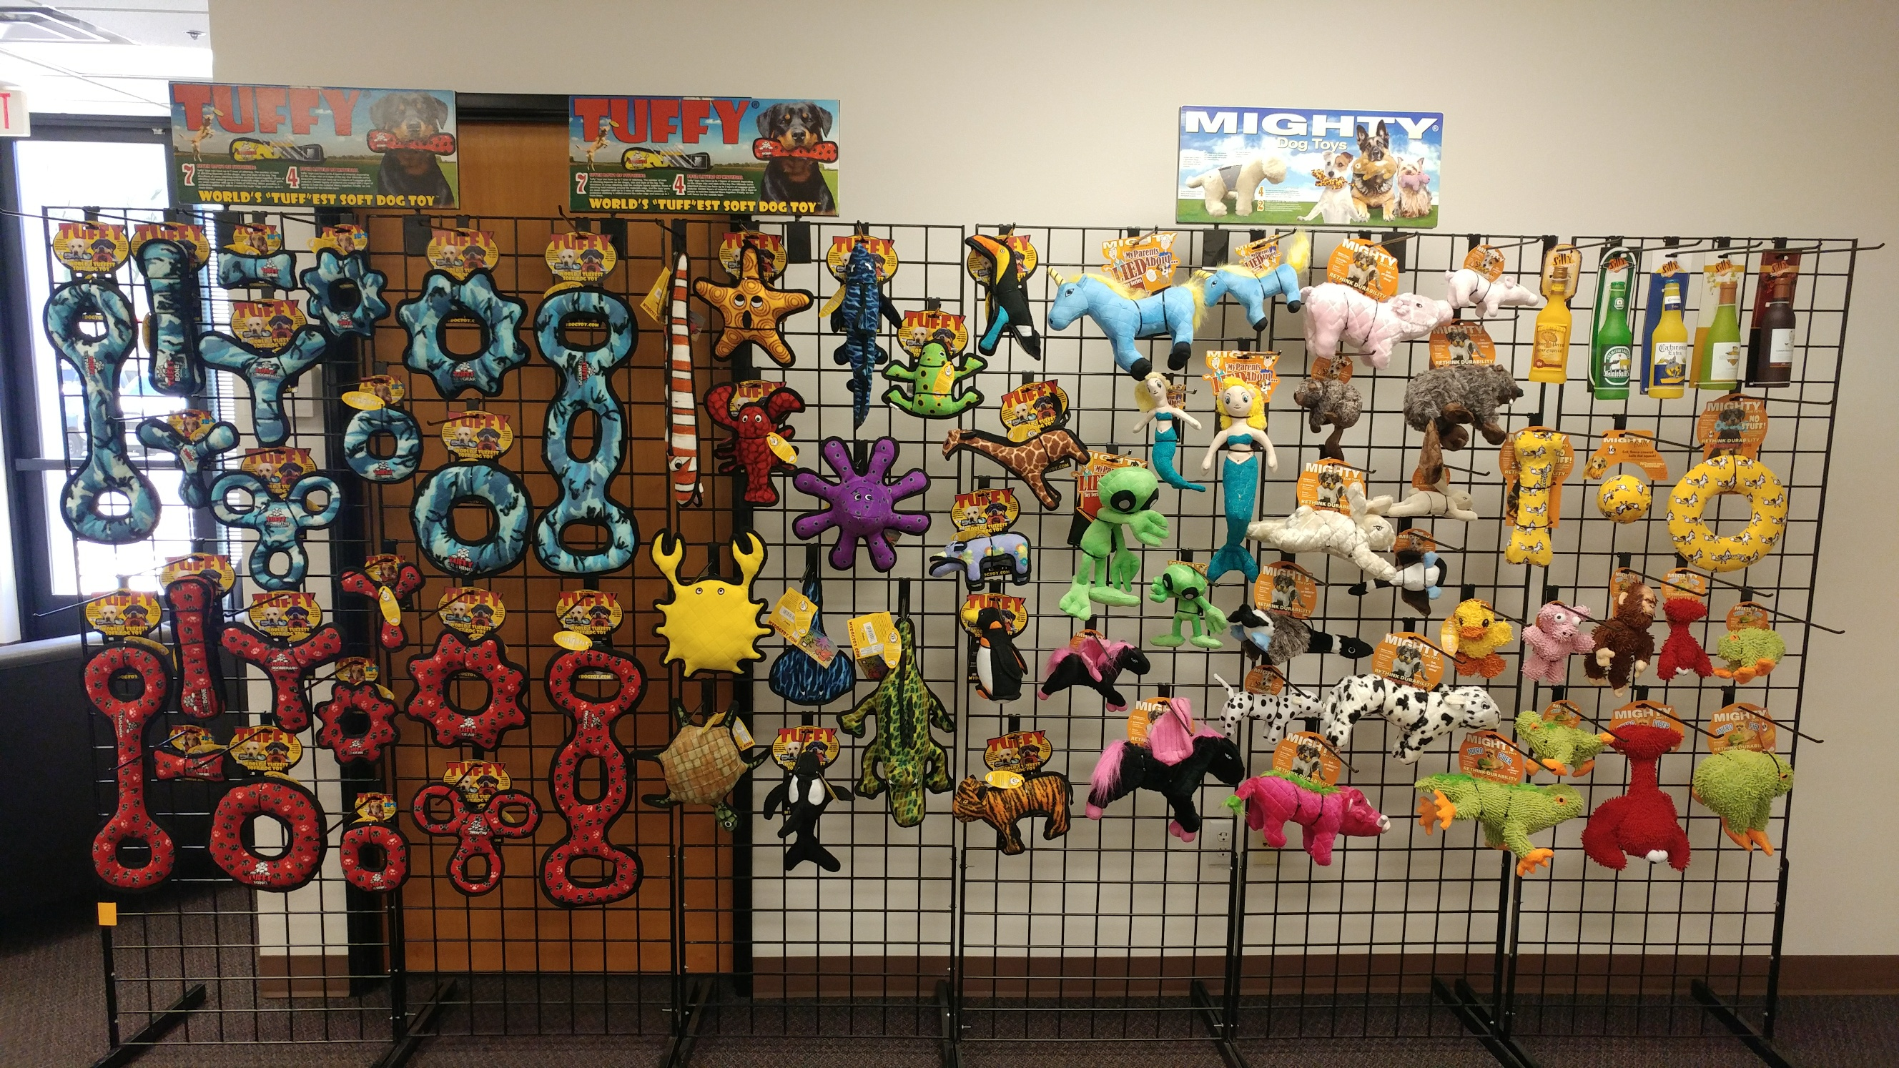
Tuffy, Mighty, & Silly Squeakers 5’ x 12’
Item Code: Rack-T-MT-SS-5x12
$1,331.36 (2 of each) $1,997.04(3 of each)

Slide 7
Tuffy, Mighty, & Silly Squeakers 5’ x 12’
Item Code: Rack-T-MT-SS-5x12
$1,331.36 (2 of each) $1,997.04 (3 of each)
180181005046 T-U-T-CB 180181005015 T-U-T-RP
180181002045 T-U-B-CB 180181002014 T-U-B-RP
180181006043 T-U-BR-CB 180181006012 T-U-BR-RP
180181904554 T-U-GR-CB 180181905407 T-U-GR-RP
180181001048 T-U-R-CB 180181001017 T-U-R-RP
180181906350 T-U-3WT-CB 180181906374 T-U-3WT-RP
180181020124 T-JR-B-CB 180181020117 T-JR-B-RP
180181016042 T-JR-BR-CB 180181016011 T-JR-BR-RP
180181906329 T-JR-3WT-CB 180181906312 T-JR-3WT-RP
180181905421 T-JR-GR-CB 180181905445 T-JR-GR-RP
180181011047 T-JR-R-CB 180181011016T-JR-R-RP
180181010019 T-OC-Eel 180181009013 T-OC-Starfish
180181910074 T-OC-JR-Lobster 180181007019 T-OC-Small-Octopus
180181020292 T-OC-Crab 180181008016 T-OC-Stingray
180181907555 T-OC-Killer-Whale 180181020018 T-OC-Alligator
180181020308 T-OC-Turtle 180181908163 T-JR-Toucan
180181903830 T-DS-Phrog 180181908125 T-JR-Z-Hippo
180181908118 T-JR-Z-Giraffe 180181908156 T-JR-Z-Tiger
180181908149 T-JR-Z-Penguin 180181904325 T-OC-Shark
180181907678 MT-L-Unicorn 180181908781 SS-LB-JP
180181907661 MTJR-L-Unicorn 180181903946 SS-BB-HS
180181906206 MT-L-Mermaid 180181903168 SS-BB-CA
180181906503 MTJR-L-Mermaid 180181903724 SS-WB-KR
180181907494 MT-L-Alien 180181903717 SS-WB-GS
180181907500 MTJR-L-Alien 180181909726 MT-Bone-UN
180181001189 MT-L-Peg-BPK 180181909719 MT-Ball-M-UN
180181001172 MTJR-L-Peg-BPK 180181909771 MTNS-Ring-UN
180181904370 MT-F-Piglet 180181909924 MTJR-MicroB-Duck
180181905117 MTJR-F-Piglet 180181908842 MTJR-MicroB-Pig
180181906008 MT-N-Beaver 180181908828 MTJR-MicroB-Lobster
180181906015 MTJR-N-Beaver 180181001196 MTJR-Micro-Bigfoot
180181903656 MT-N-Rabbit-Brn 180181908910 MTJR-Micro-Frog
180181905155 MTJR-N-Rabbit-Brn 180181908927 MTJR-Micro-Lizard
180181904431 MT-F-Cow 180181908507 MT-Micro-Frog
180181905216 MTJR-F-Cow 180181908538 MT-Micro-Lizard
180181904035 MT-N-Duck 180181908798 MT-MicroB-Lobster
180181905131 MTJR-N-Duck
180181908491 MT-S-Warthog-PK

Slide 8
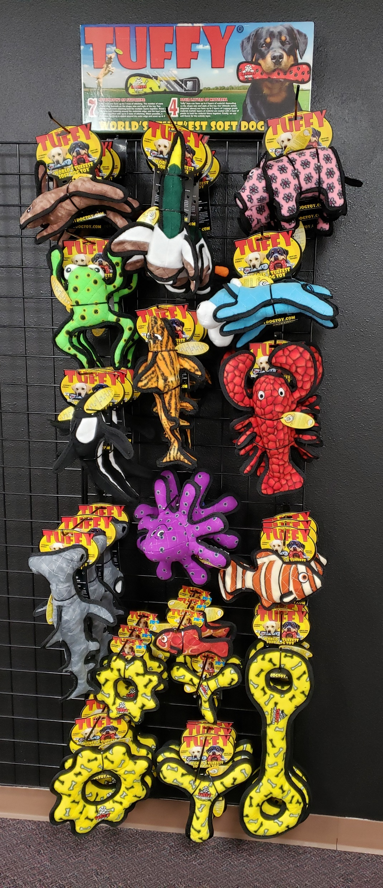
Tuffy Best Sellers 6’ x 3’
Item Code: Rack-T-BestSellers-6x3
Wholesale Price: $465.18
3 T-JR-BY-Rabbit-BRN
3 T-JR-BY-Duck
3 T-JR-BY-Pig
3 T-DS-Phrog-Leap
3 T-JR-BY-Cow
3 T-OC-Tiger-Shark
3 T-OC-Killer-Whale
3 T-OC-Larry-Lobster
3 T-OC-Hammerhead
3 T-OC-Fish-OR
3 T-OC-JR-Fish-RD
3 T-JR-GR-YB
3 T-JR-BR-YB
3 T-U-GR-YB
3 T-U-BR-YB
3 T-U-T-YB
3 T-OC-Small-Octopus

Slide 9
Tuffy Best Sellers 6’ x 3’
Item Code: Rack-T-BestSellers-6x3
Wholesale Price: $465.18
180181908217 T-JR-BY-Rabbit-BRN
180181908187 T-JR-BY-Duck
180181908200 T-JR-BY-Pig
180181907944 T-DS-Phrog-Leap
180181021480 T-JR-BY-Cow
180181906978 T-OC-Tiger-Shark
180181907555 T-OC-Killer-Whale
180181020148 T-OC-Larry-Lobster
180181907333 T-OC-Hammerhead
180181908545 T-OC-Fish-OR
180181908569 T-OC-JR-Fish-RD
180181905452 T-JR-GR-YB
180181016035 T-JR-BR-YB
180181905414 T-U-GR-YB
180181006036 T-U-BR-YB
180181005039 T-U-T-YB
180181007019 T-OC-Small-Octopus

Slide 10
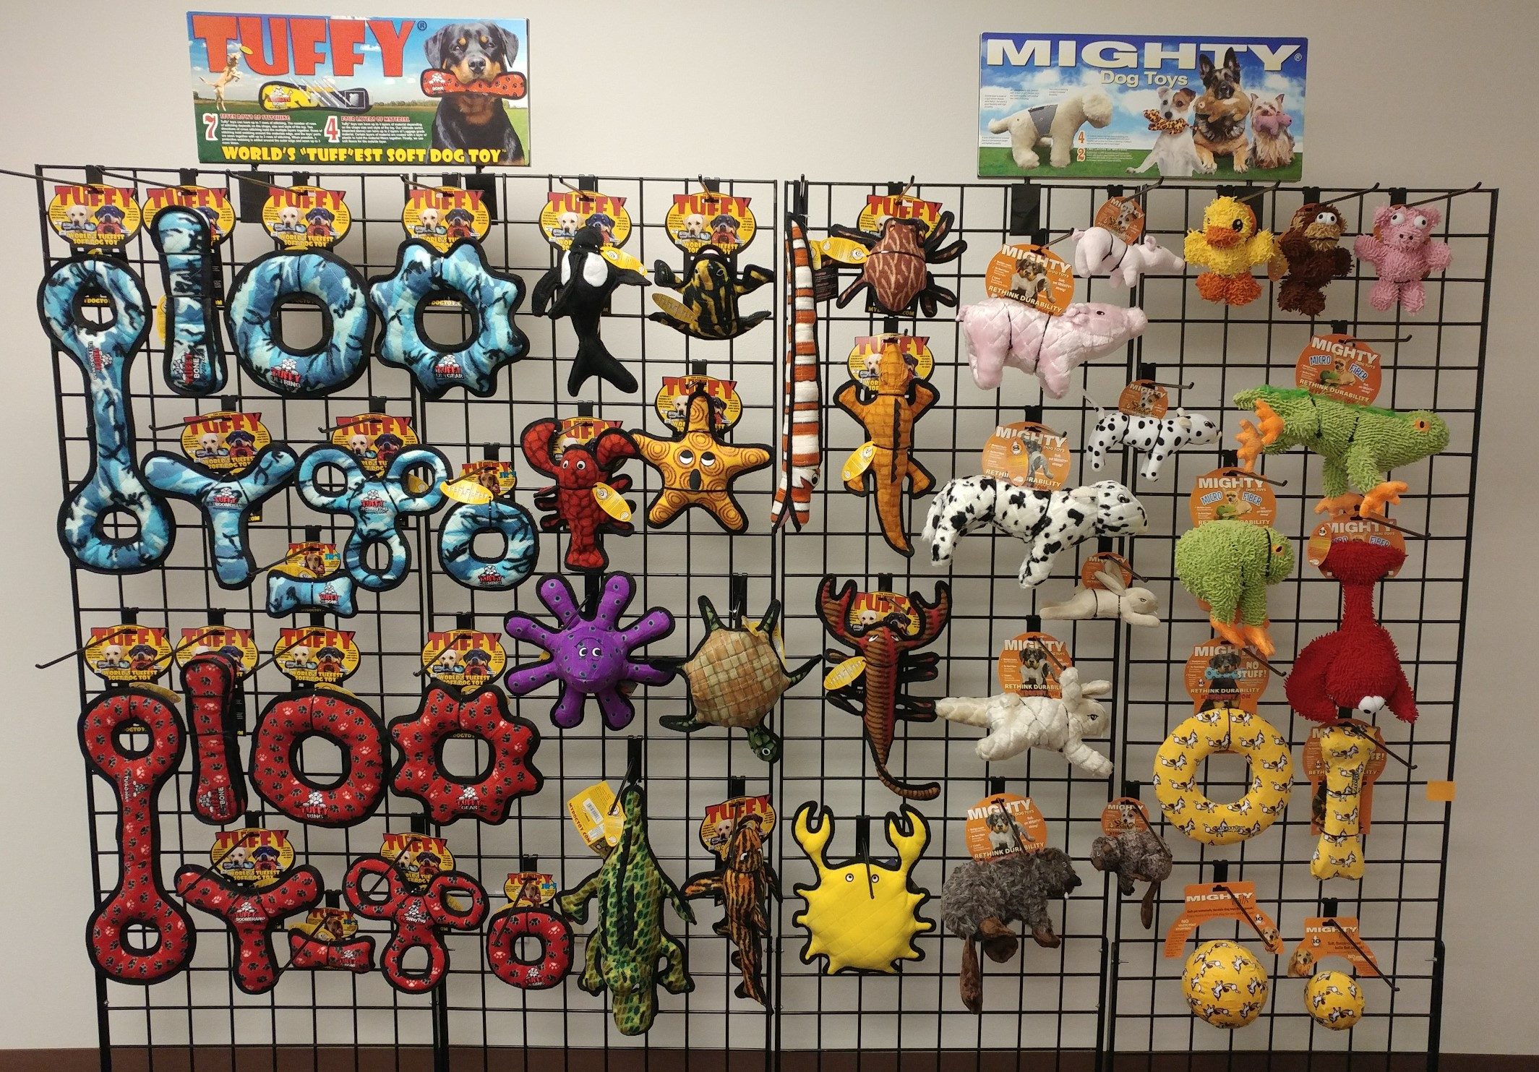
Tuffy & Mighty
5’ x 8’
Item Code:
Rack-T-MT-5x8
Wholesale Price: $867.54 (2 of each) $1,301.31 (3 of each)

Slide 11
Tuffy & Mighty 5’ x 8’
Item Code: Rack-T-MT-5x8
Wholesale Price: $867.54 (2 of each) $1,301.31 (3 of each)
180181005046 T-U-T-CB 180181907555 T-OC-Killer-Whale
180181002045 T-U-B-CB 180181910074 T-OC-JR-Lobster
180181001048 T-U-R-CB 180181007019 T-OC-Small-Octopus
180181905384 T-U-GR-CB 180181020018 T-OC-Alligator
180181006043 T-U-BR-CB 180181010019 T-OC-Eel
180181020124 T-JR-B-CB 180181009013 T-OC-Starfish
180181906329 T-JR-3WT-CB 180181020308 T-OC-Turtle
180181011047 T-JR-R-CB 180181906978 T-OC-Tiger-Shark
180181005015 T-U-T-RP 180181020292 T-OC-Crab
180181002014 T-U-B-RP 180181903830 T-DS-Phrog
180181001017 T-U-R-RP 180181903755 T-DS-Spider
180181905407 T-U-GR-RP 180181908897 T-DS-Gila-Monster
180181006012 T-U-BR-RP 180181903694 T-DS-Scorpion
180181020117 T-JR-B-RP
180181906312 T-JR-3WT-RP
180181011016 T-JR-R-RP
180181904370 MT-F-Piglet 180181909702 MT-Ball-L-UN
180181905117 MTJR-F-Piglet 180181909719 MT-Ball-M-UN
180181904431 MT-F-Cow
180181905216 MTJR-F-Cow
180181903656 MT-N-Rabbit-Brn
180181905155 MTJR-Rabbit-Brn
180181906008 MT-N-Beaver
180181906015 MTJR-N-Beaver
180181909924 MTJR-MicroB-Duck
180181908835 MTJR-MicroB-Monkey
180181908842 MTJR-MicroB-Pig
180181908798 MT-MicroB-Lobster
180181908538 MT-Micro-Lizard
180181908507 MT-Micro-Frog
180181909771 MTNS-Ring-UN
180181909726 MT-Bone-UN

Slide 12
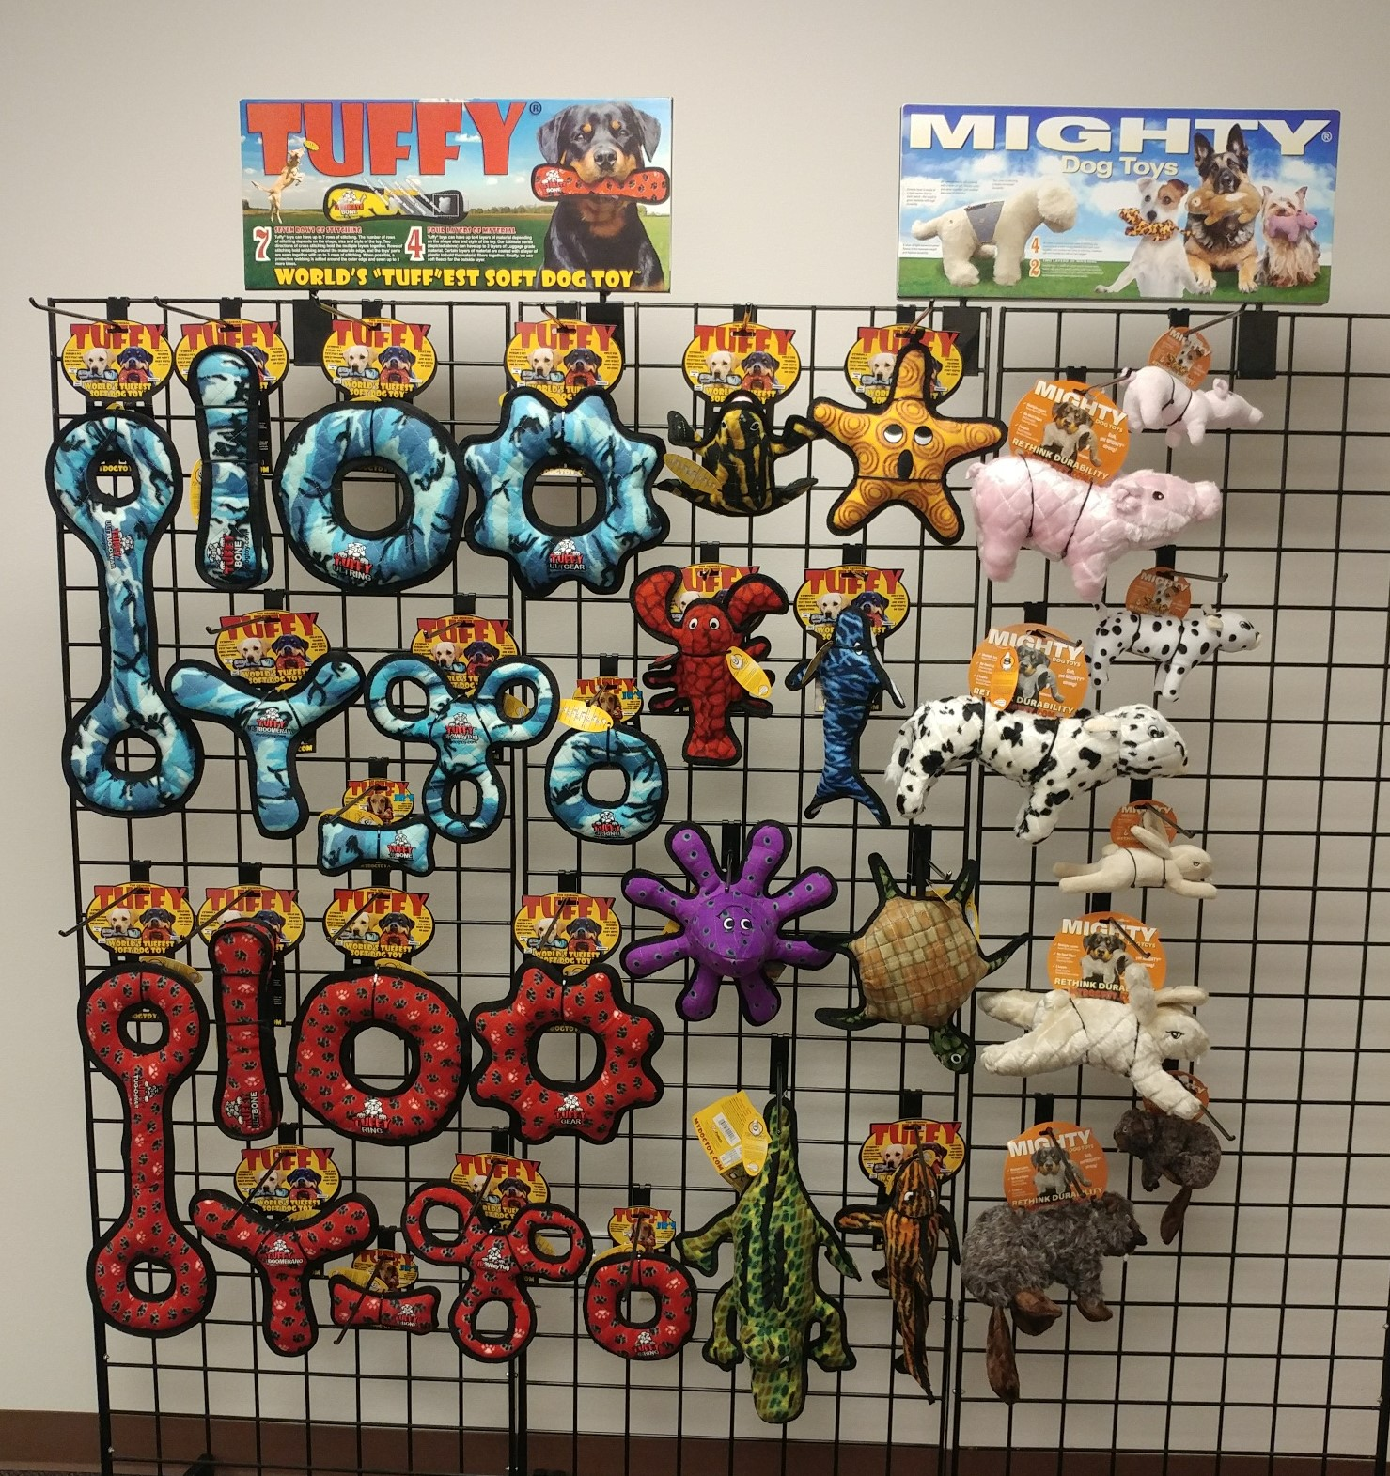
Tuffy & Mighty Option 1 (5’ x 5’)
Item Code: Rack-T-MT-5x5-1
Wholesale Price:
$567.48 (2 of each)
$851.22 (3 of each)

Slide 13
Tuffy & Mighty Option 1 (5’ x 5’) Item Code: Rack-T-MT-5x5-1
Wholesale Price: $567.48 (2 of each) $851.22 (3 of each)
180181005046 T-U-T-CB
180181002045 T-U-B-CB
180181001048 T-U-R-CB
180181905384 T-U-GR-CB
180181006043 T-U-BR-CB
180181020124 T-JR-B-CB
180181906329 T-JR-3WT-CB
180181011047 T-JR-R-CB
180181005015 T-U-T-RP
180181002014 T-U-B-RP
180181001017 T-U-R-RP
180181905407 T-U-GR-RP
180181006012 T-U-BR-RP
180181020117 T-JR-B-RP
180181906312 T-JR-3WT-RP
180181011016 T-JR-R-RP
180181903830 T-DS-Phrog
180181910074 T-OC-JR-Lobster
180181007019 T-OC-Small-Octopus
180181020018 T-OC-Alligator
180181009013 T-OC-Starfish
180181904653 T-OC-Whale
180181020308 T-OC-Turtle
180181906978 T-OC-Tiger-Shark
180181904370 MT-F-Piglet
180181905117 MTJR-F-Piglet
180181904431 MT-F-Cow
180181905216 MTJR-F-Cow
180181903656 MT-N-Rabbit-Brn
180181905155 MTJR-N-Rabbit-Brn
180181906008 MT-N-Beaver
180181906015 MTJR-N-Beaver

Slide 14
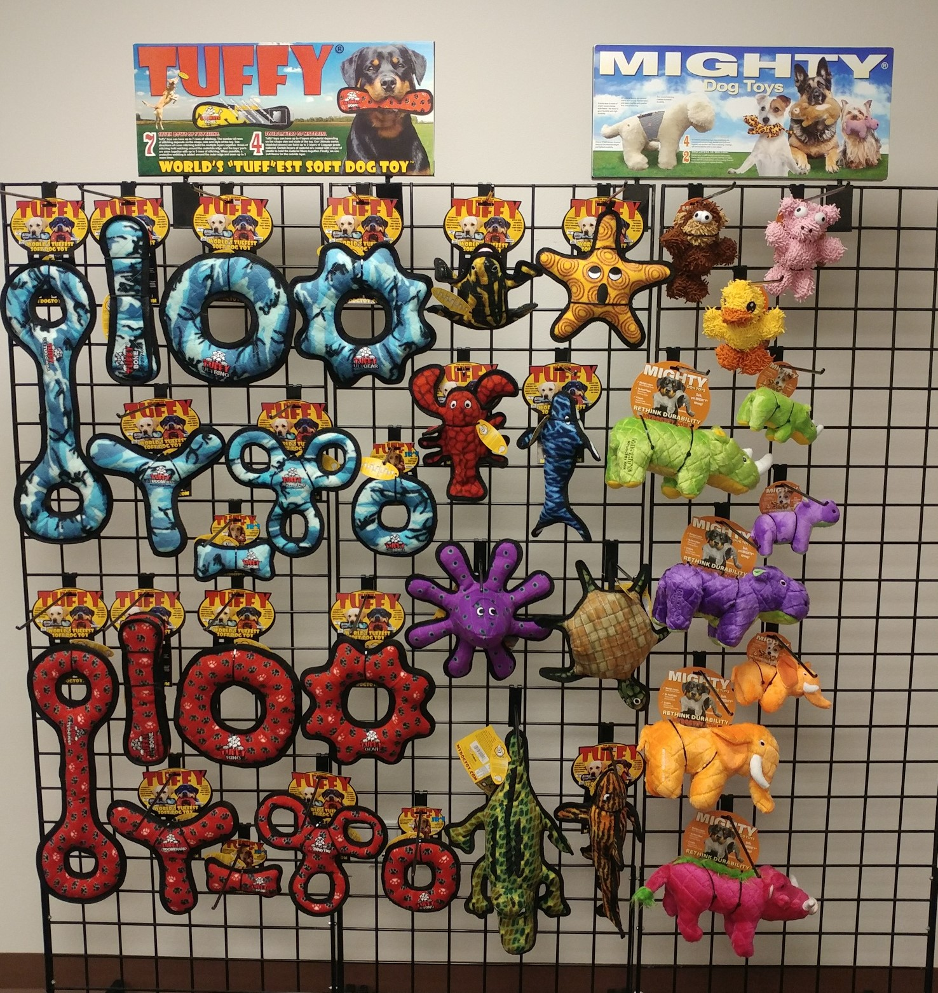
Tuffy & Mighty Option 2 (5’ x 5’)
Item Code: Rack-T-MT-5x5-2
Wholesale Price:
$599.10 (2 of each)
$898.65 (3 of each)

Slide 15
Tuffy & Mighty Option 2 (5’ x 5’)Item Code: Rack-T-MT-5x5-2
Wholesale Price: $599.10 (2 of each) $898.65 (3 of each)
180181005046 T-U-T-CB
180181002045 T-U-B-CB
180181001048 T-U-R-CB
180181905384 T-U-GR-CB
180181006043 T-U-BR-CB
180181020124 T-JR-B-CB
180181906329 T-JR-3WT-CB
180181011047 T-JR-R-CB
180181005015 T-U-T-RP
180181002014 T-U-B-RP
180181001017 T-U-R-RP
180181905407 T-U-GR-RP
180181006012 T-U-BR-RP
180181020117 T-JR-B-RP
180181906312 T-JR-3WT-RP
180181011016 T-JR-R-RP
180181903830 T-DS-Phrog
180181910074 T-OC-JR-Lobster
180181007019 T-OC-Small-Octopus
180181020018 T-OC-Alligator
180181009013 T-OC-Starfish
180181904653 T-OC-Whale
180181020308 T-OC-Turtle
180181906978 T-OC-Tiger-Shark
180181908835 MTJR-MicroB-Monkey
180181909924 MTJR-MicroB-Duck
180181908842 MTJR-MicroB-Pig
180181909887 MT-S-Rhino-Grn
180181909993 MTJR-S-Rhino-Grn
180181909849 MT-S-Hippo-PL
180181909962 MTJR-S-Hippo-PL
180181909832 MT-S-Elephant-OR
180181909955 MTJR-S-Elephant-OR
180181908491 MT-S-Warthog-PK

Slide 16
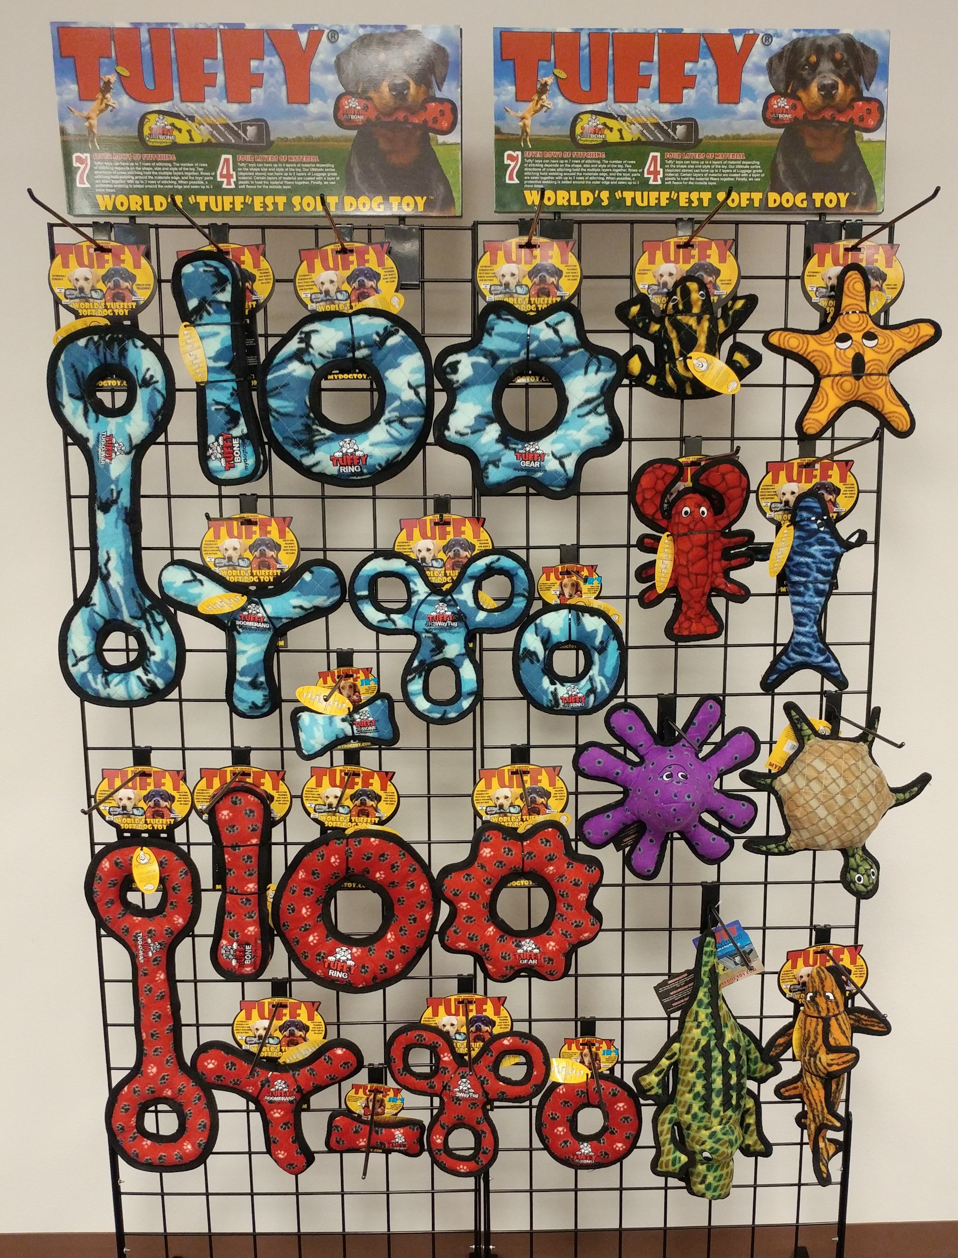
Tuffy Shapes & Ocean Creatures
5’ x 4’
Item Code:Rack-T-Ult-OC-5x4
Wholesale Price:
$421.92 (2 of each)
$632.88 (3 of each)

Slide 17
Tuffy Shapes & Ocean Creatures 5’ x 4’ Item Code:Rack-T-Ult-OC-5x4
Wholesale Price: $421.92 (2 of each) $632.88 (3 of each)
180181005046 T-U-T-CB
180181002045 T-U-B-CB
180181001048 T-U-R-CB
180181905384 T-U-GR-CB
180181006043 T-U-BR-CB
180181020124 T-JR-B-CB
180181906329 T-JR-3WT-CB
180181011047 T-JR-R-CB
180181903830 T-DS-Phrog
180181009013 T-OC-Starfish
180181910074 T-OC-JR-Lobster
180181904653 T-OC-Whale
180181005015 T-U-T-RP
180181002014 T-U-B-RP
180181001017 T-U-R-RP
180181905407 T-U-GR-RP
180181006012 T-U-BR-RP
180181020117 T-JR-B-RP
180181906312 T-JR-3WT-RP
180181011016 T-JR-R-RP
180181007019 T-OC-Small-Octopus
180181020308 T-OC-Turtle
180181020018 T-OC-Alligator
180181906978 T-OC-Tiger-Shark

Slide 18
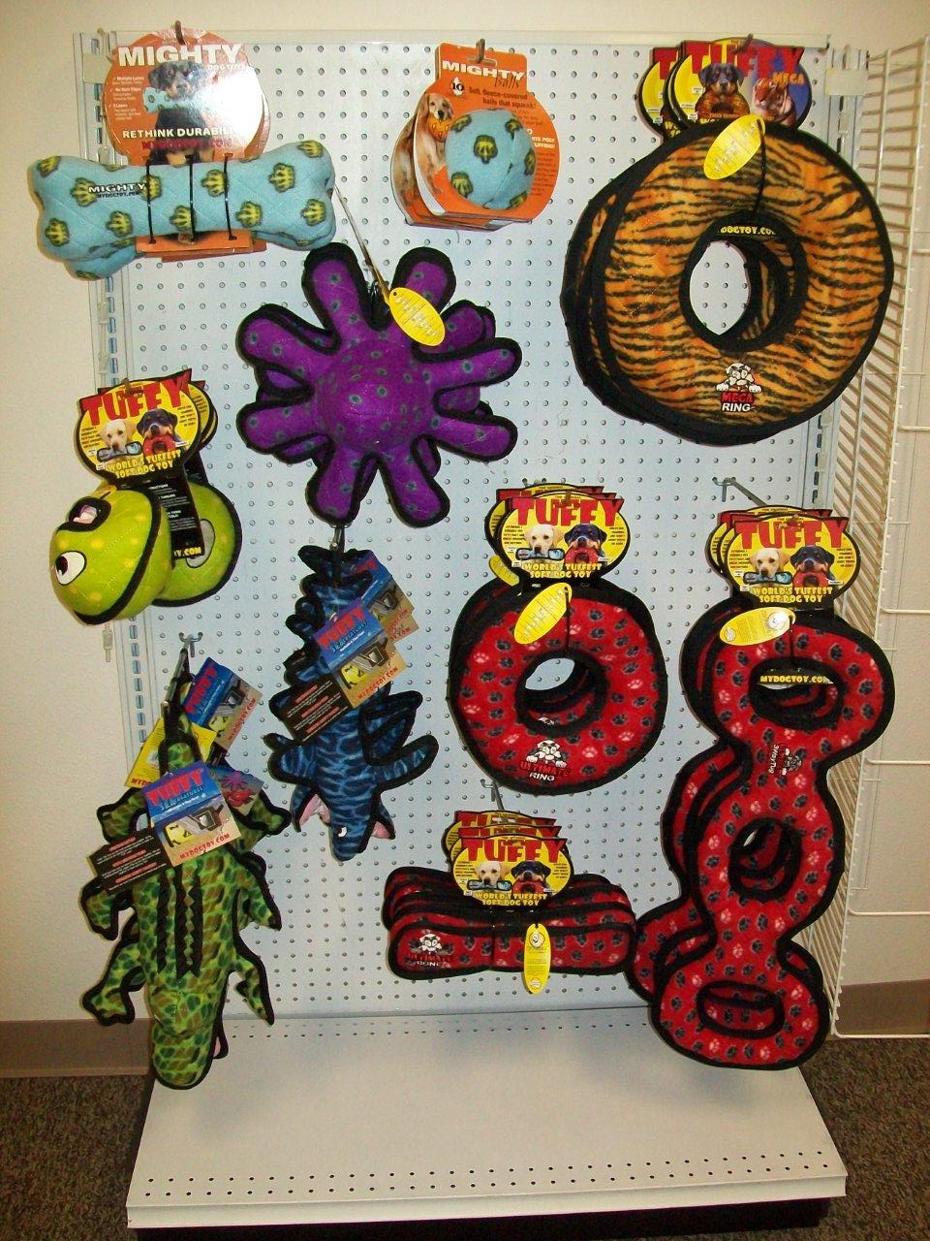
Tuffy-Mighty 4.5’ x 3.25’
Item Code: Rack-T-MT-4.5x3
Wholesale Price: $311.70
3 MT-Bone-BL
180181903670
3 MT-Ball-M-BL
180181904295
3 T-MG-R-TG
180181020155
3 T-A-Ball-Grn
180181906183
3 T-OC-Small-Octopus
180181007019
3 T-OC-Shark
180181904325
3 T-U-R-RP
180181001017
3 T-U-B-RP
180181002014
3 T-U-3WT-RP
180181906459
3 T-OC-Alligator
180181020018

Slide 19
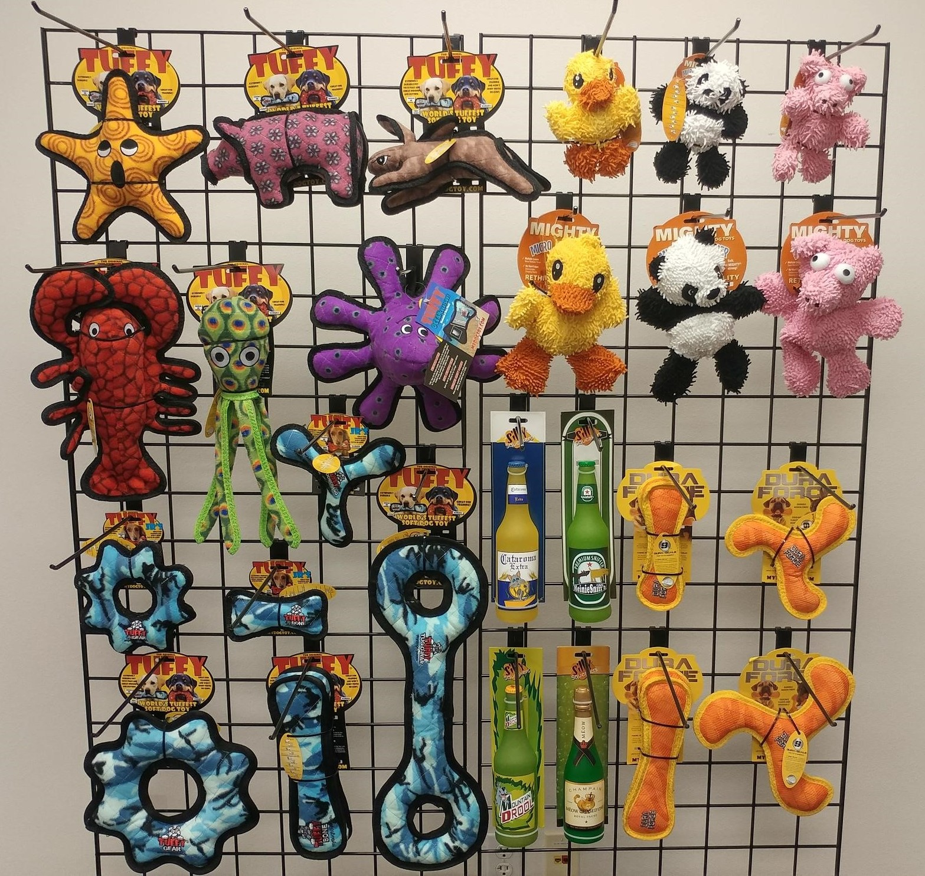
Tuffy, Mighty, DuraForce & Silly Squeakers 4.25’ x 6’
Item Code: Rack-T-MT-DF-SS-4x5
Wholesale Price:
$444.52 (2 of each)
$666.78 (3 of each)

Slide 20
Tuffy, Mighty, DuraForce & Silly Squeakers 4.25’ x 6’
Item Code: Rack-T-MT-DF-SS-4x5
Wholesale Price: $444.52 (2 of each) $666.78 (3 of each)
180181009013 T-OC-Starfish
180181908200 T-JR-BY-Pig
180181908217 T-JR-BY-Rabbit-Brn
180181020148 T-OC-Larry-Lobster
180181020810 T-OC-Squid-GN
180181007019 T-OC-Small-Octopus
180181016042 T-JR-BR-CB
180181905421 T-JR-GR-CB
180181020124 T-JR-B-CB
180181905384 T-U-GR-CB
180181002045 T-U-B-CB
180181005046 T-U-T-CB
180181909924 MTJR-MicroB-Duck
180181909948 MTJR-MicroB-Panda
180181908842 MTJR-MicroB-Pig
180181020469 MT-MicroBM-Duck
180181020445 MT-MicroBM-Panda
180181020483 MT-MicroBM-Pig
180181903168 SS-BB-CA
180181903946 SS-BB-HS
180181903922 SS-BB-MD
180181907937 SS-WB-MC
180181909597 DFJR-B-T-OY
180181909634 DFJR-BR-T-OY
180181909511 DF-B-T-OY
180181909474 DF-BR-T-OY

Slide 21
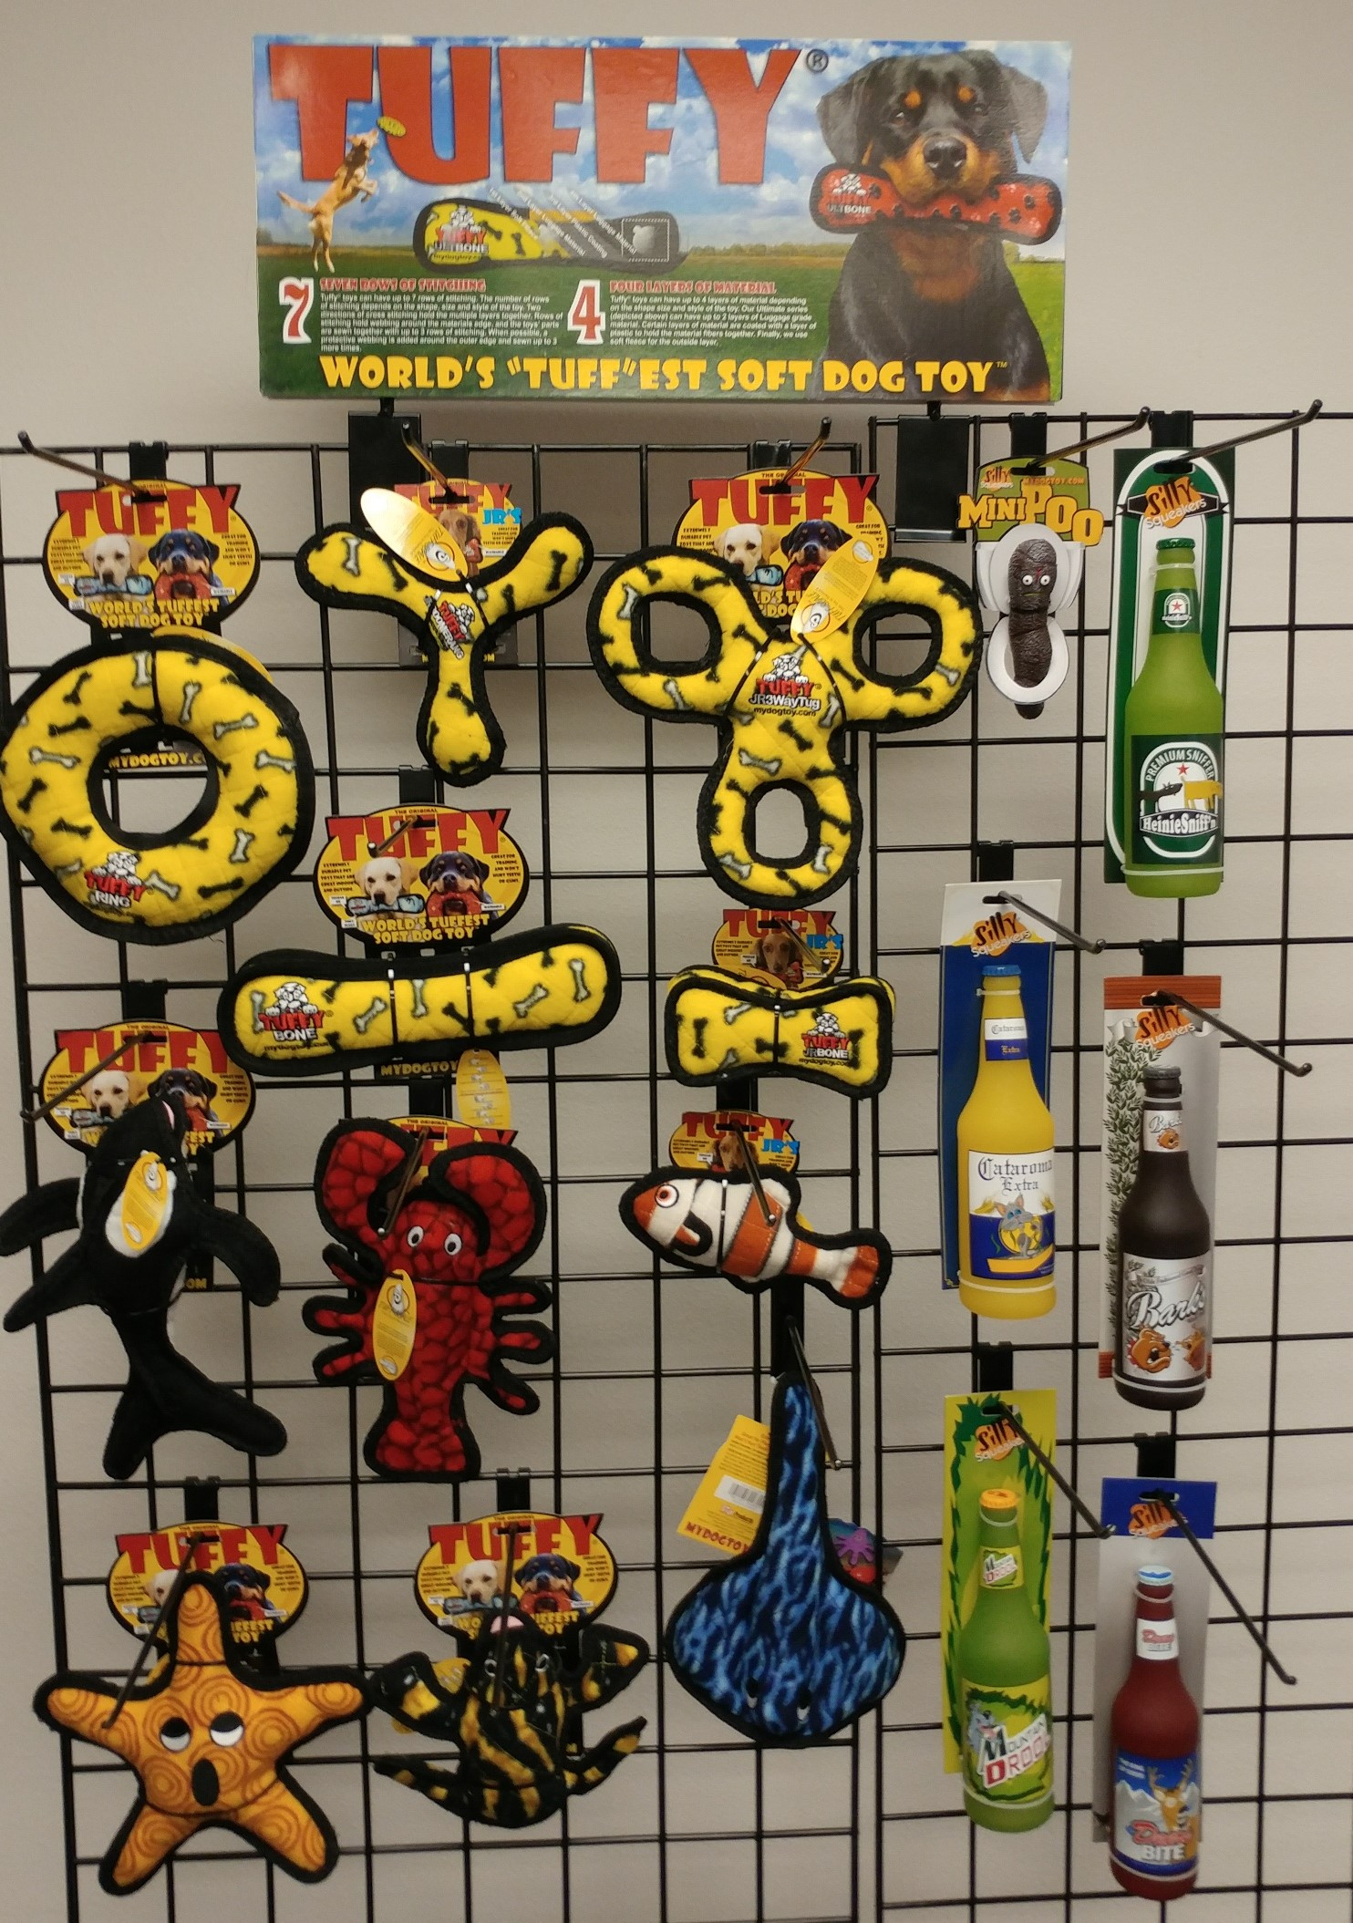
Tuffy & Silly Squeakers 4’ x 4’ Item Code: Rack-T-SS-4x4
Wholesale Price: $253.96 (2 of each) $380.94 (3 of each)
T-U-R-YB
180181001031
T-JR-BR-YB
180181016035
T-JR-3WT-YB
180181906343
T-U-B-YB
180181002038
T-JR-B2-YB
180181907180
T-OC-Killer-Whale
180181907555
T-OC-JR-Lobster
180181910074
T-OC-JR-Fish-OR
180181908576
T-OC-Starfish
180181009013
SS-MiniPoops
180181902987
SS-BB-HS
180181903946
SS-BB-CA
180181903168
SS-BB-BR
180181903939
SS-BB-MD
180181903922
SS-BB-KB
180181903908
T-DS-Phrog
180181903830
T-OC-Starfish
180181009013

Slide 22
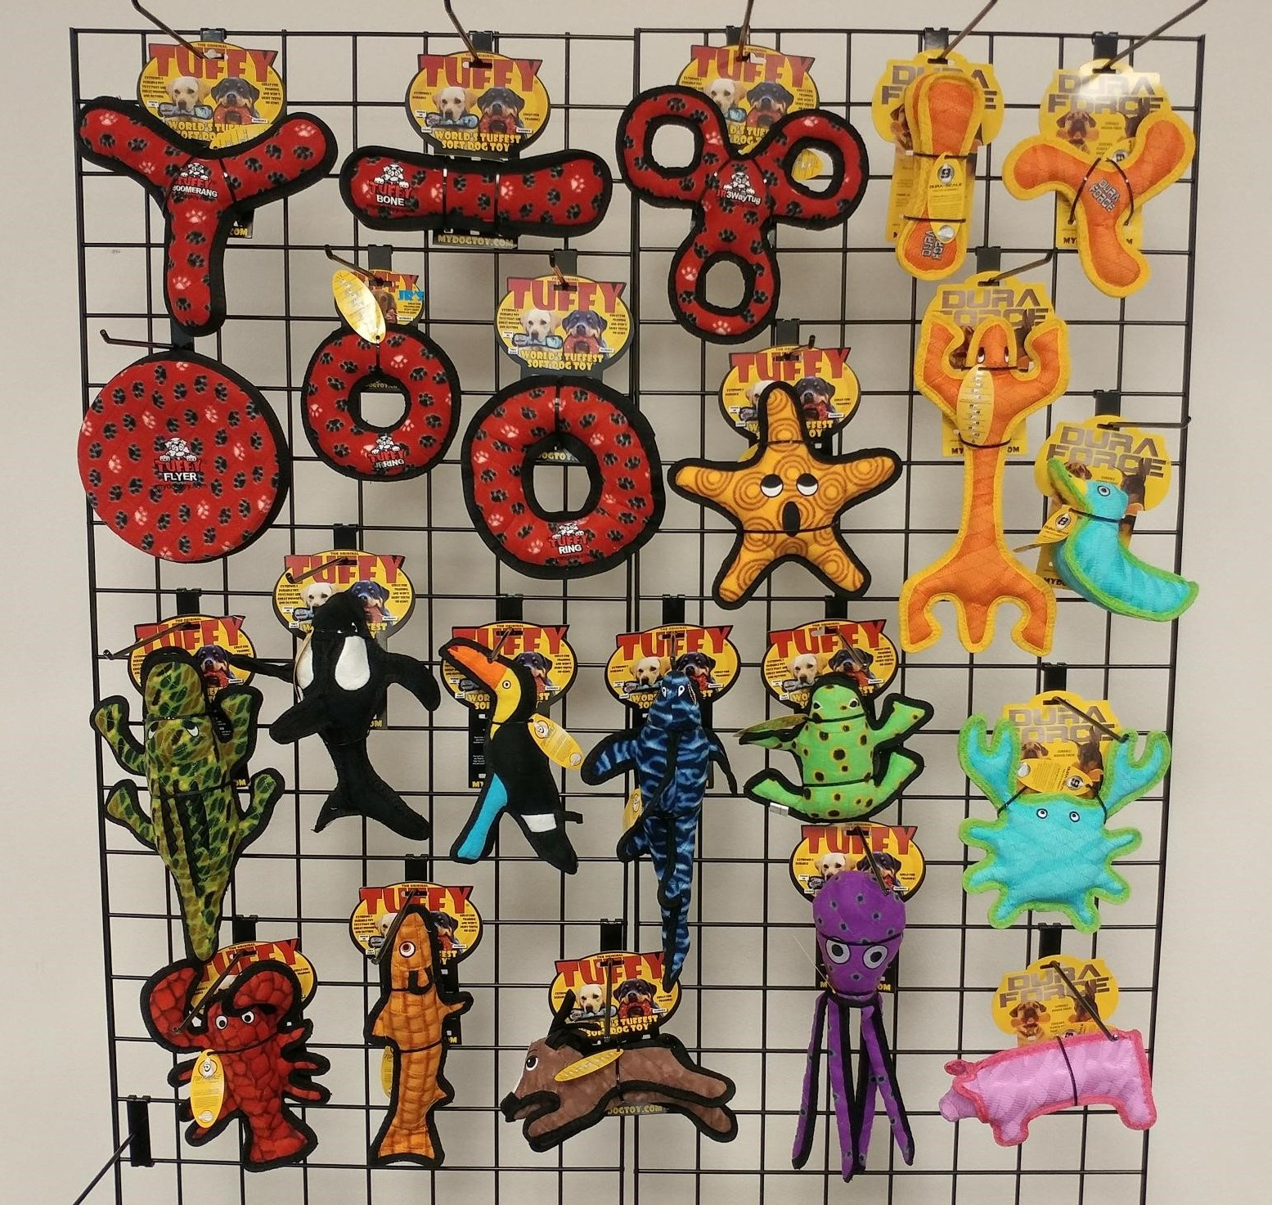
Tuffy & DuraForce 4.25’ x 6’
Item Code: Rack-T-DF-4x5
Wholesale Price:
$393.82 (2 of each)
$590.73 (3 of each)

Slide 23
Tuffy & DuraForce 4.25’ x 6’ Item Code: Rack-T-DF-4x5
Wholesale Price: $393.82 (2 of each) $590.73 (3 of each)
180181006012 T-U-BR-RP
180181002014 T-U-B-RP
180181906312 T-JR-3WT-RP
180181020032 T-U-FL-RP
180181001017 T-U-R-RP
180181011016 T-JR-R-RP
180181009013 T-OC-Starfish
180181020018 T-OC-Alligator
180181907555 T-OC-Killer-Whale
180181908163 T-JR-Z-Toucan
180181904325 T-OC-Shark
180181903830 T-DS-Phrog
180181910074 T-JR-OC-Lobster
180181908590 T-OC-Trout-OR
180181020827 T-JR-BY-Pony
180181020803 T-OC-Squid-PR
180181909597 DFJR-B-T-OY
180181909634 DFJR-BR-T-OY
180181020551 DFC-Lizard-T-OY
180181020582 DFC-Duck1-T-BG
180181020568 DFC-Crab-T-BG
180181020520 DFC-Pig-T-PP

Slide 24
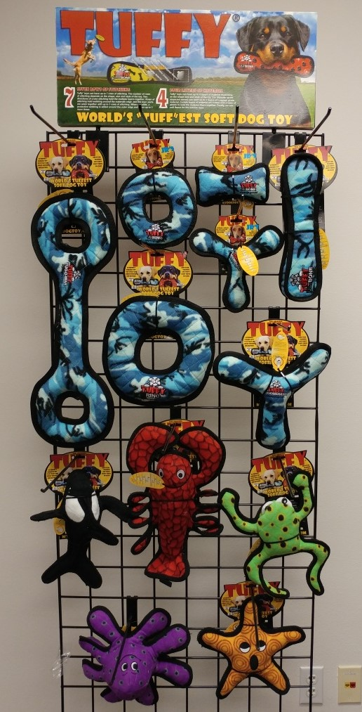
Tuffy 5’ x 3’ Option 1 Item Code: Rack-T-5x3-1
Wholesale Price: $207.30 (2 of each) $310.95 (3 of each)
180181005046 T-U-T-CB
180181011047 T-JR-R-CB
180181020124 T-JR-B-CB
180181016042 T-JR-BR-CB
180181002045 T-U-B-CB
180181001048 T-U-R-CB
180181006043 T-U-BR-CB
180181907555T-OC-Killer-Whale
180181020148 T-OC-Larry-Lobster
180181907944 T-DS-Phrog-Leap
180181007019 T-OC-Small-Octopus
180181009013 T-OC-Starfish

Slide 25
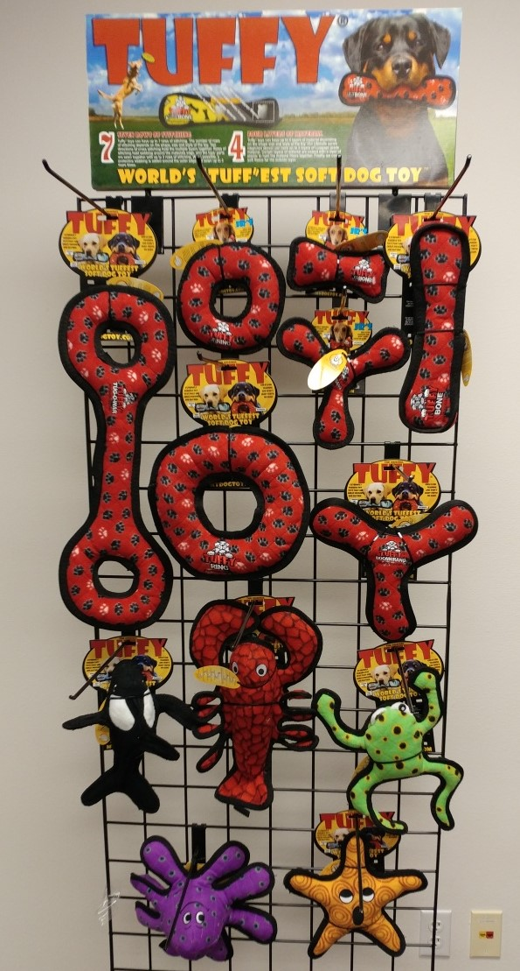
Tuffy 5’ x 3’ Option 2 Item Code: Rack-T-5x3-2
Wholesale Price: $207.30 (2 of each) $310.95 (3 of each)
180181005015 T-U-T-RP
180181011016 T-JR-R-RP
180181020117 T-JR-B-RP
180181016011 T-JR-BR-RP
180181002014 T-U-B-RP
180181001017 T-U-R-RP
180181006012 T-U-BR-RP
180181907555T-OC-Killer-Whale
180181020148 T-OC-Larry-Lobster
180181907944 T-DS-Phrog-Leap
180181007019 T-OC-Small-Octopus
180181009013 T-OC-Starfish

Slide 26
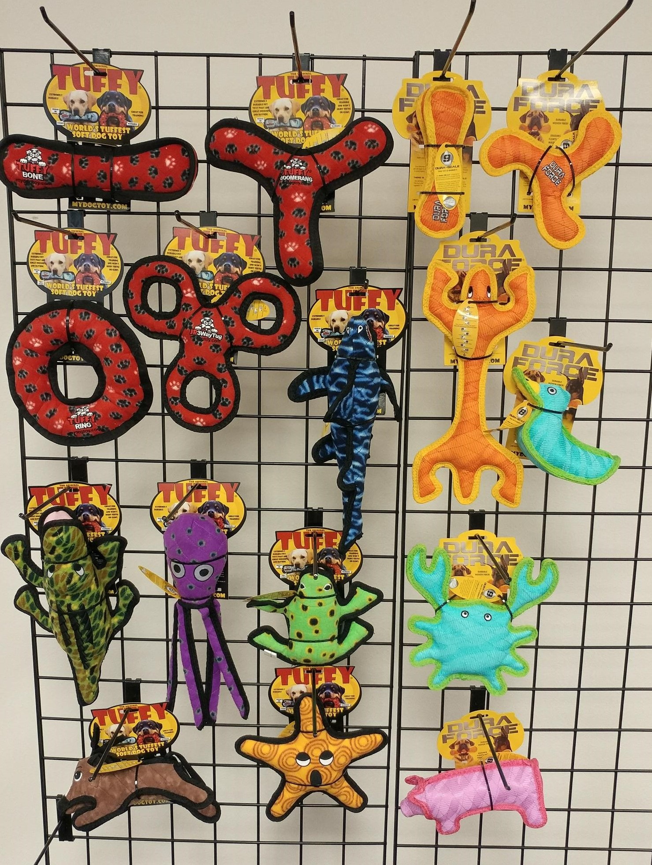
Tuffy & DuraForce 5’ x 4.5’ Item Code: Rack-T-DF-5x4.5
Wholesale Price: $297.96 (2 of each) $446.94 (3 of each)
180181002014 T-U-B-RP
180181006012 T-U-BR-RP
180181001017 T-U-R-RP
180181906312 T-JR-3WT-RP
180181904325 T-OC-Shark
180181020018 T-OC-Alligator
180181020803 T-OC-Squid-PR
180181903830 T-DS-Phrog
180181909511 DF-B-T-OY
180181909474 DF-BR-T-OY
180181020551 DFC-Lizard-T-OY
180181020582DFC-Duck1-T-BG
180181020568 DFC-Crab-T-BG
180181020520 DFC-Pig-T-PP
180181009013 T-OC-Starfish
180181908217 T-JR-BY-Rabbit-BRN

Slide 27
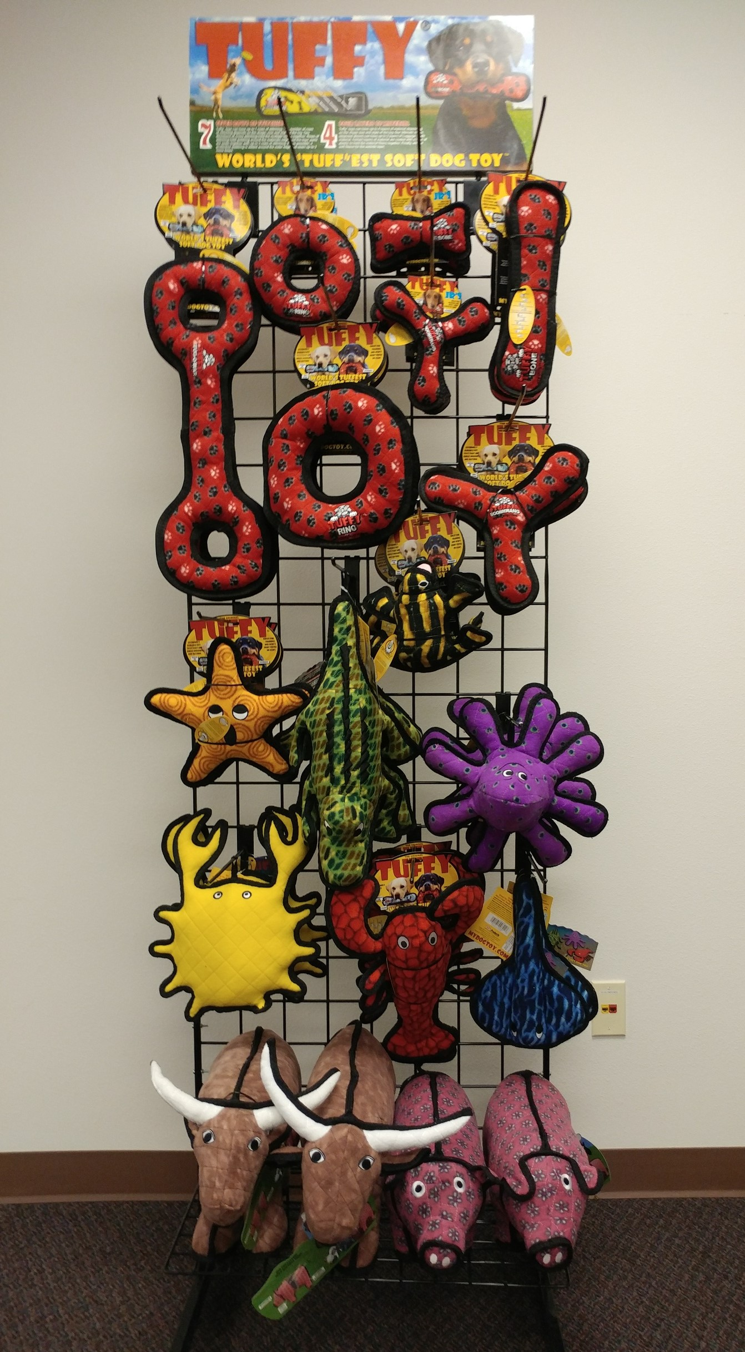
Tuffy 6’ x 3’ Item Code: Rack-T-6x3
Wholesale Price:
$317.70 (2 of each)
$443.24 (3 of each except Pig & Bull are 2 of each)
180181005015 T-U-T-RP
180181011016 T-JR-R-RP
180181020117 T-JR-B-RP
180181016011 T-JR-BR-RP
180181002014 T-U-B-RP
180181001017 T-U-R-RP
180181006012 T-U-BR-RP
180181009013 T-OC-Starfish
180181020018 T-OC-Alligator
180181903830 T-DS-Phrog
180181007019 T-OC-Small-Octopus
180181020292 T-OC-Crab
180181020148 T-OC-Larry-Lobster
180181008016 T-OC-Stingray
180181901256 T-BY-Bull
180181901287 T-BY-Pig

Slide 28
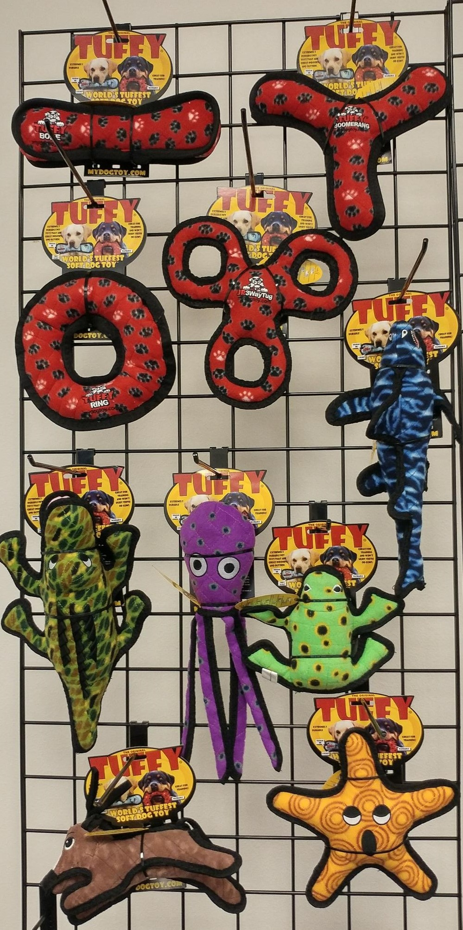
Tuffy 4’ x 2’ Item Code: Rack-T-4x2
Wholesale Price: $183.40 (2 of each) $275.10 (3 of each)
180181002014 T-U-B-RP
180181006012 T-U-BR-RP
180181001017 T-U-R-RP
180181906312 T-JR-3WT-RP
180181904325 T-OC-Shark
180181020018 T-OC-Alligator
180181020803 T-OC-Squid-PR
180181903830 T-DS-Phrog
180181908217 T-JR-BY-Rabbit-BRN
180181009013 T-OC-Starfish

Slide 29
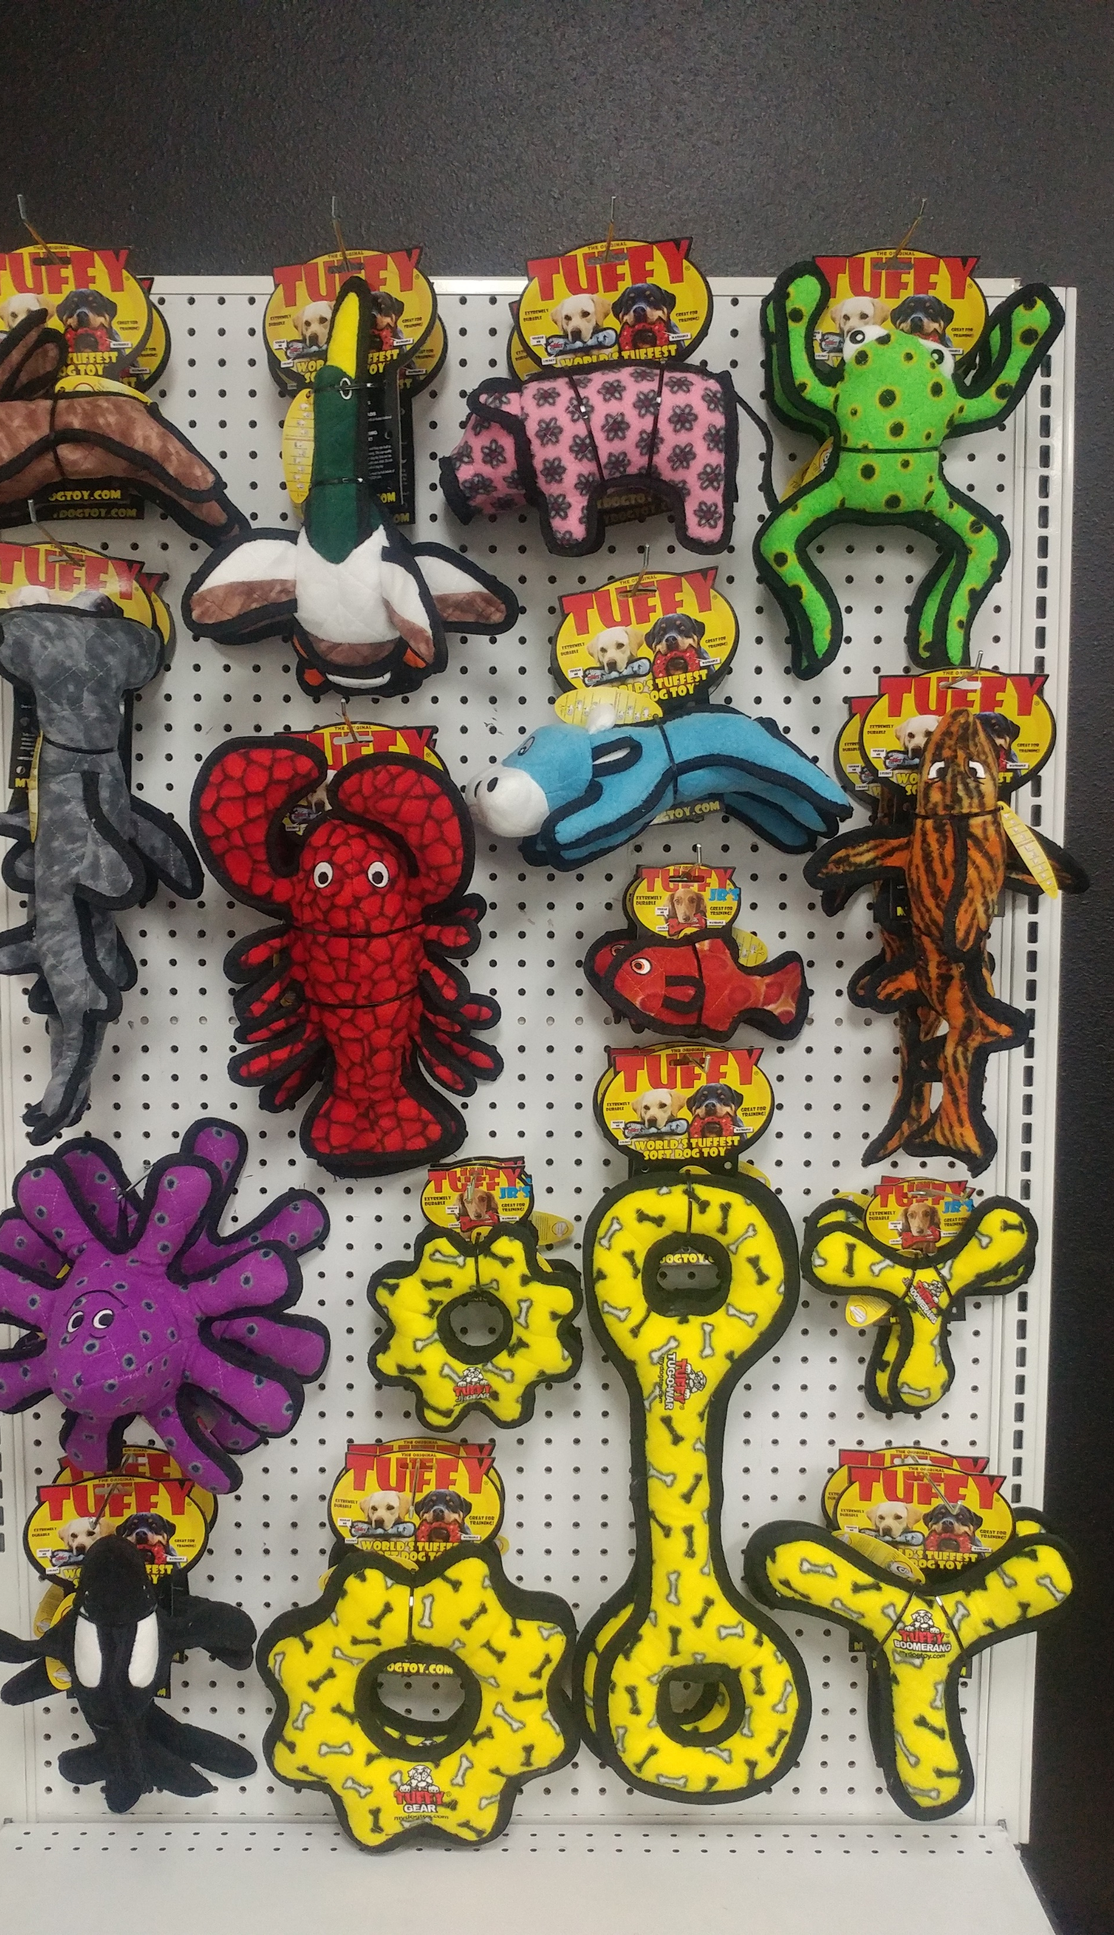
Tuffy POG Yellow
Item Code: POG-T-YB-4.5x3

Slide 30
Tuffy POG Yellow - Item Code: POG-T-YB-4.5x3
Wholesale Price: $ 291.66
180181908217 T-JR-BY-Rabbit-Brn (2)
180181908187 T-JR-BY-Duck (2)
180181908200 T-JR-BY-Pig (2)
180181021480 T-JR-BY-Cow (2)
180181907944 T-DS-Phrog-Leap (2)
180181907555 T-OC-Killer-Whale (2)
180181906978 T-OC-Tiger-Shark (2)
180181020148 T-OC-Larry-Lobster (2)
180181907333 T-OC-Hammerhead (2)
180181007019 T-OC-Small-Octopus (2)
180181903830 T-OC-JR-Fish-RD (2)
180181905452 T-JR-GR-YB (2)
180181016035 T-JR-BR-YB (2)
180181905414 T-U-GR-YB (2)
180181006036 T-U-BR-YB (2)
180181005039 T-U-T-YB (2)

Slide 31
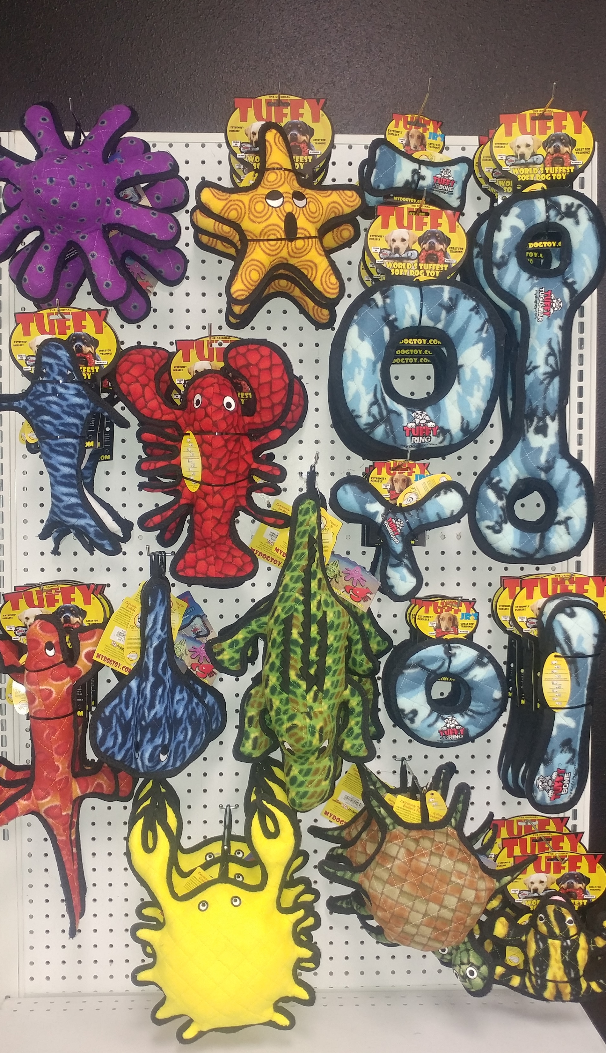
Tuffy POG Blue
Item Code: POG-T-CB-4.5x3

Slide 32
Tuffy POG Blue - Item Code: POG-T-CB-4.5x3
Wholesale Price: $ 404.66
180181904653 T-OC-Whale (3)
180181020148 T-OC-Larry-Lobster (2)
180181007019 T-OC-Small-Octopus (2)
180181009013 T-OC-Starfish (3)
180181008016 T-OC-Stingray (3)
180181020018 T-OC-Alligator (2)
180181020292 T-OC-Crab (3)
180181020308 T-OC-Turtle (3)
180181903748 T-DS-Lizard (3)
180181903830 T-DS-Phrog (3)
180181020124 T-JR-B-CB (3)
180181016042 T-JR-BR-CB (3)
180181011047 T-JR-R-CB (3)
180181001048 T-U-R-CB (3)
180181002045 T-U-B-CB (3)
180181005046 T-U-T-CB (3)

Slide 33

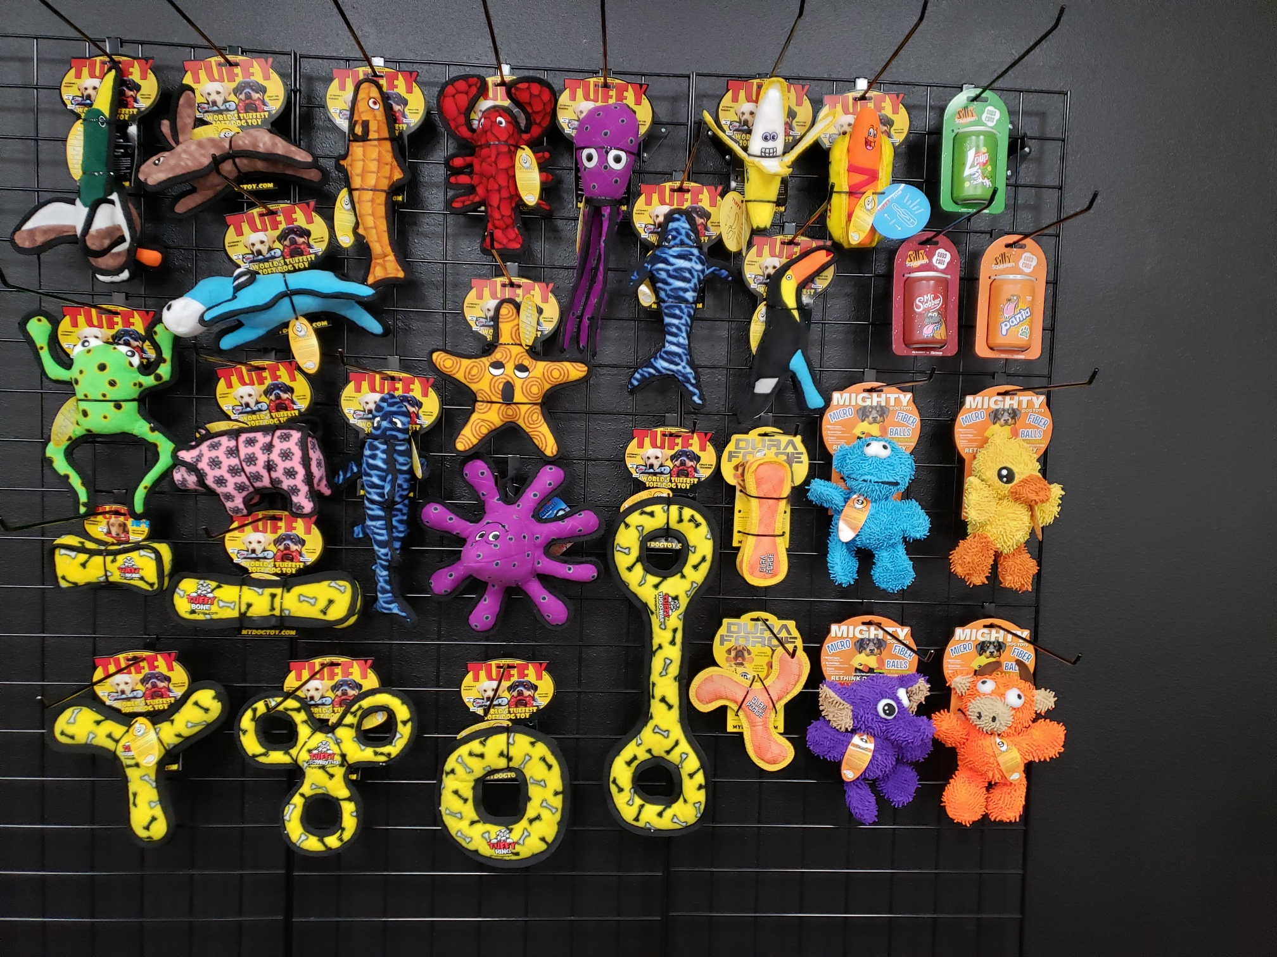
Item Code:
POG-T-MG-DF-SS-YB

Slide 34
Item Code: POG-T-MG-DF-SS-YB
Wholesale Price: $782.57
180181909597 DFJR-B-T-OY (3)
180181909634 DFJR-BR-T-OY (3)
180181021510 MT-MicroBM-Bull-OR (3)
180181020469 MT-MicroBM-Duck (3)
180181020612 MT-MicroBM-Elephant (3)
180181020643 MT-MicroBM-Monster (3)
180181022241 SS-SC-LP (3)
180181022272 SS-SC-MS (3)
180181022265 SS-SC-PT (3)
180181907944 T-DS-Phrog-Leap (3)
180181020940 T-FF-Banana (3)
180181020957 T-FF-HotDog (3)
180181906343 T-JR-3WT-YB (3)
180181020100 T-JR-B-YB (3)
180181021480 T-JR-BY-Cow (3)
180181908187 T-JR-BY-Duck (3)
180181908200 T-JR-BY-Pig (3)
180181908217 T-JR-BY-Rabbit-BRN (3)
180181908163 T-JR-Z-Toucan (3)
180181910074 T-OC-JR-Lobster (3)
180181904325 T-OC-Shark (3)
180181007019 T-OC-Small-Octopus (2)
180181020803 T-OC-Squid-PR (3)
180181009013 T-OC-Starfish (3)
180181908590 T-OC-Trout-OR (3)
180181904653 T-OC-Whale (3)
180181002038 T-U-B-YB (3)
180181006036 T-U-BR-YB (3)
180181001031 T-U-R-YB (3)
180181005039 T-U-T-YB (3)

Slide 35
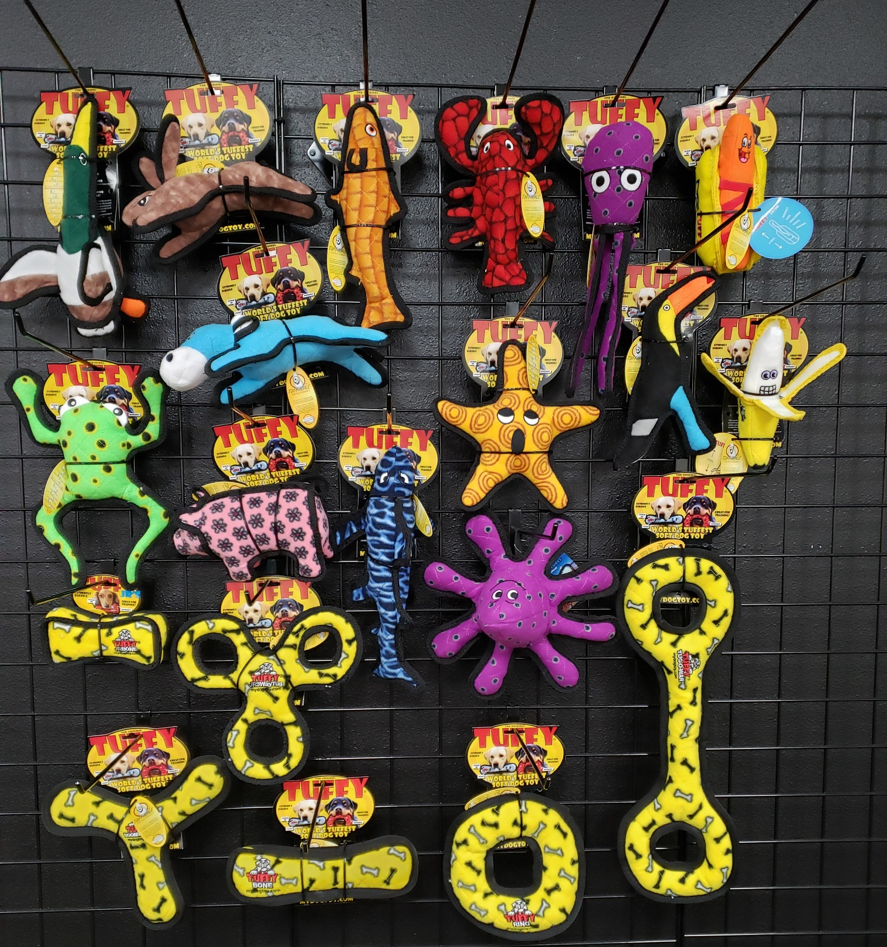

Item Code:
POG-T-FF-YB

Slide 36
Item Code: POG-T-FF-YB
Wholesale Price $518.69
180181907944 T-DS-Phrog-Leap (3)
180181020940 T-FF-Banana (3)
180181020957 T-FF-HotDog (3)
180181906343 T-JR-3WT-YB (3)
180181020100 T-JR-B-YB (3)
180181021480 T-JR-BY-Cow (3)
180181908187 T-JR-BY-Duck (3)
180181908200 T-JR-BY-Pig (3)
180181908217 T-JR-BY-Rabbit-BRN (3)
180181908163 T-JR-Z-Toucan (3)
180181910074 T-OC-JR-Lobster (3)
180181904325 T-OC-Shark (3)
180181007019 T-OC-Small-Octopus (2)
180181020803 T-OC-Squid-PR (3)
180181009013 T-OC-Starfish (3)
180181908590 T-OC-Trout-OR (3)
180181002038 T-U-B-YB (3)
180181006036 T-U-BR-YB (3)
180181001031 T-U-R-YB (3)
180181005039 T-U-T-YB (3)

Slide 37
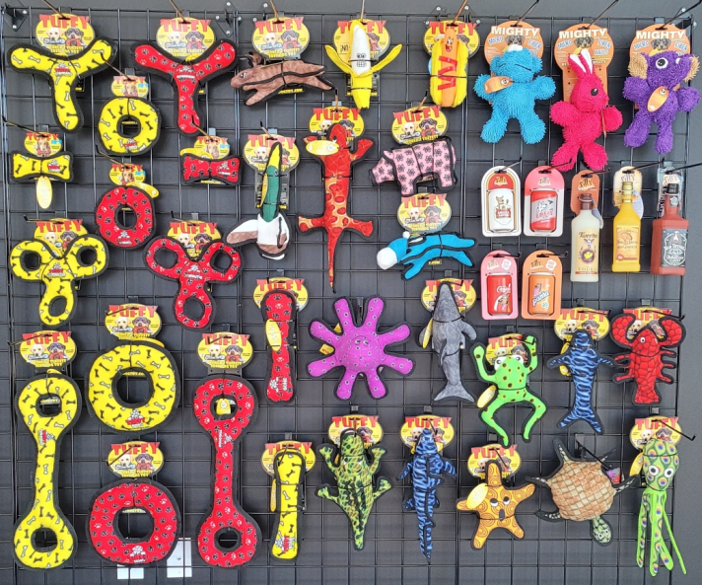
6 FT x 5 FT Set
Item Code: POG-MT-SS-T-6x5

Slide 38
Item Code: POG-MT-SS-T-6x5
Wholesale Price $1066.52
180181020612 MT-MicroBM-Elephant (3)
180181020643 MT-MicroBM-Monster (3)
180181020636 MT-MicroBM-Rabbit (3)
180181022395 SS-BC-BK (3)
180181022388 SS-BC-SA (3)
180181908606 SS-LB-BS (3)
180181908781 SS-LB-JP (3)
180181020759 SS-LB-TW (3)
180181022258 SS-SC-CC (3)
180181022265 SS-SC-PT (3)
180181903748 T-DS-Lizard (3)
180181907944 T-DS-Phrog-Leap (3)
180181020940 T-FF-Banana (3)
180181020957 T-FF-HotDog (3)
180181906312 T-JR-3WT-RP (3)
180181906343 T-JR-3WT-YB (3)
180181020117 T-JR-B-RP (3)
180181020100 T-JR-B-YB (3)
180181021480 T-JR-BY-Cow (3)
180181908187 T-JR-BY-Duck (3)
180181908200 T-JR-BY-Pig (3)
180181908217 T-JR-BY-Rabbit-BRN (3)
180181011016 T-JR-R-RP (3)
180181011030 T-JR-R-YB (3)
180181910036 T-M-OC-Alligator (3)
180181023668 T-OC-Dolphin (3)
180181910074 T-OC-JR-Lobster (3)
180181909498 T-OC-Shark-EM (3)
180181007019 T-OC-Small-Octopus (2)
180181020810 T-OC-Squid-GN (3)
180181009013 T-OC-Starfish (3)
180181020308 T-OC-Turtle (3)
180181904653 T-OC-Whale (3)
180181002014 T-U-B-RP (3)
180181002038 T-U-B-YB (3)
180181006012 T-U-BR-RP (3)
180181006036 T-U-BR-YB (3)
180181001017 T-U-R-RP (3)
180181001031 T-U-R-YB (3)
180181005015 T-U-T-RP (3)
180181005039 T-U-T-YB (3)

Slide 39
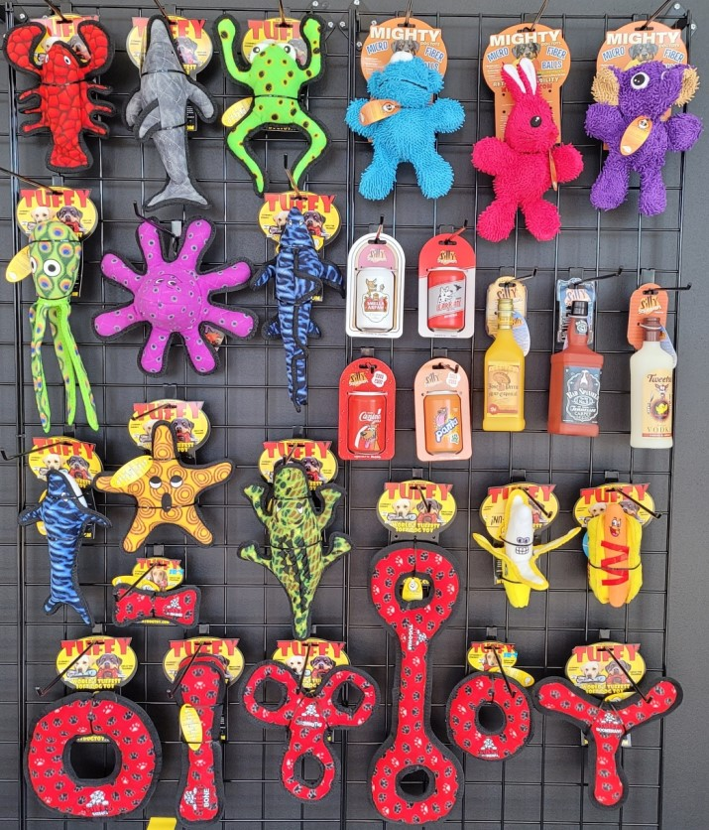
4 FT X 5 FT Set
Item Code:POG-MT-SS-T-4x5

Slide 40
Item Code: POG-MT-SS-T-4x5
Wholesale Price $724.31
180181020612 MT-MicroBM-Elephant (3)
180181020643 MT-MicroBM-Monster (3)
180181020636 MT-MicroBM-Rabbit (3)
180181022395 SS-BC-BK (3)
180181022388 SS-BC-SA (3)
180181908606 SS-LB-BS (3)
180181908781 SS-LB-JP (3)
180181020759 SS-LB-TW (3)
180181022258 SS-SC-CC (3)
180181022241 SS-SC-LP (3)
180181907944 T-DS-Phrog-Leap (3)
180181020940 T-FF-Banana (3)
180181020957 T-FF-HotDog (3)
180181906312 T-JR-3WT-RP (3)
180181020117 T-JR-B-RP (3)
180181011016 T-JR-R-RP (3)
180181910036 T-M-OC-Alligator (3)
180181023668 T-OC-Dolphin (3)
180181910074 T-OC-JR-Lobster (3)
180181909498 T-OC-Shark-EM (3)
180181007019 T-OC-Small-Octopus (2)
180181020810 T-OC-Squid-GN (3)
180181009013 T-OC-Starfish (3)
180181904653 T-OC-Whale (3)
180181002014 T-U-B-RP (3)
180181006012 T-U-BR-RP (3)
180181001017 T-U-R-RP (3)
180181005015 T-U-T-RP (3)

Slide 41
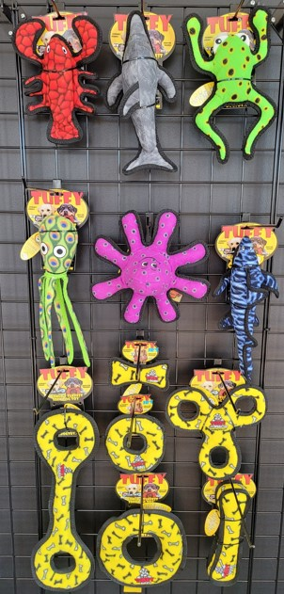
2 FT X 5 FT Set
Item Code: POG-T-YB-2x5

Slide 42
Item Code: POG-T-YB-2x5
Wholesale Price $304.43
180181907944 T-DS-Phrog-Leap (3)
180181906343 T-JR-3WT-YB (3)
180181020100 T-JR-B-YB (3)
180181011030 T-JR-R-YB (3)
180181023668 T-OC-Dolphin (3)
180181910074 T-OC-JR-Lobster (3)
180181909498 T-OC-Shark-EM (3)
180181007019 T-OC-Small-Octopus (2)
180181020810 T-OC-Squid-GN (3)
180181002038 T-U-B-YB (3)
180181001031 T-U-R-YB (3)
180181005039 T-U-T-YB (3)

Slide 43
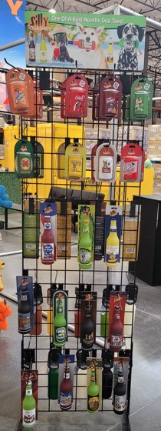
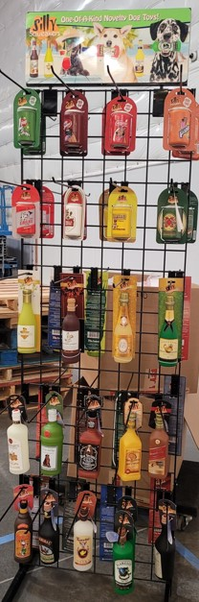
Item Code: POG-Silly-6x3

Slide 44
Item Code: POG-Silly-6x3
Wholesale Price: $790.89
180181903939 SS-BB-BR (3)
180181903168 SS-BB-CA (3)
180181908354 SS-BB-CT (3)
180181908378 SS-BB-DB (3)
180181908385 SS-BB-DP (3)
180181903892 SS-BB-DR (3)
180181903946 SS-BB-HS (3)
180181903908 SS-BB-KB (3)
180181903922 SS-BB-MD (3)
180181908330 SS-BB-PN (3)
180181908347 SS-BB-SC (3)
180181022395 SS-BC-BK (6)
180181022364 SS-BC-DP (6)
180181022371 SS-BC-PP (6)
180181022388 SS-BC-SA (6)
180181020728 SS-LB-BL (3)
180181020704 SS-LB-BP (3)
180181908606 SS-LB-BS (3)
180181020711 SS-LB-DW (3)
180181020834 SS-LB-HM (3)
180181908781 SS-LB-JP (3)
180181020735 SS-LB-KH (3)
180181020841 SS-LB-SS (3)
180181020742 SS-LB-TF (3)
180181020759 SS-LB-TW (3)
180181022258 SS-SC-CC (6)
180181022241 SS-SC-LP (6)
180181022272 SS-SC-MS (6)
180181022265 SS-SC-PT (6)
180181903700 SS-WB-CP (3)
180181903717 SS-WB-GS (3)
180181903724 SS-WB-KR (3)
180181907937 SS-WB-MC (3)

Slide 45
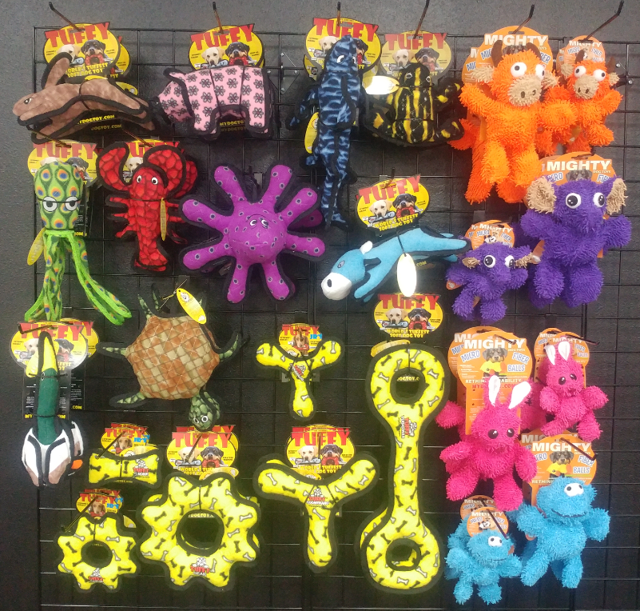
Item Code: POG-T-MT-Micro-Mix-5x5

Slide 46
Item Code: POG-T-MT-Micro-Mix-5x5
Wholesale Price $643.33
180181908217 T-JR-BY-Rabbit-BRN (3)
180181908200 T-JR-BY-Pig (3)
180181021480 T-JR-BY-Cow (3)
180181908187 T-JR-BY-Duck (3)
180181903830 T-DS-Phrog (3)
180181910074 T-OC-JR-Lobster (3)
180181904325 T-OC-Shark-EM (3)
180181007019 T-OC-Small-Octopus (2)
180181020810 T-OC-Squid-GN (3)
180181020308 T-OC-Turtle (2)
180181020100 T-JR-B-YB (3)
180181905452 T-JR-GR-YB (3)
180181016035 T-JR-BR-YB (3)
180181006036 T-U-BR-YB (3)
180181905414 T-U-GR-YB (3)
180181005039 T-U-T-YB (3)
180181021510 MT-MicroBM-Bull-OR (3)
180181021657 MTJR-MicroB-Bull-OR (3)
180181020612 MT-MicroBM-Elephant (3)
180181021084 MTJR-MicroB-Elephant (3)
180181020636 MT-MicroBM-Rabbit (3)
180181021121 MTJR-MicroB-Rabbit (3)
180181020643 MT-MicroBM-Monster (3)
180181021114 MTJR-MicroB-Monster (3)

Slide 47
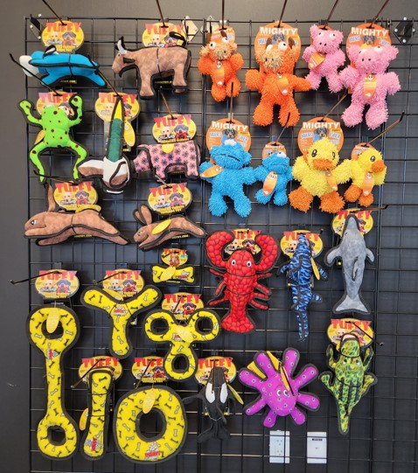
Item Code: POG-MT-MicroB-T-4x5

Slide 48
Item Code: POG-MT-MicroB-T-4x5
Wholesale Price: $796.64
180181021480 T-JR-BY-Cow (3)
180181908170 T-JR-BY-Bull (3)
180181907944 T-DS-Phrog-Leap (3)
180181908200 T-JR-BY-Pig (3)
180181906954 T-BY-Rabbit-Brn (3)
180181908217 T-JR-BY-Rabbit-Brn (3)
180181908187 T-JR-BY-Duck (3)
180181020148 T-OC-Larry-Lobster (3)
180181909498 T-OC-Shark-EM (3)
180181907555 T-OC-Killer-Whale (3)
180181023668 T-OC-Dolphin (3)
180181007019 T-OC-Small-Octopus (2)
180181020018 T-OC-Alligator (3)
180181002038 T-U-B-YB (3)
180181006036 T-U-BR-YB (3)
180181001031 T-U-R-YB (3)
180181005039 T-U-T-YB (3)
180181020100 T-JR-B-YB (3)
180181906343 T-JR-3WT-YB (3)
180181021510 MT-MicroBM-Bull-OR (3)
180181021657 MTJR-MicroB-Bull-OR (3)
180181020483 MT-MicroBM-Pig (3)
180181908842 MTJR-MicroB-Pig (3)
180181020643 MT-MicroBM-Monster (3)
180181021114 MTJR-MicroB-Monster (3)
180181020469 MT-MicroBM-Duck (3)
180181909924 MTJR-MicroB-Duck (3)

Slide 49
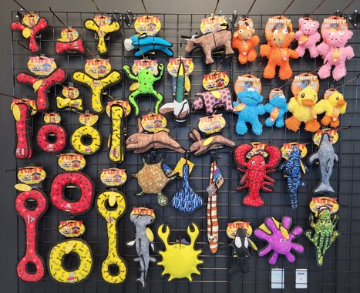
Item Code: POG-MT-MicroB-T-6x5

Slide 50
Item Code: POG-MT-MicroB-T-6x5
Wholesale Price: $1127.42
180181016011 T-JR-BR-RP (3)
180181020117 T-JR-B-RP (3)
180181016035 T-JR-BR-YB (3)
180181020100 T-JR-B-YB (3)
180181006012 T-U-BR-RP (3)
180181006036 T-U-BR-YB (3)
180181002014 T-U-B-RP (3)
180181002038 T-U-B-YB (3)
180181001017 T-U-R-RP (3)
180181001031 T-U-R-YB (3)
180181011016 T-JR-R-RP (3)
180181011030 T-JR-R-YB (3)
180181005015 T-U-T-RP (3)
180181005039 T-U-T-YB (3)
180181907555 T-OC-Killer-Whale (3)
180181007019 T-OC-Small-Octopus (2)
180181020018 T-OC-Alligator (3)
180181020148 T-OC-Larry-Lobster (3)
180181909498 T-OC-Shark-EM (3)
180181023668 T-OC-Dolphin (3)
180181021480 T-JR-BY-Cow (3)
180181907944 T-DS-Phrog-Leap (3)
180181908170 T-JR-BY-Bull (3)
180181908200 T-JR-BY-Pig (3)
180181908187 T-JR-BY-Duck (3)
180181908217 T-JR-BY-Rabbit-BRN (3)
180181906954 T-BY-Rabbit-Brn (3)
180181020308 T-OC-Turtle (3)
180181008016 T-OC-Stingray (3)
180181010019 T-OC-Eel (3)
180181907333 T-OC-Hammerhead (3)
180181020292 T-OC-Crab (3)
180181020469 MT-MicroBM-Duck (3)
180181909924 MTJR-MicroB-Duck (3)
180181021510 MT-MicroBM-Bull-OR (3)
180181021657 MTJR-MicroB-Bull-OR (3)
180181020483 MT-MicroBM-Pig (3)
180181908842 MTJR-MicroB-Pig (3)
180181021114 MTJR-MicroB-Monster (3)
180181020643 MT-MicroBM- Monster (3)

Slide 51
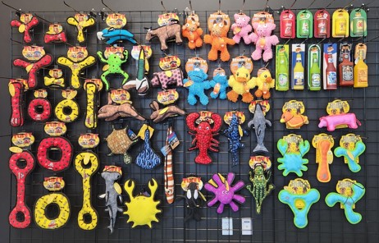
Item Code: POG-DF-MT-SS-T-8x5

Slide 52
Item Code: POG-DF-MT-SS-T-8x5
Wholesale Price: $1526.30
180181022364 SS-BC-DP (3)
180181903922 SS-BB-MD (3)
180181903168 SS-BB-CA (3)
180181908606 SS-LB-BS (3)
180181908781 SS-LB-JP (3)
180181020575 DFC-Duck2-T-OY (3)
180181020520 DFC-Pig-T-PP (3)
180181020568 DFC-Crab-T-BG (3)
180181909511 DF-B-T-OY (3)
180181909542 DF-TR-T-BG (3)
180181909467 DF-BR-T-BG (3)
180181909627 DFJR-BR-T-BG (3)
180181016011 T-JR-BR-RP (3)
180181020117 T-JR-B-RP (3)
180181016035 T-JR- BR-YB (3)
180181006012 T-U-BR-RP (3)
180181006036 T-U-BR-YB (3)
180181020100 T-JR-B-YB (3)
180181002014 T-U-B-RP (3)
180181002038 T-U-B-YB (3)
180181011016 T-JR-R-RP (3)
180181011030 T-JR-R-YB (3)
180181001017 T-U-R-RP (3)
180181001031 T-U-R-YB (3)
180181005015 T-U-T-RP (3)
180181005039 T-U-T-YB (3)
180181021480 T-JR-BY-Cow (3)
180181020018 T-OC-Alligator (3)
180181908170 T-JR-BY-Bull (3)
180181907944 T-DS-Phrog-Leap (3)
180181908187 T-JR-BY-Duck (3)
180181908200 T-JR-BY-Pig (3)
180181908217 T-JR-BY-Rabbit-Brn (3)
180181906954 T-BY-Rabbit-Brn (3)
180181020308 T-OC-Turtle (3)
180181008016 T-OC-Stingray (3)
180181010019 T-OC-Eel (3)
180181907333 T-OC-Hammerhead (3)
180181020292 T-OC-Crab (3)
180181907555 T-OC-Killer-Whale (3)
180181020148 T-OC-Larry-Lobster (3)
180181007019 T-OC-Small-Octopus (2)
180181909498 T-OC-Shark-EM (3)
180181023668 T-OC-Dolphin (3)
180181903946 SS-BB-HS (3)
180181908354 SS-BB-CT (3)
180181020469 MT-MicroBM-Duck (3)
180181909924 MTJR-MicroB-Duck (3)
180181021510 MT-MicroBM-Bull-OR (3)
180181021657 MTJR-MicroB-Bull-OR (3)
180181020483 MT-MicroBM-Pig (3)
180181908842 MTJR-MicroB-Pig (3)
180181021114 MTJR-MicroB-Monster (3)
180181020643 MT-MicroBM- Monster (3)
180181022258 SS-SC-CC (3)
180181022241 SS-SC-LP (3)
180181022272 SS-SC-MS (3)
180181022371 SS-BC-PP (3)

Slide 53
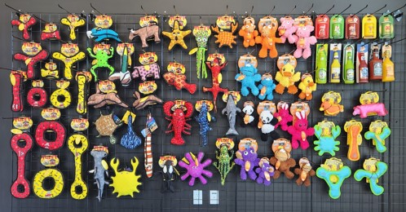
Item Code: POG-DF-MT-SS-T-10x5

Slide 54
Item Code: POG-DF-MT-SS-T-10x5
Wholesale Price: $1915.82
180181016011 T-JR-BR-RP (3)
180181020117 T-JR-B-RP (3)
180181006012 T-U-BR-RP (3)
180181016035 T-JR- BR-YB (3)
180181006036 T-U-BR-YB (3)
180181020100 T-JR-B-YB (3)
180181002014 T-U-B-RP (3)
180181002038 T-U-B-YB (3)
180181011016 T-JR-R-RP (3)
180181011030 T-JR-R-YB (3)
180181001017 T-U-R-RP (3)
180181001031 T-U-R-YB (3)
180181005015 T-U-T-RP (3)
180181005039 T-U-T-YB (3)
180181021480 T-JR-BY-Cow (3)
180181009013 T-OC-Starfish (3)
180181908552 T-OC-Fish-RD (3)
180181020810 T-OC-Squid-GN (3)
180181903748 T-DS-Lizard (3)
180181023583 T-M-OC-Crab-OR (3)
180181908170 T-JR-BY-Bull (3)
180181907944 T-DS-Phrog-Leap (3)
180181908187 T-JR-BY-Duck (3)
180181908200 T-JR-BY-Pig (3)
180181908217 T-JR-BY-Rabbit-Brn (3)
180181906954 T-BY-Rabbit-Brn (3)
180181020308 T-OC-Turtle (3)
180181008016 T-OC-Stingray (3)
180181010019 T-OC-Eel (3)
180181907333 T-OC-Hammerhead (3)
180181020292 T-OC-Crab (3)
180181907555 T-OC-Killer-Whale (3)
180181020148 T-OC-Larry-Lobster (3)
180181007019 T-OC-Small-Octopus (2)
180181020018 T-OC-Alligator (3)
180181909498 T-OC-Shark-EM (3)
180181023668 T-OC-Dolphin (3)
180181903946 SS-BB-HS (3)
180181908354 SS-BB-CT (3)
180181020469 MT-MicroBM-Duck (3)
180181909924 MTJR-MicroB-Duck (3)
180181021510 MT-MicroBM-Bull-OR (3)
180181021657 MTJR-MicroB-Bull-OR (3)
180181020483 MT-MicroBM-Pig (3)
180181908842 MTJR-MicroB-Pig (3)
180181021114 MTJR-MicroB-Monster (3)
180181020643 MT-MicroBM- Monster (3)
180181020445 MT-MicroBM-Panda (3)
180181909948 MTJR-MicroB-Panda (3)
180181020636 MT-MicroBM-Rabbit (3)
180181021121 MTJR-MicroB-Rabbit (3)
180181020612 MT-MicroBM-Elephant (3)
180181021084 MTJR-MicroB-Elephant (3)
180181020452 MT-MicroBM-Monkey (3)
180181908835 MTJR-MicroB-Monkey (3)
180181022258 SS-SC-CC (3)
180181022241 SS-SC-LP (3)
180181022272 SS-SC-MS (3)
180181022371 SS-BC-PP (3)
180181022364 SS-BC-DP (3)
180181903922 SS-BB-MD (3)
180181903168 SS-BB-CA (3)
180181908606 SS-LB-BS (3)
180181908781 SS-LB-JP (3)
180181020575 DFC-Duck2-T-OY (3)
180181020520 DFC-Pig-T-PP (3)
180181020568 DFC-Crab-T-BG (3)
180181909511 DF-B-T-OY (3)
180181909542 DF-TR-T-BG (3)
180181909467 DF-BR-T-BG (3)
180181909627 DFJR-BR-T-BG (3)

Slide 55
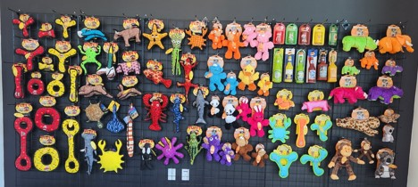
Item Code: POG-DF-MT-SS-T-12x5

Slide 56
Item Code: POG-DF-MT-SS-T-12x5
Wholesale Price: $ 2275.88
180181016011 T-JR-BR-RP (3)
180181020117 T-JR-B-RP (3)
180181006012 T-U-BR-RP (3)
180181016035 T-JR- BR-YB (3)
180181006036 T-U-BR-YB (3)
180181020100 T-JR-B-YB (3)
180181002014 T-U-B-RP (3)
180181002038 T-U-B-YB (3)
180181011016 T-JR-R-RP (3)
180181011030 T-JR-R-YB (3)
180181001017 T-U-R-RP (3)
180181001031 T-U-R-YB (3)
180181005015 T-U-T-RP (3)
180181005039 T-U-T-YB (3)
180181021480 T-JR-BY-Cow (3)
180181009013 T-OC-Starfish (3)
180181908552 T-OC-Fish-RD (3)
180181020810 T-OC-Squid-GN (3)
180181903748 T-DS-Lizard (3)
180181023583 T-M-OC-Crab-OR (3)
180181908170 T-JR-BY-Bull (3)
180181907944 T-DS-Phrog-Leap (3)
180181908187 T-JR-BY-Duck (3)
180181908200 T-JR-BY-Pig (3)
180181908217 T-JR-BY-Rabbit-Brn (3)
180181906954 T-BY-Rabbit-Brn (3)
180181020308 T-OC-Turtle (3)
180181008016 T-OC-Stingray (3)
180181010019 T-OC-Eel (3)
180181907333 T-OC-Hammerhead (3)
180181020292 T-OC-Crab (3)
180181907555 T-OC-Killer-Whale (3)
180181020148 T-OC-Larry-Lobster (3)
180181007019 T-OC-Small-Octopus (2)
180181020018 T-OC-Alligator (3)
180181909498 T-OC-Shark-EM (3)
180181023668 T-OC-Dolphin (3)
180181908354 SS-BB-CT (3)
180181022371 SS-BC-PP (3)
180181022364 SS-BC-DP (3)
180181908606 SS-LB-BS (3)
180181908781 SS-LB-JP (3)
180181020469 MT-MicroBM-Duck (3)
180181909924 MTJR-MicroB-Duck (3)
180181021510 MT-MicroBM-Bull-OR (3)
180181021657 MTJR-MicroB-Bull-OR (3)
180181020483 MT-MicroBM-Pig (3)
180181908842 MTJR-MicroB-Pig (3)
180181021114 MTJR-MicroB-Monster (3)
180181020643 MT-MicroBM- Monster (3)
180181020445 MT-MicroBM-Panda (3)
180181909948 MTJR-MicroB-Panda (3)
180181020636 MT-MicroBM-Rabbit (3)
180181021121 MTJR-MicroB-Rabbit (3)
180181020612 MT-MicroBM-Elephant (3)
180181021084 MTJR-MicroB-Elephant (3)
180181020452 MT-MicroBM-Monkey (3)
180181908835 MTJR-MicroB-Monkey (3)
180181022258 SS-SC-CC (3)
180181022241 SS-SC-LP (3)
180181022272 SS-SC-MS (3)
180181903922 SS-BB-MD (3)
180181903168 SS-BB-CA (3)
180181903946 SS-BB-HS (3)
180181020575 DFC-Duck2-T-OY (3)
180181020520 DFC-Pig-T-PP (3)
180181020568 DFC-Crab-T-BG (3)
180181909511 DF-B-T-OY (3)
180181909542 DF-TR-T-BG (3)
180181909467 DF-BR-T-BG (3)
180181909627 DFJR-BR-T-BG (3)
180181909887 MT-S-Rhino-Grn (3)
180181909993 MTJR-S-Rhino-Grn (3)
180181909832 MT-S-Elephant-OR (3)
180181909955 MTJR-S-Elephant-OR (3)
180181908491 MT-S-Warthog-PK (3)
180181904455 MT-S-Leopard (3)
180181904844 MTJR-S-Leopard (3)
180181909856 MT-S-Monkey-BR (3)
180181909979 MTJR-S-Monkey-BR (3)
180181907845 MT-S-Koala (3)
180181907852 MTJR-S-Koala (3)
180181909849 MT-S-Hippo-PL (3)
180181909962 MTJR-S-Hippo-PL (3)

