Slide 1
17 Years Designing & Manufacturing Brands

Slide 2
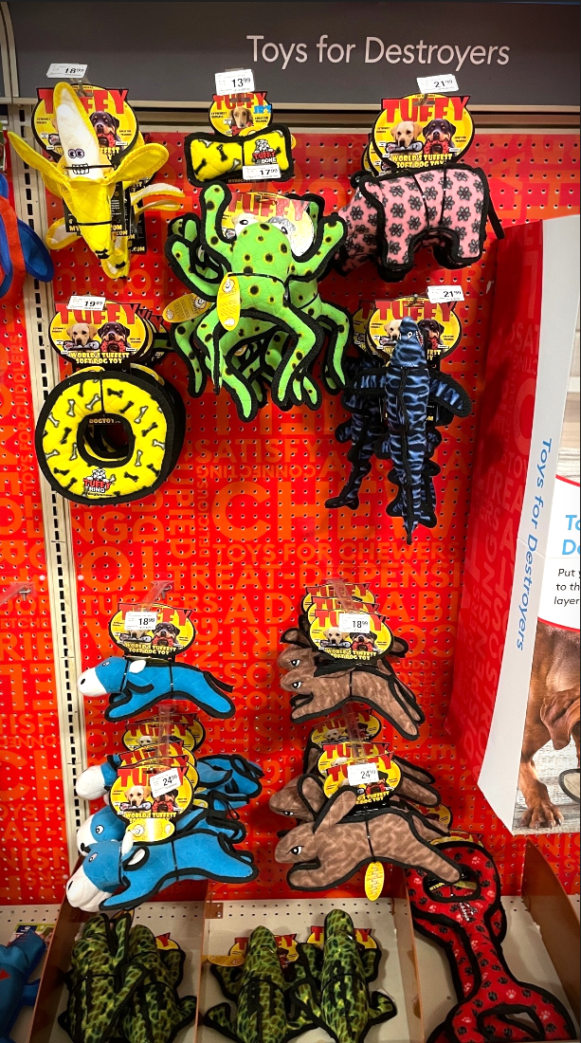
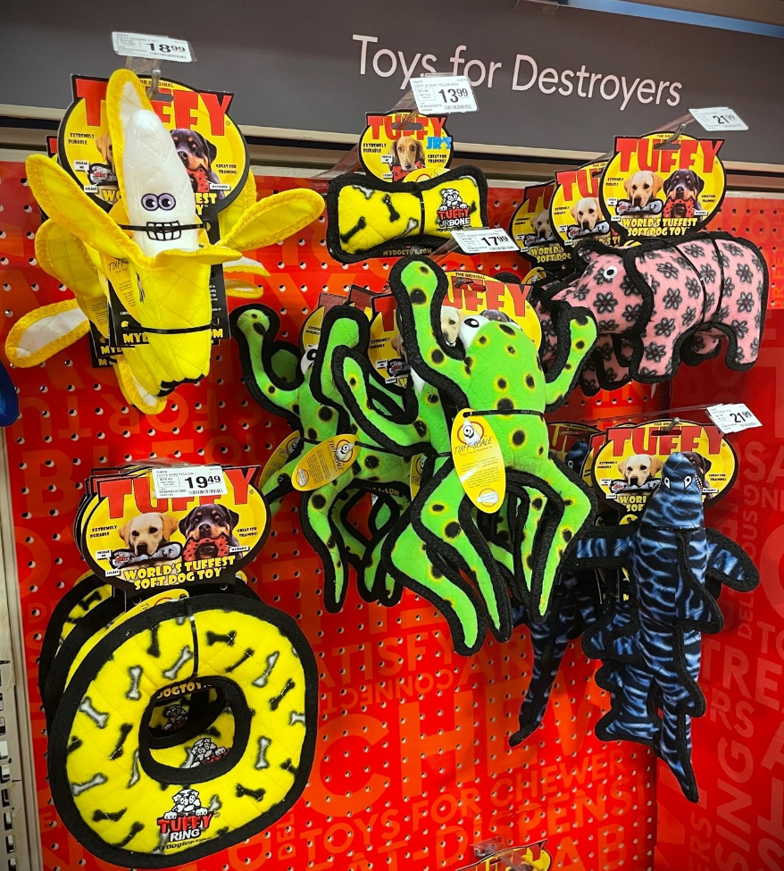
Store Display

Slide 3
CAT Form

Slide 4
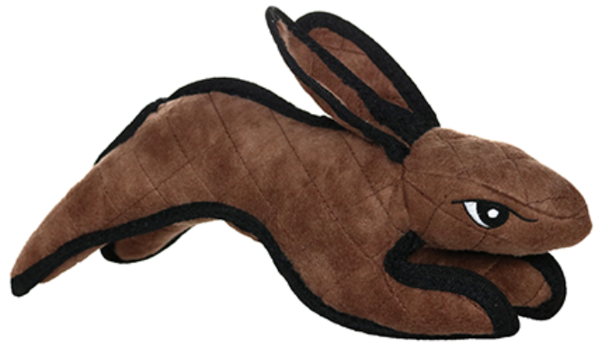
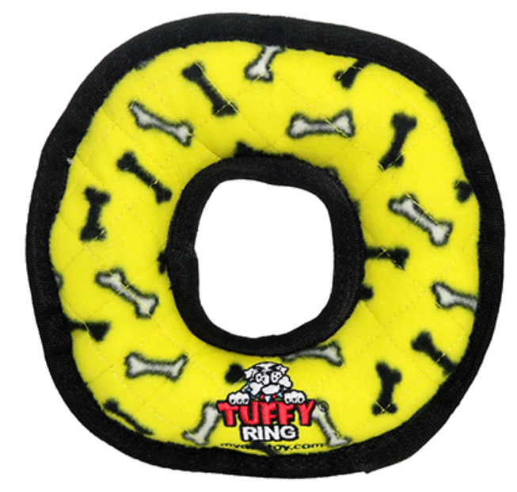
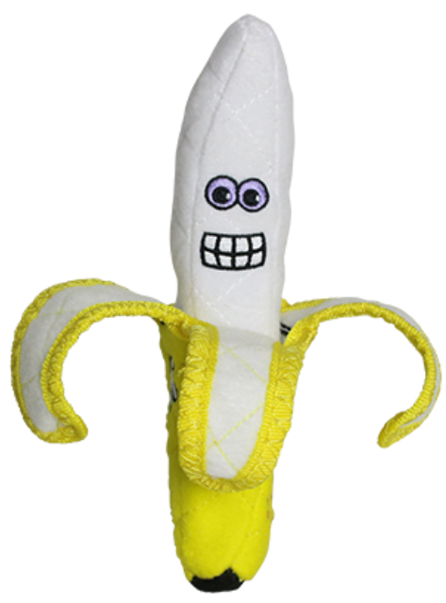
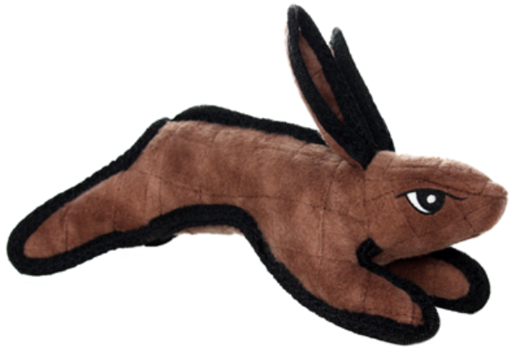
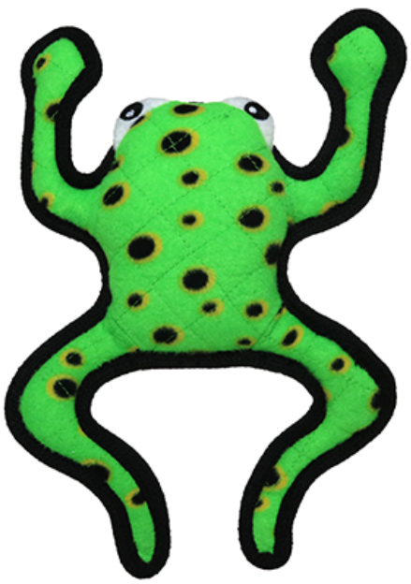
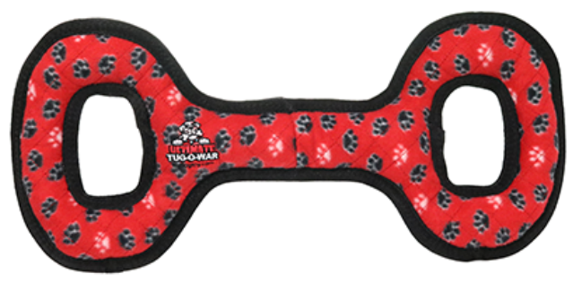
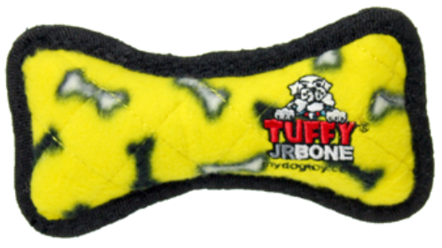
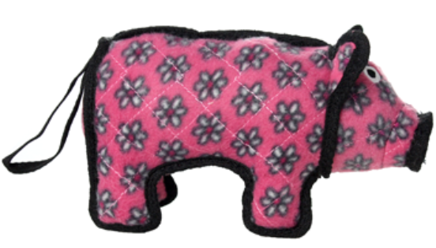
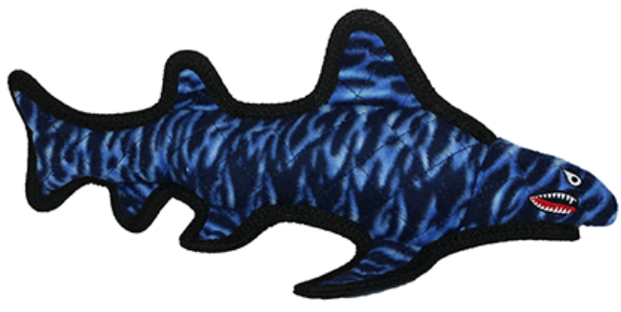
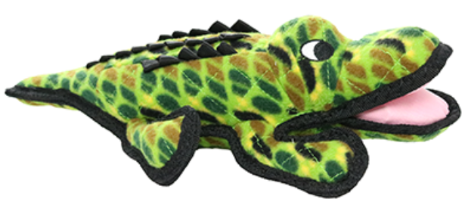
2021 | T-M-TO-RP 5247173 | T-BY-Rabbit-BRN 5264491 | T-M-R-YB 5247165 | T-JR-B-YB 5264493 | T-JR-BY-Pig 5247168 | T-OC-Shark-EM 5247167 | T-FF-Banana 5293367 | T-JR-BY-Rabbit-BRN 5247166 | T-DS-Phrog-Leap 5275882 | T-M-OC-Alligator 5247169
1st QTR | 17541 | 17527 | 14590 | 14124 | 14404 | 12460 | 12160 | 12589 | 14355 | 8229
2nd QTR | 19320 | 17632 | 16512 | 16675 | 15355 | 15384 | 14746 | 13871 | 14736 | 9049
3rd QTR | 19993 | 16497 | 18152 | 18398 | 16852 | 19086 | 16654 | 14633 | 13512 | 9514
4th QTR | 34335 | 26786 | 28065 | 26253 | 23065 | 22296 | 25188 | 24639 | 17778 | 15673
TOTAL Units | 91189 | 78442 | 77319 | 75450 | 69676 | 69226 | 68748 | 65732 | 60381 | 42465
Store count | 1523-1543 | 1627-1642 | 1347-1391 | 1528-1642 | 1528-1622 | 1534-1645 | 1528-1620 | 1523-1543 | 973-1367 | 974-1367
UPSPW | 1.2 | .98 | 1.15 | .98 | .90 | .90 | .90 | .87 | 1.1 | .80
Retail Cost | $26.99 | $24.99 | $19.49 | $13.99 | $21.99 | $21.99 | $18.99 | $18.99 | $17.99 | $21.99
TOTAL $ | $ 2,461,191 | $ 1,960,266 | $ 1,506,947 | $ 1,055,545 | $ 1,532,175 | $ 1,522,280 | $ 1,305,525 | $ 1,248,251 | $ 1,086,254 | $ 933,805

Slide 5
PETSMART 2023 RESET
SUGGESTIONS

Slide 6
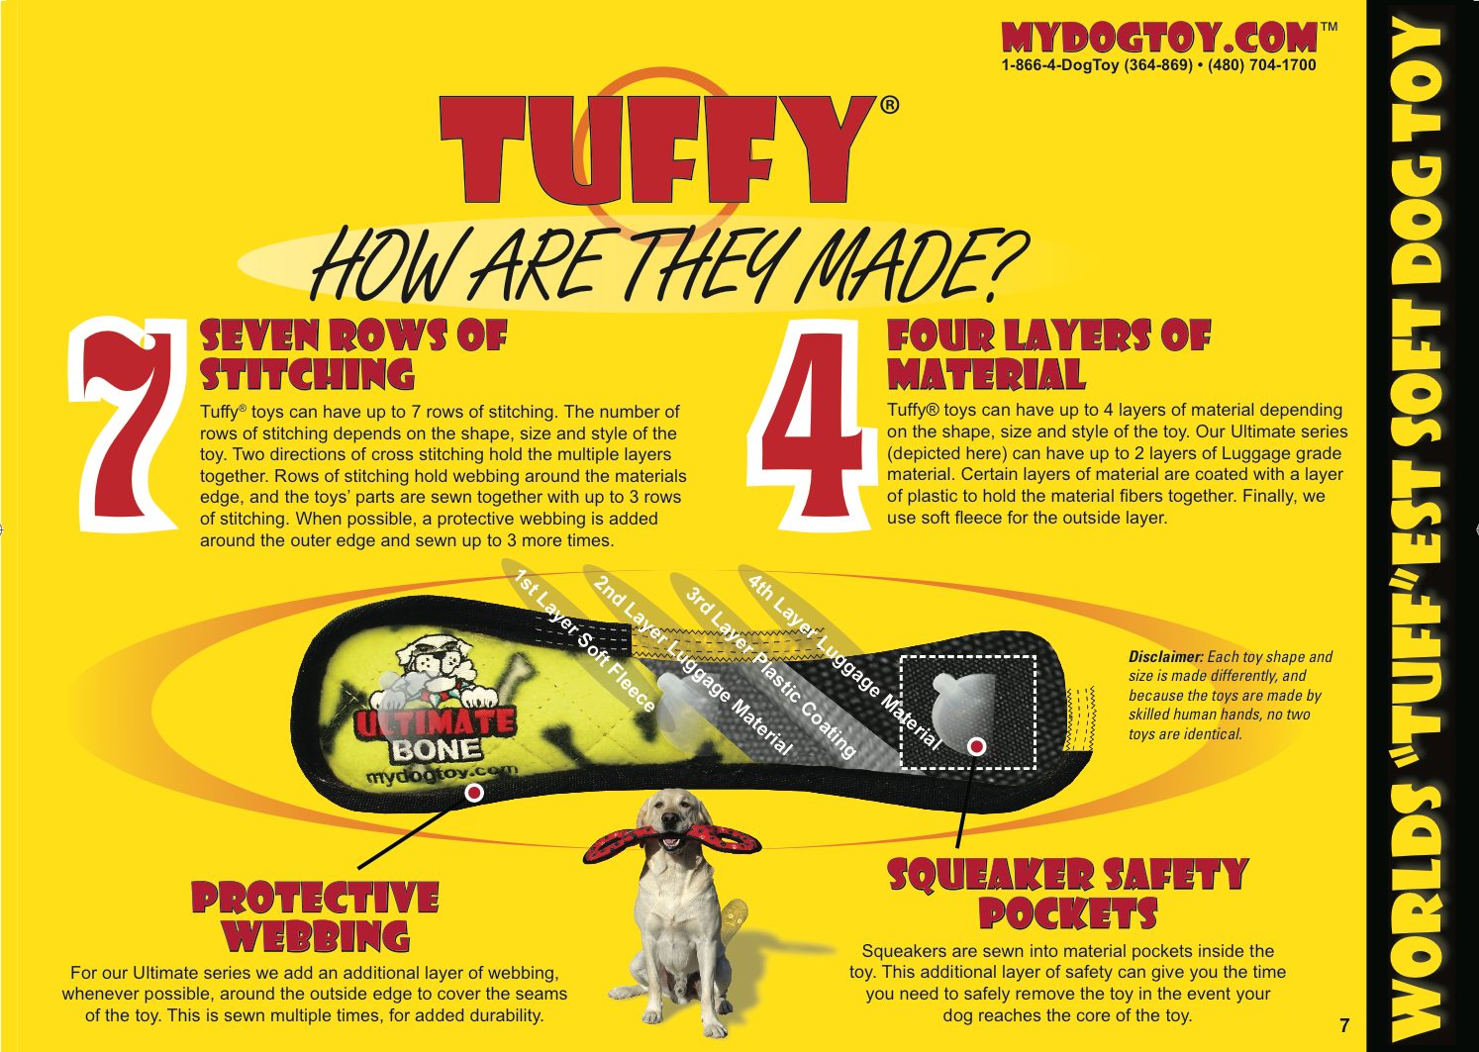

Slide 7
2023 NEW ITEM SUGGESTION Tuffy Medium Crab Orange
Item Code: T-M-OC-Crab-OR
UPC: 180181023583
Dims: 1.5”x 9”x 10.75”
Best selling size & shape. Can change fleece to any existing Tuffy Fleece to create custom toy for Petsmart.
Petsmart Price $6.15
Petsmart Retail $20.50

Slide 8
2023 NEW ITEM SUGGESTION Tuffy Ocean Creature Turtle
Item Code: T-OC-Turtle
UPC: 180181020308
Item Dims: 3”x 12”x 13”
Unique toy shape, great for medium to large size dogs.
Petsmart Price $7.95
Petsmart Retail $26.50

Slide 9
2023 NEW ITEM SUGGESTION Tuffy Ocean Creature Dolphin
Item Code: T-OC-Dolphin
UPC: 180181023668
Item Dims: 3.5”x 7.5”x 14.5”
New toy we just launched! Shape is great for all dog breeds.
Petsmart Price $6.90
Petsmart Retail $22.99

Slide 10
2023 NEW ITEM SUGGESTION Tuffy Ocean Creature Killer Whale
Item Code: T-OC-Killer-Whale
UPC: 180181907555
Item Dims: 7”x 9”x 13.5”
Best selling toy shape, great size for all dog breeds.
Petsmart Price $6.90
Petsmart Retail $22.99

Slide 11
2023 NEW ITEM SUGGESTION Tuffy Junior Zoo Monkey
Item Code: T-JR-Z-Monkey
UPC: 180181908132
Item Dims: 3”x 8”x 10”
Unique shape that works for all regions of the country.
Petsmart Price $6.75
Petsmart Retail $22.50

Slide 12
2023 NEW ITEM SUGGESTION Tuffy Junior Barn Yard Horse
Item Code: T-JR-BY-Horse
UPC: 180181908194
Item Dims: 2”x 10”x 8”
Unique shape that is great for all regions of the country.
Petsmart Price $6.15
Petsmart Retail $20.50

Slide 13
2023 XMAS - NEW ITEM SUGGESTION Tuffy Holiday Santa
Item Code: T-H-Santa
UPC: 180181023750
Item Dims: 2.17”x 7.67”x 13”
Unique toy, great for a clip strip, or any in and out holiday program.
Petsmart Price $6.45
Petsmart Retail $21.50

Slide 14
2023 XMAS - NEW ITEM SUGGESTION Tuffy Holiday Elf
Item Code: T-H-Elf
UPC: 180181023767
Item Dims: 1.77”x 7.67”x 13”
Unique toy, great for a clip strip, or any in and out holiday program.
Petsmart Price $6.45
Petsmart Retail $21.50

Slide 15
2023 XMAS - NEW ITEM SUGGESTION Tuffy Holiday Gingerbread Man
Item Code: T-H-Gingerbread-Man
UPC: 180181023774
Item Dims: 1.77”x 7.5”x 12.75”
Unique toy, great for a clip strip, or any in and out holiday program.
Petsmart Price $6.15
Petsmart Retail $20.50

Slide 16
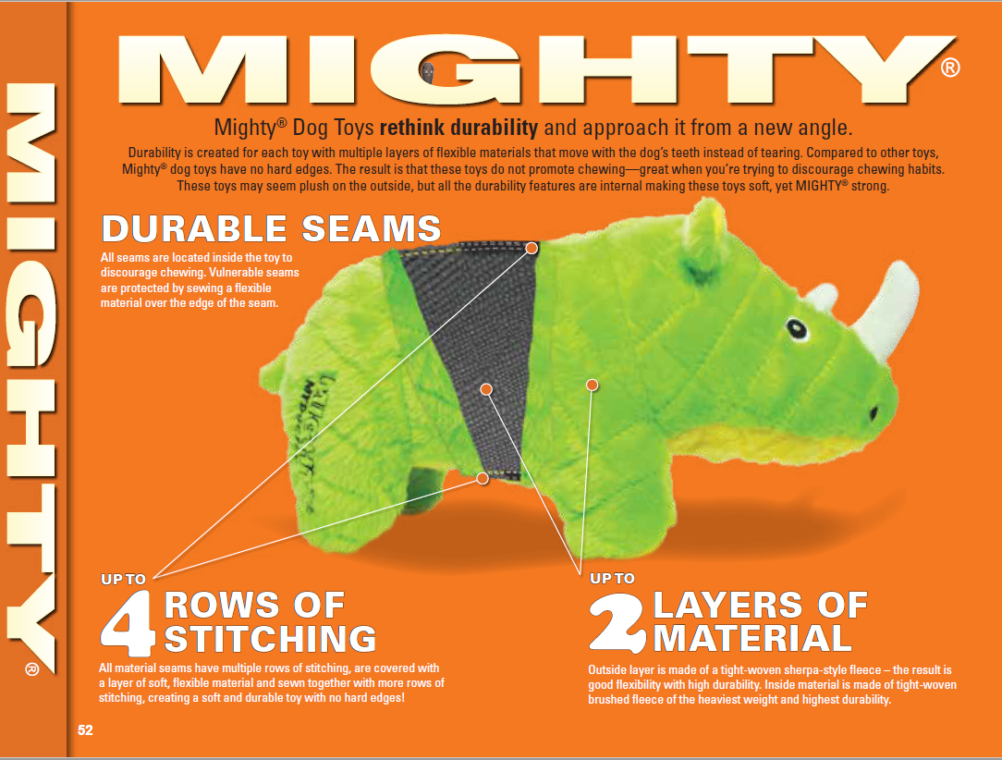

Slide 17
2023 NEW ITEM SUGGESTION Mighty Ocean Seahorse
Item Code: MT-O-Seahorse
UPC: 180181906121
Item Dims: 3.25”x 12.5”x 9.5”
Unique, innovative shape great for all dog breeds.
Petsmart Price $7.20
Petsmart Retail $23.99

Slide 18
2023 NEW ITEM SUGGESTION Mighty Mermaid
Item Code: MT-L-Mermaid
UPC: 180181906206
Item Dims: 4”x 6”x 18.5”
Unique, innovative shape great for all breeds.
Petsmart Price $7.05
Petsmart Retail $23.50

Slide 19
2023 NEW ITEM SUGGESTION Mighty Safari Rhino Green
Item Code: MT-S-Rhino-Grn
UPC: 180181909887
Item Dims: 4.25”x 11.5”x 10”
Unique, innovative shape great for medium to large size dogs.
Petsmart Price $7.80
Petsmart Retail $25.99

Slide 20
2023 NEW ITEM SUGGESTION Mighty Safari Elephant Orange
Item Code: MT-S-Elephant-OR
UPC: 180181909832
Item Dims: 4”x 12”x 9.5”
Unique, innovative shape, and orange is a bestselling color right now.
Petsmart Price $7.80
Petsmart Retail $25.99

Slide 21
Funny Novelty Toys – Great Impulse Buy!

Slide 22
2023 NEW ITEM SUGGESTION Silly Squeakers Soda Can Canine Cola
Item Code: SS-SC-CC
UPC: 180181022258
Item Dims: 2.75”x 4.12”x 7.5”
Great impulse buy for inline.
Petsmart Price $3.75
Petsmart Retail $10.99

Slide 23
2023 NEW ITEM SUGGESTION Silly Squeakers Meow Chased One
Item Code: SS-WB-MC
UPC: 180181907937
Item Dims: 3”x 3”x 12”
Unique toy – great impulse buy.
Petsmart Price $4.50
Petsmart Retail $14.99

Slide 24
2023 NEW ITEM SUGGESTION Silly Squeakers I-Balls Small 3 Pack
Item Code: SS-IB-S-BL-BR-PK
UPC: 180181904028
Item Dims: 2”x 7.25”x 7.5”
Unique toy, 3 squeaky toys in one, great for cats or small dogs.
Petsmart Price $5.10
Petsmart Retail $16.99

