Slide 1



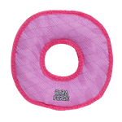


PDQ’S

Slide 2


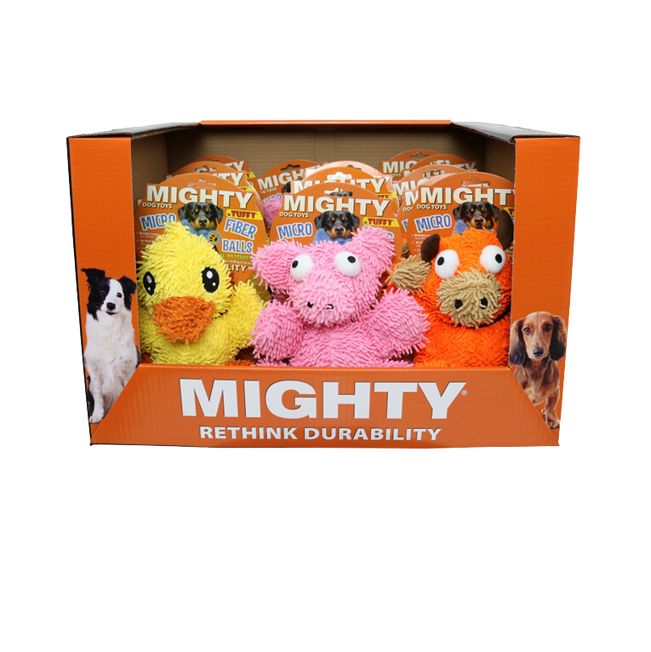
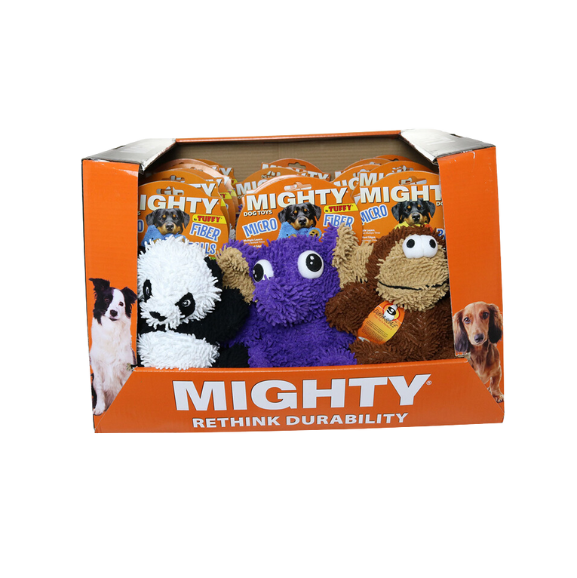
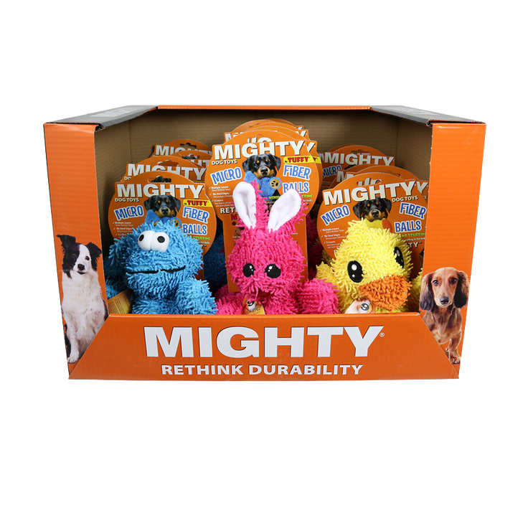
MICROFIBER PDQ’S
Item Code: MT-PDQ-Duck-Pig-BullOr
UPC: 180181031601
Wholesale Price: $189.00
Item Code: MT-PDQ-MicroBM-Mon-Rab-Duck
UPC: 180181030765
Wholesale Price: $189.00
Item Code: MT-PDQ-MicroBM-Pan-ElphPr-Monk
UPC: 180181030512
Wholesale Price: $214.20
•180181020469 MT-MicroBM-Duck (5)
•180181020483 MT-MicroBM-Pig (5)
•180181021510 MT-MicroBM-Bull-OR (5)
•180181020469 MT-MicroBM-Duck (5)
•180181020643 MT-MicroBM-Monster (5)
•180181020636 MT-MicroBM-Rabbit (5)
•180181020445 MT-MicroBM-Panda (6)
•180181020612 MT-MicroBM-Elephant (5)
•180181020452 MT-MicroBM-Monkey (6)

Slide 3
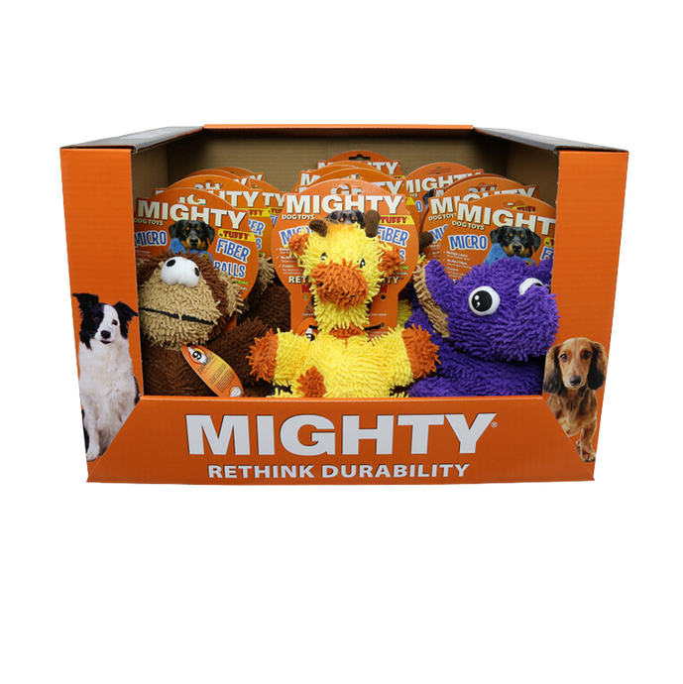
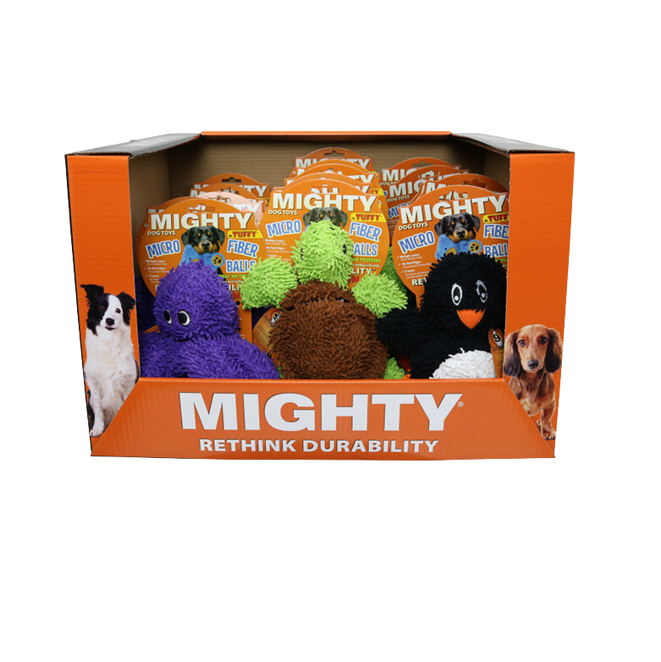
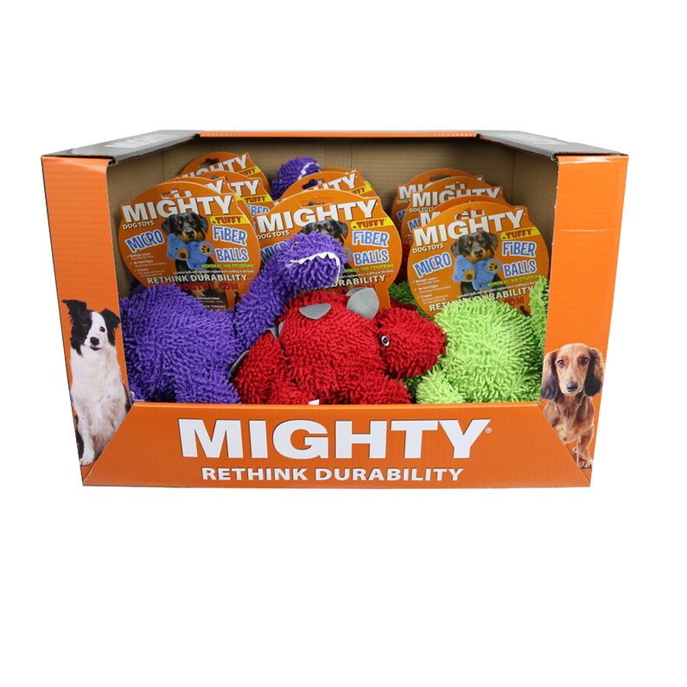
MICROFIBER PDQ’S
Item Code: MT-PDQ-Monk-Grf-ElphPr
UPC: 180181031595
Wholesale Price: $189.00
Item Code: MT-PDQ-Oct-Trt-Pen-BK
UPC: 180181031618
Wholesale Price: $189.00
Item Code: MT-PDQ-MicroBM-Brach-Stego-Tri
UPC: 180181030758
Wholesale Price: $151.20
•180181020452 MT-MicroBM-Monkey (5)
•180181020629 MT-MicroBM-Giraffe (5)
•180181020612 MT-MicroBM-Elephant (5)
•180181031076 MT-MicroBM-Oct-PR (5)
•180181031069 MT-MicroBM-Turtle-G (5)
•180181028151 MT-MicroBM-Penguin-BK (5)
•180181024238 MT-MicroBM-Brach-PR (4)
•180181024214 MT-MicroBM-Stego-RD (4)
•180181024221 MT-MicroBM-Tri-GN (4)

Slide 4
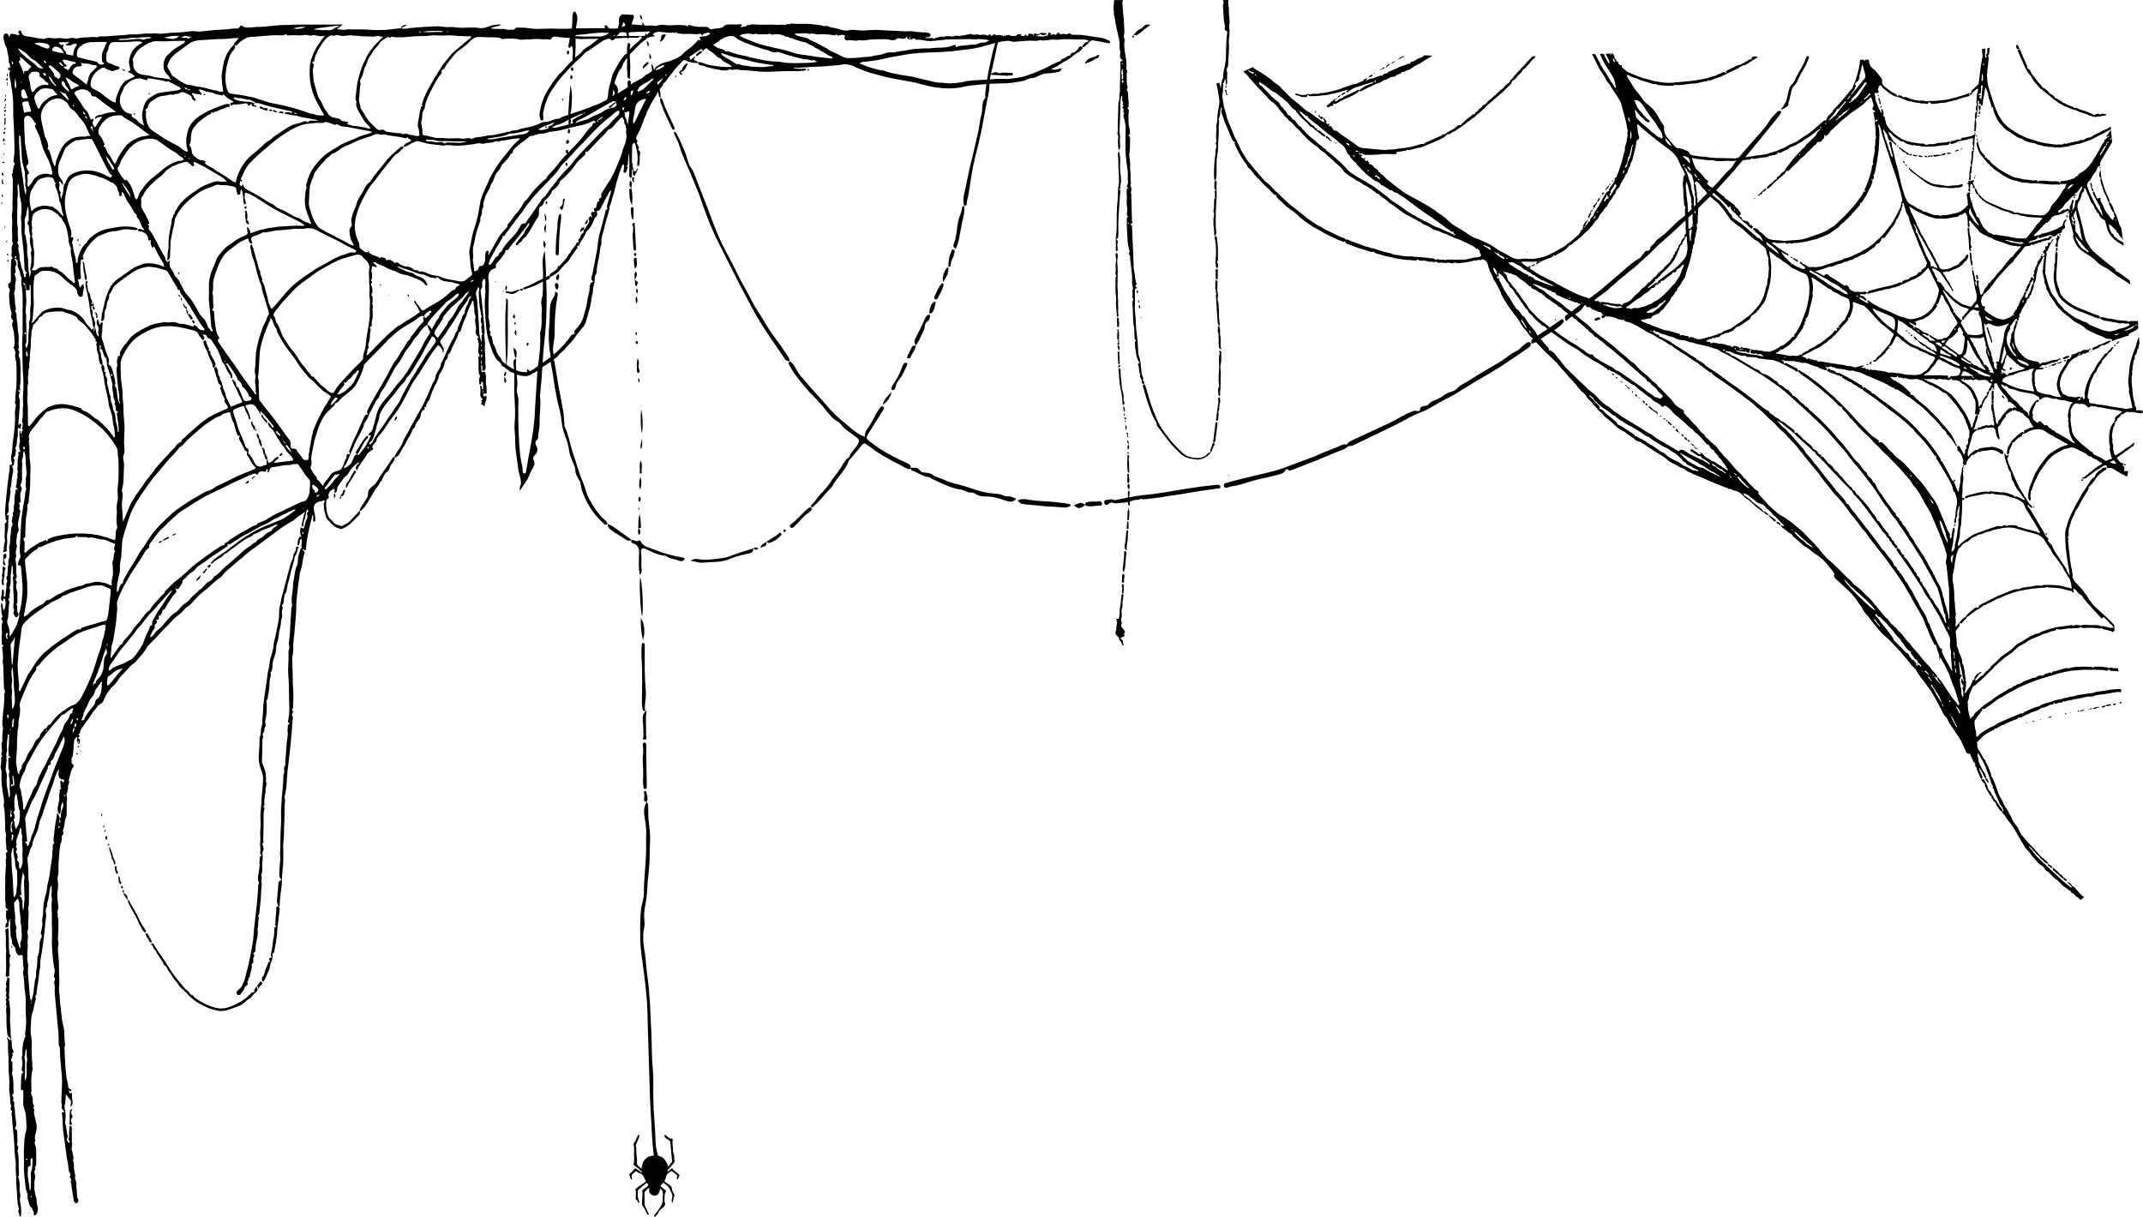
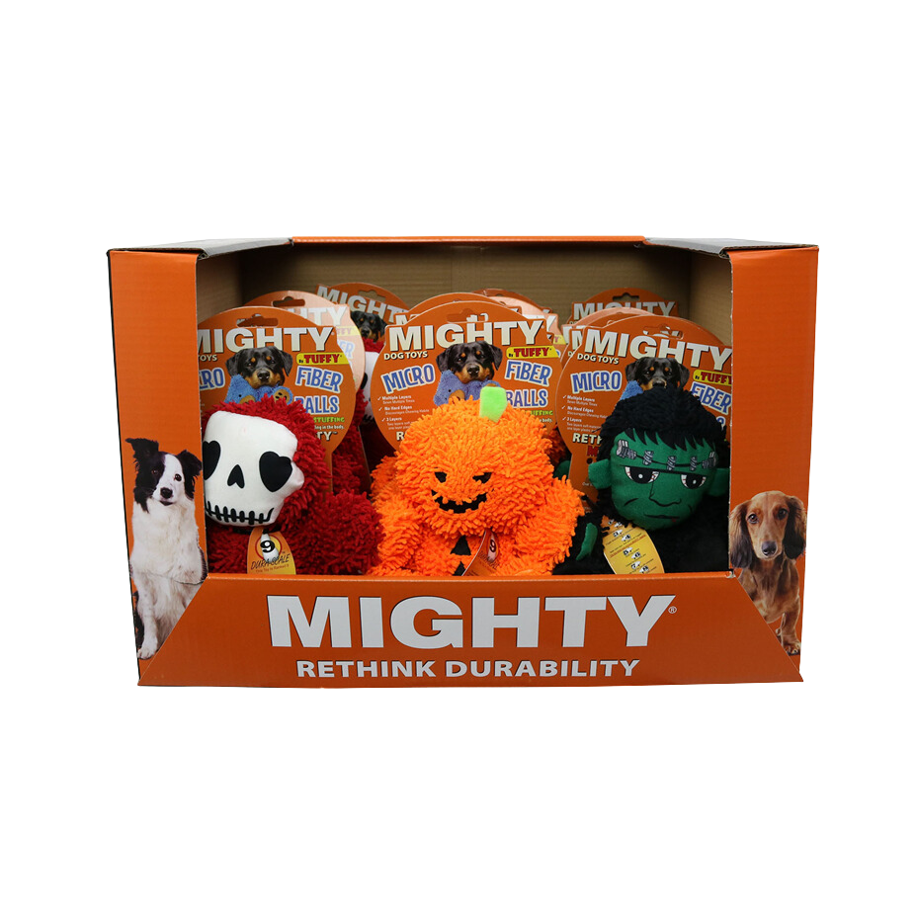
MICROFIBER PDQ - HALLOWEEN
Item Code: MT-PDQ-Frnk-Grm-Pmk
UPC: 180181030949
Wholesale Price: $189.00
•180181024535 MT-MicroBM-Frankenstein (5)
•180181024528 MT-MicroBM-Grim-Reaper (5)
•180181024368 MT-MicroBM-Pumpkin-Man (5)

Slide 5

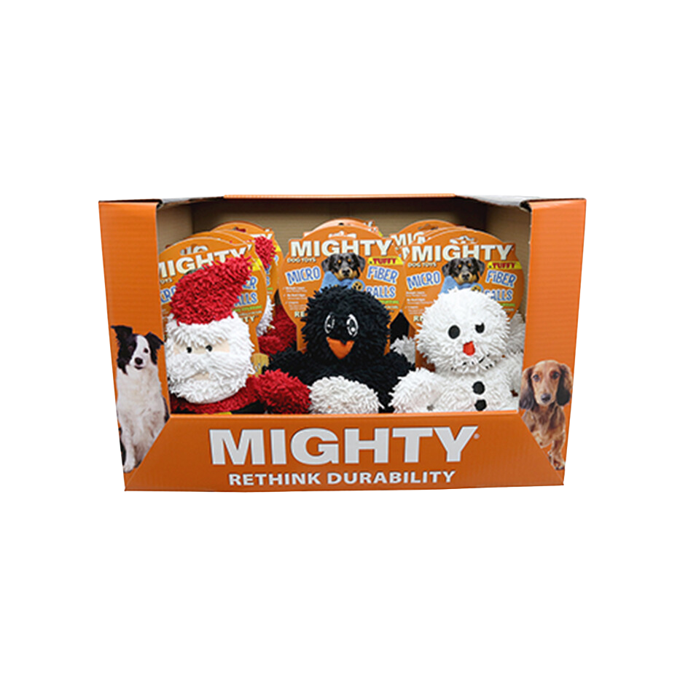
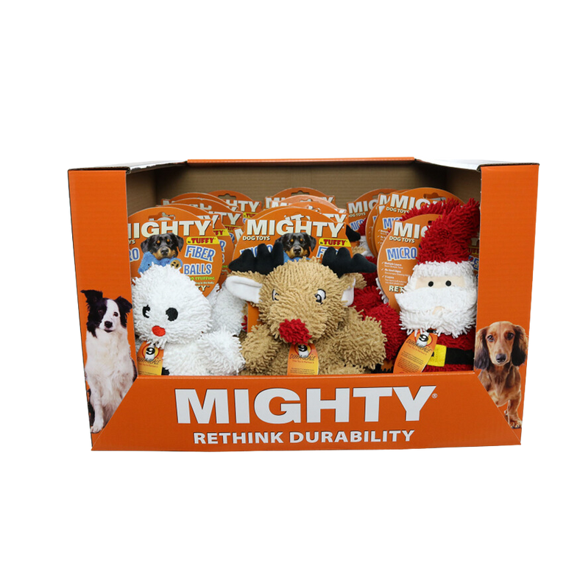
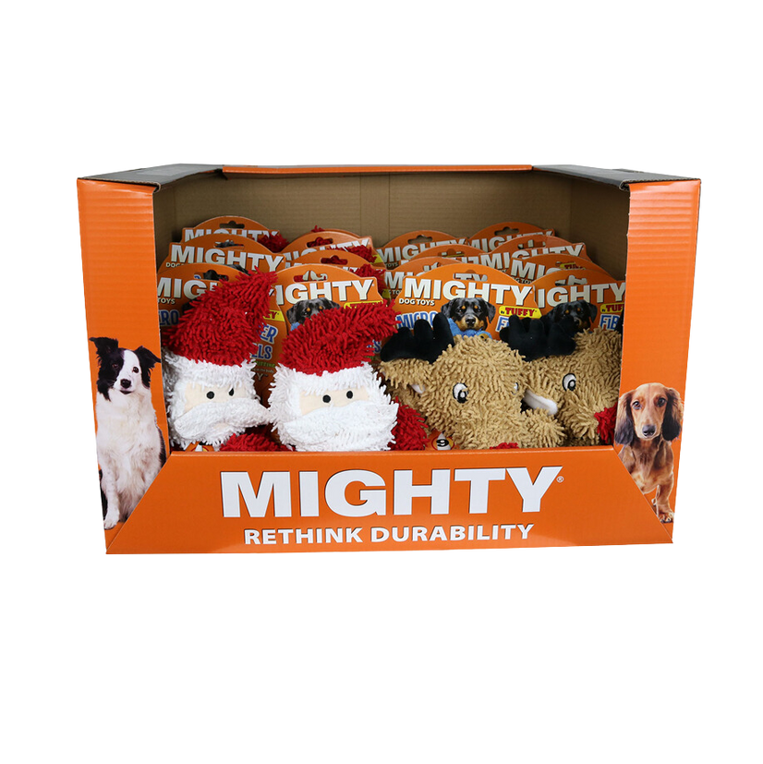
MICROFIBER PDQ’S - HOLIDAY
Item Code: MT-PDQ-San-Snw-Pen-BK
UPC: 180181031328
Wholesale Price: $189.00
Item Code: MT-PDQ-San-Snw-Rndr
UPC: 180181030963
Wholesale Price: $189.00
Item Code: MT-PDQ-MicroBM-San-Rndr
UPC: 180181030413
Wholesale Price: $226.80
•180181024351 MT-MicroBM-Santa (5)
•180181028151 MT-MicroBM-Penguin-BK (5)
•180181028168 MT-MicroBM-Snowman (5)
•180181024351 MT-MicroBM-Santa (5)
•180181024450 MT-MicroBM-Reindeer (5)
•180181028168 MT-MicroBM-Snowman (5)
•180181024351 MT-MicroBM-Santa (9)
•180181024450 MT-MicroBM-Reindeer (9)

Slide 6


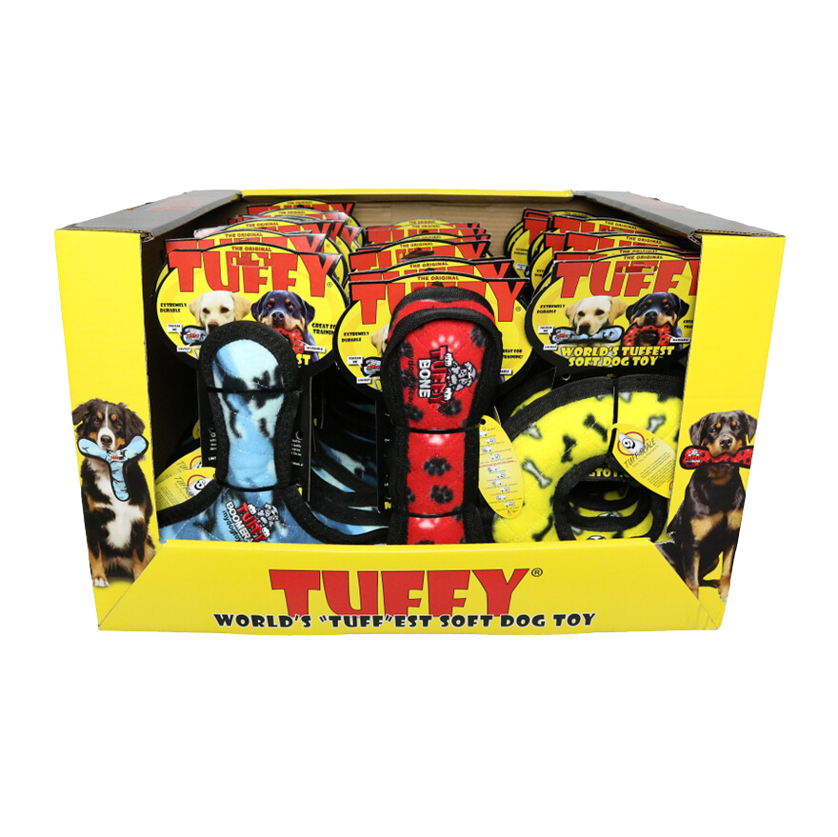
PDQ’S
Item Code: T-PDQ-BR-B-R
UPC: 180181023149
Wholesale Price: $263.10
•180181006043 T-U-BR-CB (10)
•180181910050 T-M-R-YB (10)
•180181102103 T-M-B-RP (10)

Slide 7


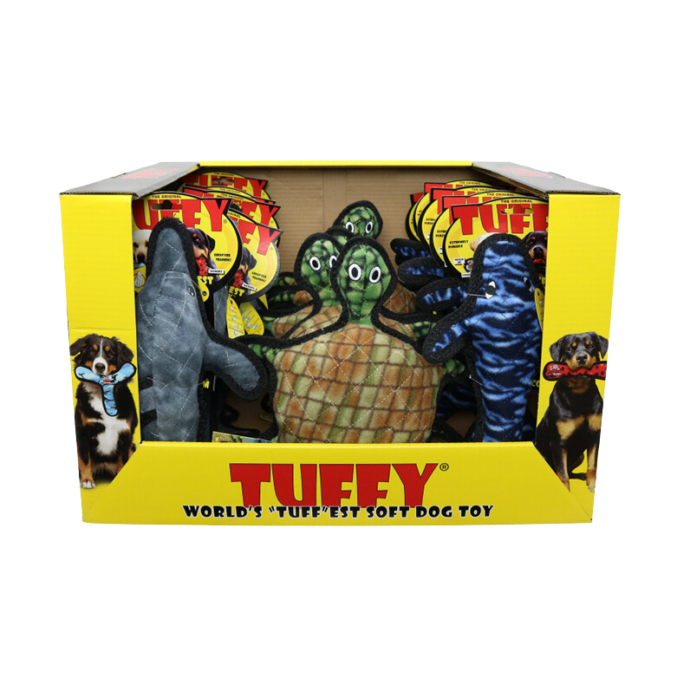
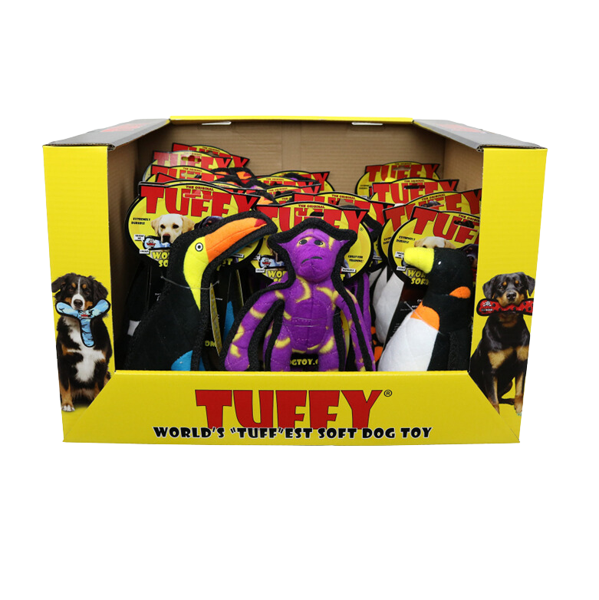
PDQ’S
Item Code: T-PDQ-Dlph-Trt-Whale
UPC: 180181031632
Wholesale Price: $157.07
Item Code: T-PDQ-JR-Tcn-Mnk-Pen
UPC: 180181031625
Wholesale Price: $165.57
•180181023668 T-OC-Dolphin (6)
•180181020308 T-OC-Turtle(5)
•180181904653 T-OC-Whale (5)
•180181908163 T-JR-Z-Toucan (7)
•180181908132 T-JR-Z-Monkey (6)
•180181908149 T-JR-Z-Penguin (5)

Slide 8

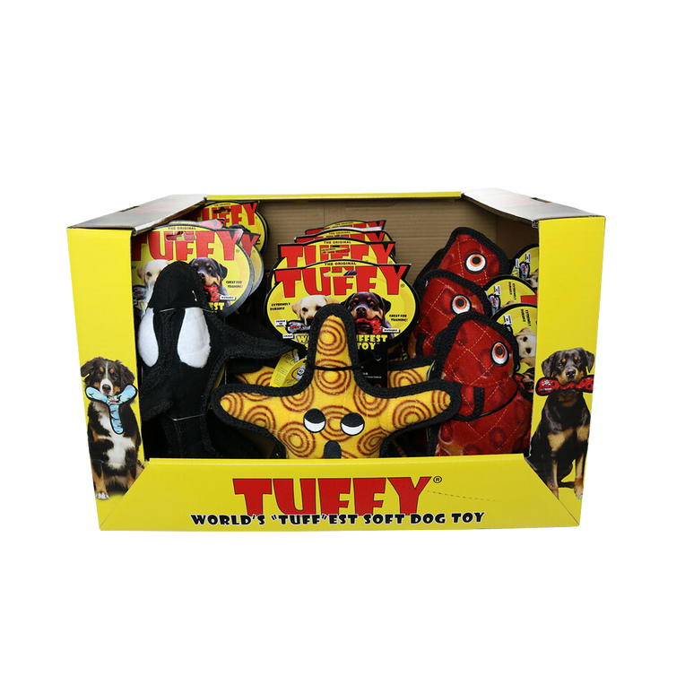
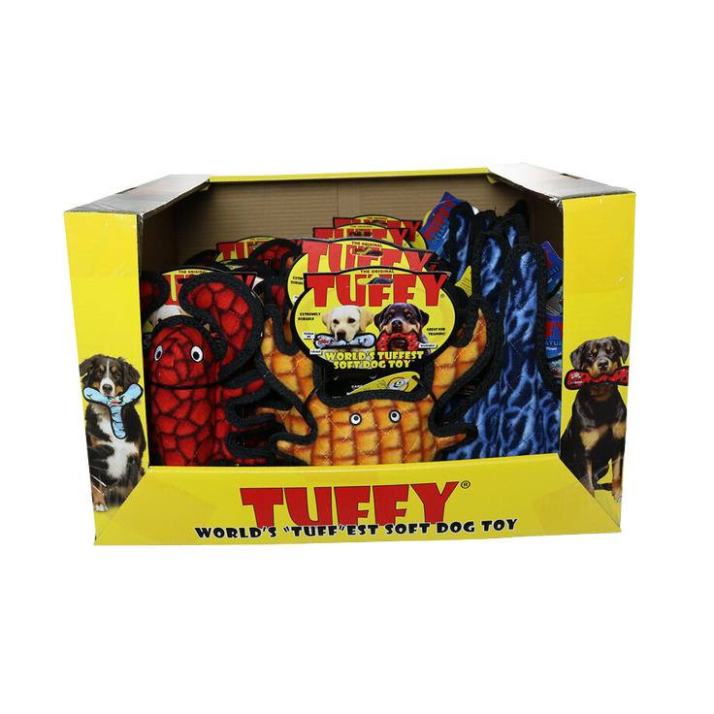
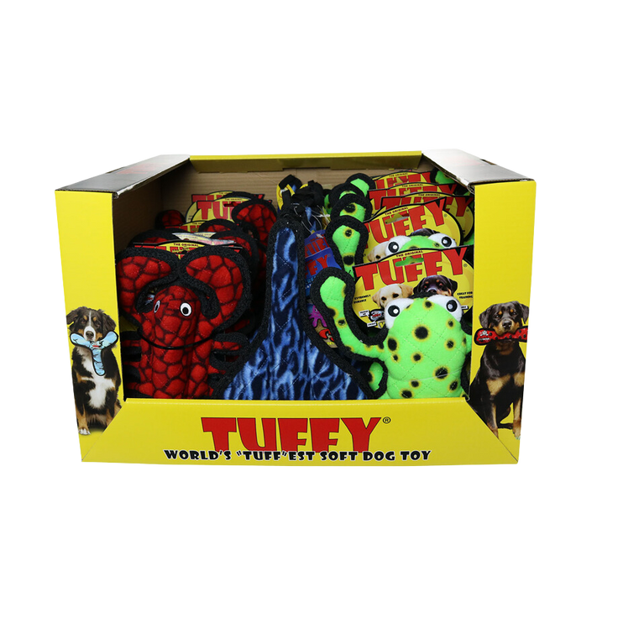
PDQ’S
Item Code: T-PDQ-OC-KilWhl-Star-FshRd
UPC: 180181030505
Wholesale Price: $186.84
Item Code: T-PDQ-OC-MCrb-OR-Sting-JrLob
UPC: 180181030499
Wholesale Price: $235.86
Item Code: T-PDQ-Sting-JrLob-PhgLp
UPC: 180181030482
Wholesale Price: $226.58
•180181009013 T-OC-Starfish (7)
•180181907555 T-OC-Killer-Whale (6)
•180181908552 T-OC-Fish-Red (7)
•180181023583 T-M-OC-Crab-OR (8)
•180181008016 T-OC-Stingray (10)
•180181910074 T-OC-JR-Lobster (8)
•180181907944 T-DS-Phrog-Leap (8)
•180181008016 T-OC-Stingray (10)
•180181910074 T-OC-JR-Lobster (8)

Slide 9
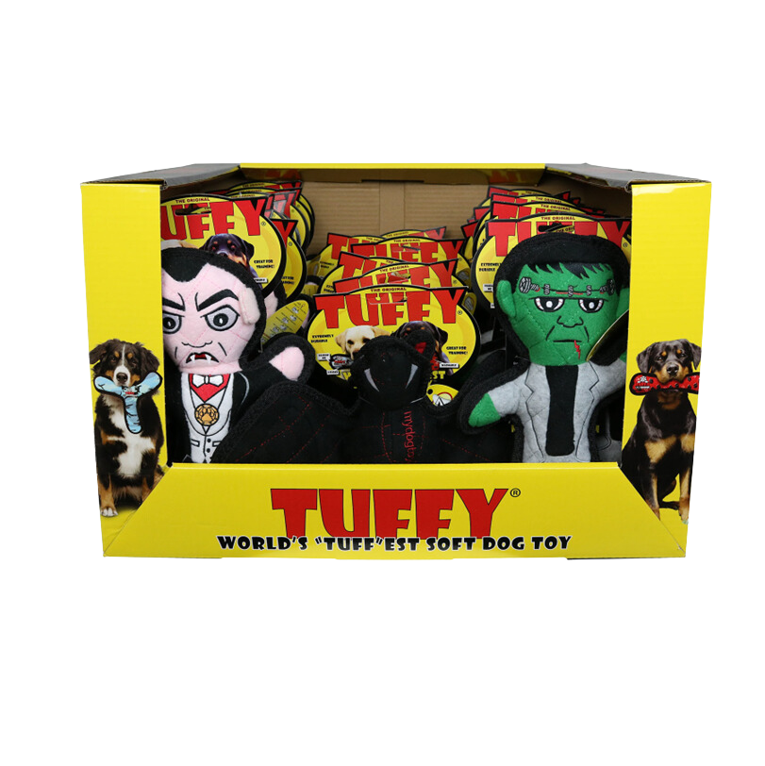
PDQ- Halloween
Item Code: T-PDQ-Bat-Drac-Frnk
UPC: 180181030406
Wholesale Price: $281.34
•180181024283 T-H-Dracula (9)
•180181906961 T-DS-Bat (6)
•180181024290 T-H-Frankenstein (9)

Slide 10
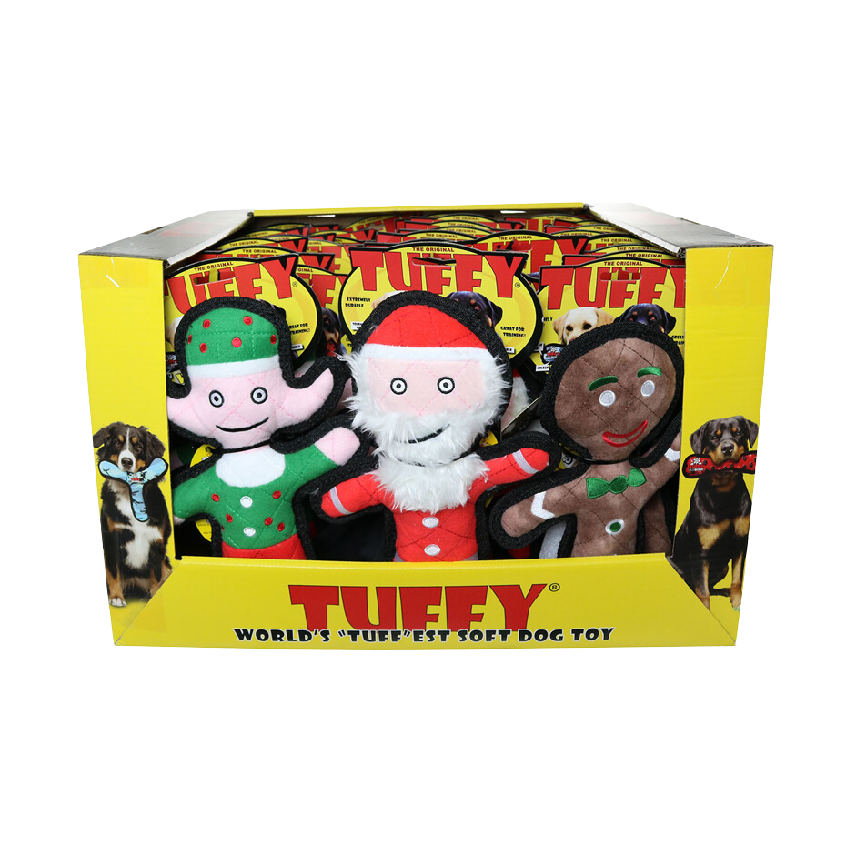
PDQ- christmas
Item Code: T-PDQ-H-Elf-Gin-San
UPC: 180181023873
Wholesale Price: $352.90
•180181023767 T-H-Elf (10)
•180181023774 T-H-Gingerbread-Man (10)
•180181023750 T-H-Santa (10)

Slide 11
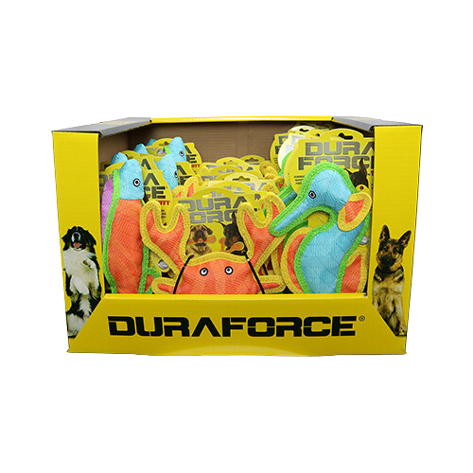
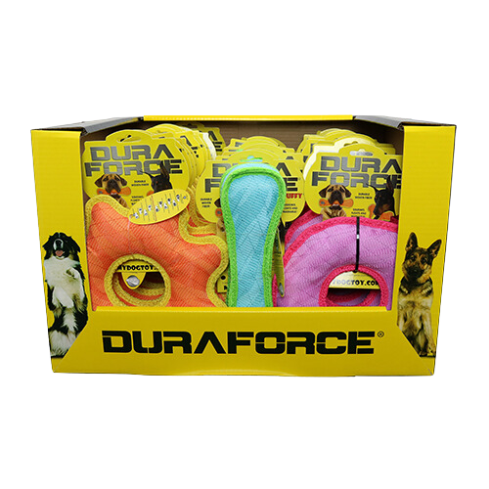
PDQ’S
Item Code: DFC-PDQ-Fish-CrbO-Sea
UPC: 180181031915
Wholesale Price: $259.45
Item Code: DF-PDQ-GRO-BBG-R
UPC: 180181031922
Wholesale Price: $248.13
•180181024603 DFC-Fish-T-BOP (7)
•180181020513 DFC-Crab-T-OY (8)
•180181031106 DFC-Seahorse-B (10)
  180181021183 DF-M-GR-T-OY (10)
  180181909504 DF-B-T-BG (8)
  180181909405 DF-M-R-T-PP (9)

