Slide 1


HOLIDAY CLIP STRIPS
2025

Slide 2
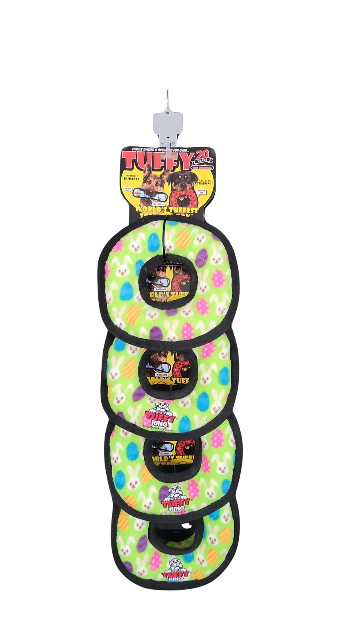
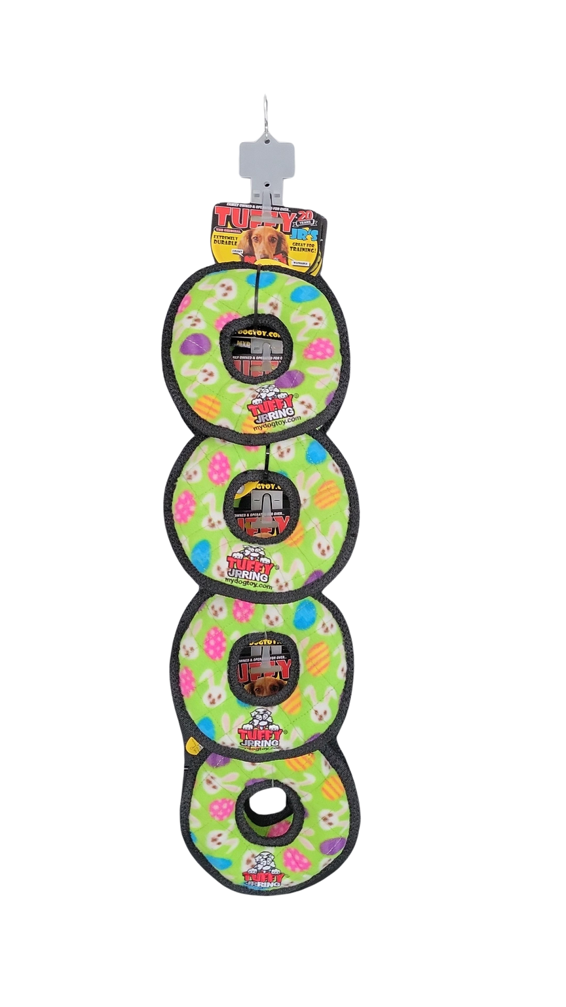
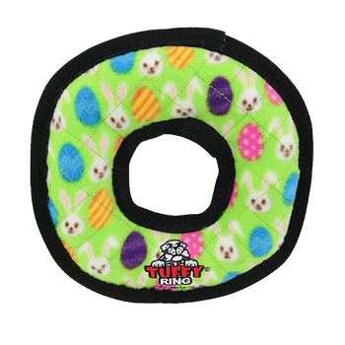
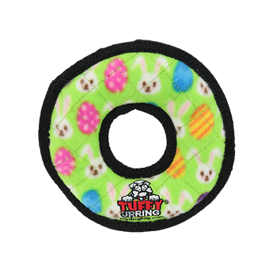
TUFFY HOLIDAY CLIP STRIPS 2025
T-H-M-R-ER-CP-8
Tuffy Holiday Medium Ring Egg - Clip Strip
8 units
180181033742
H: 33.5" W: 9" D: 7"
$77.12
T-H-JR-R-ER-CP-8
Tuffy Holiday Jr Ring Egg - Clip Strip
8 units
180181033735
H: 30" W: 7" D: 5.5"
$55.84

Slide 3
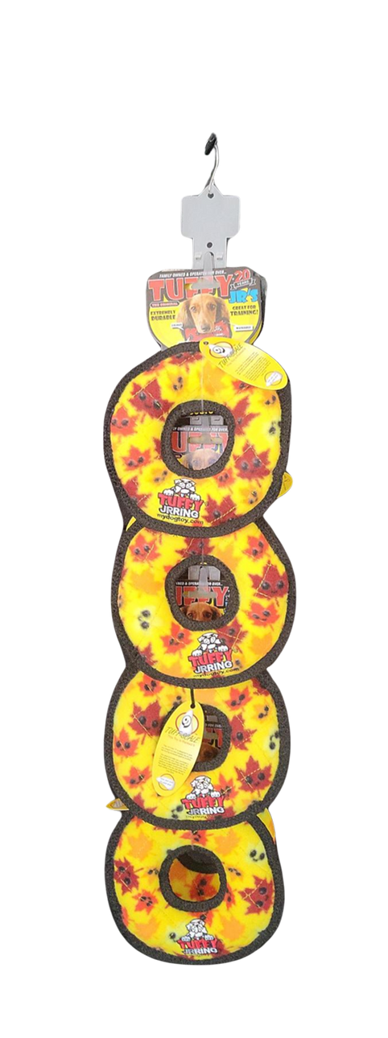
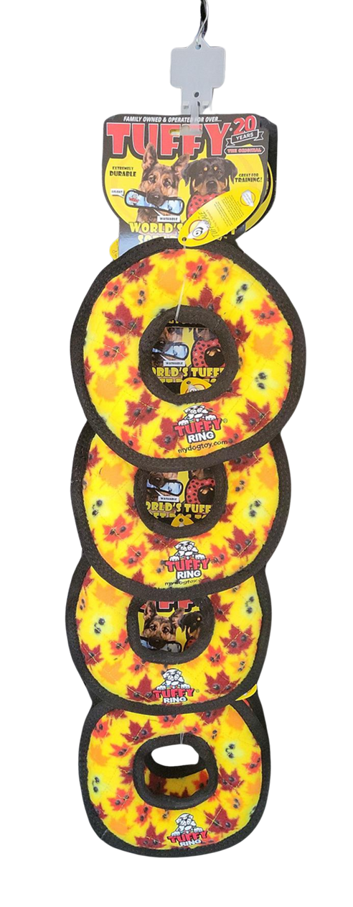
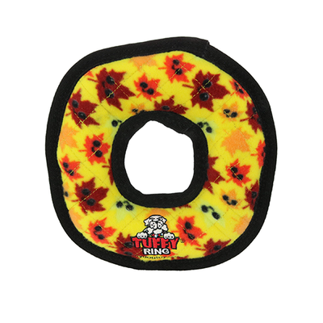
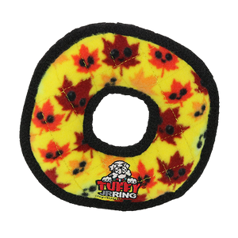
TUFFY HOLIDAY CLIP STRIPS 2025
T-H-M-R-LV-CP-8
Tuffy Holiday Medium Ring Leaves - Clip Strip
8 units
180181033704
H: 33.5" W: 9" D: 7"
$77.12
T-H-JR-R-LV-CP-8
Tuffy Holiday Jr Ring Leaves - Clip Strip
8 units
180181033698
H: 30" W:7" D: 5.5"
$55.84

Slide 4
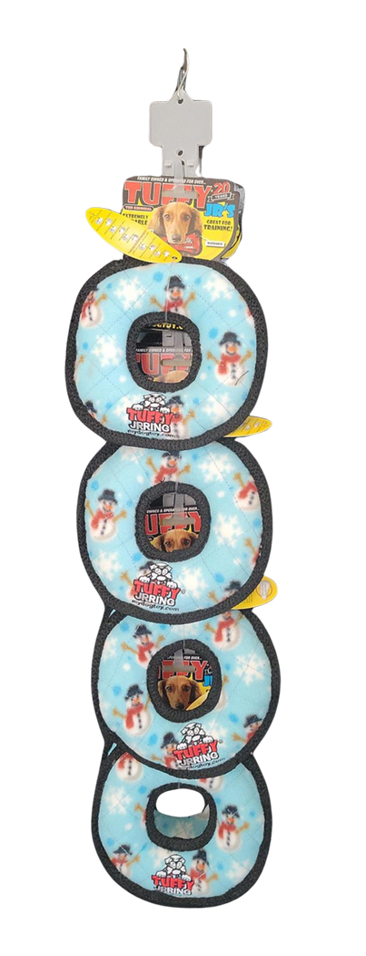
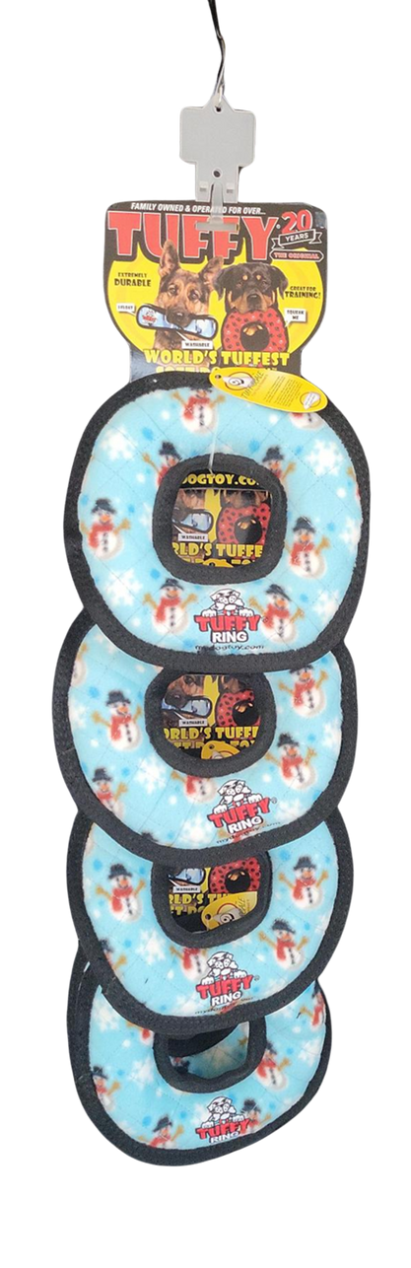
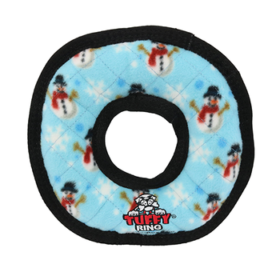
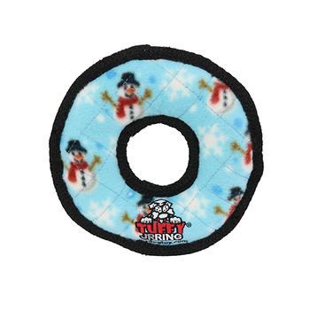
TUFFY HOLIDAY CLIP STRIPS 2025
T-H-M-R-SW-CP-8
Tuffy Holiday Medium Ring Snowman - Clip Strip
8 units
180181033681
H: 33.5" W: 9" D: 7"
$77.12
T-H-JR-R-SW-CP-8
Tuffy Holiday Jr Ring Snowman - Clip Strip
8 units
180181033674
H: 30" W: 7: D: 5.5"
$55.84

Slide 5
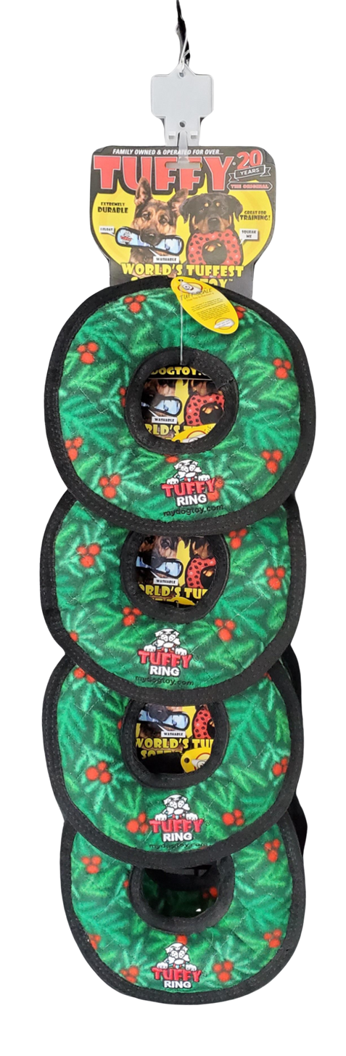
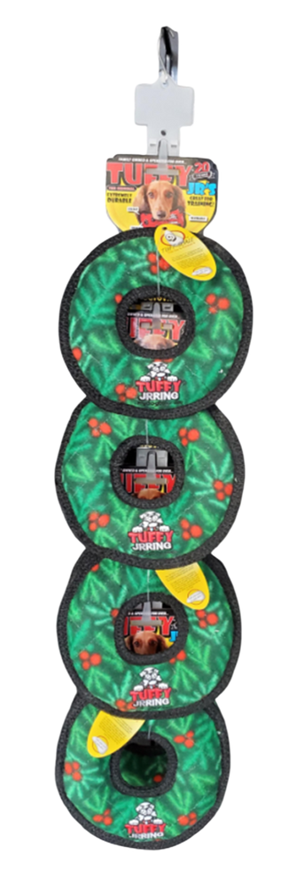
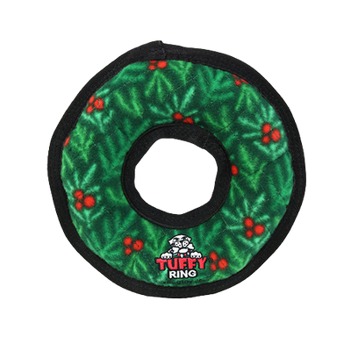
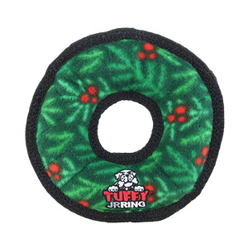
TUFFY HOLIDAY CLIP STRIPS 2025
T-M-R-WR-CP-8
Tuffy Medium Ring Wreath - Clip Strip
8 units
180181033179
H: 33.5" W: 9" D: 7"
$77.12
T-JR-R-WR-CP-8
Tuffy Junior Ring Wreath - Clip Strip
8 units
180181033094
H: 30" W:7" D: 5.5"
$55.84

Slide 6
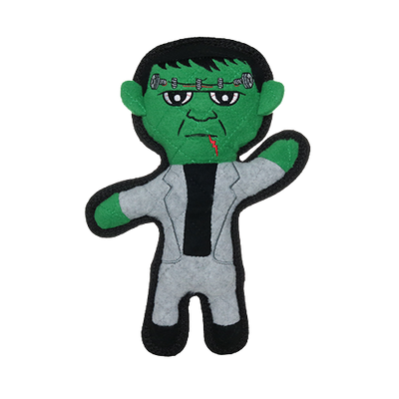
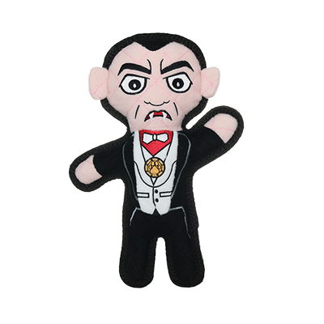
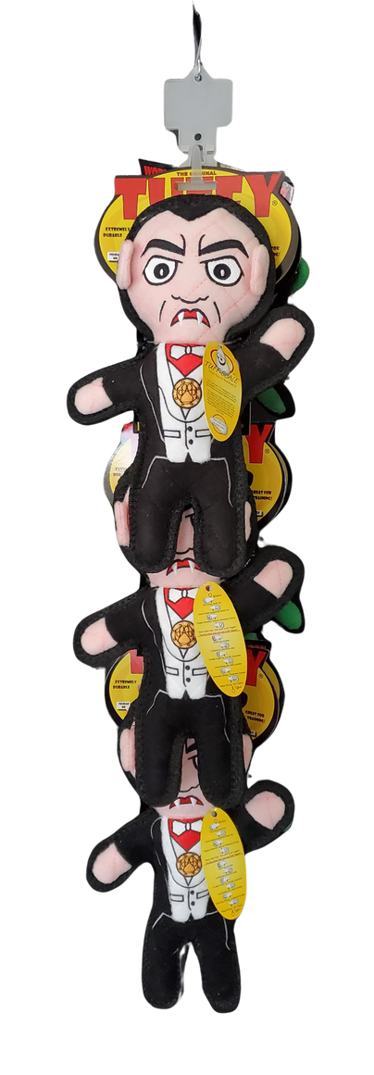
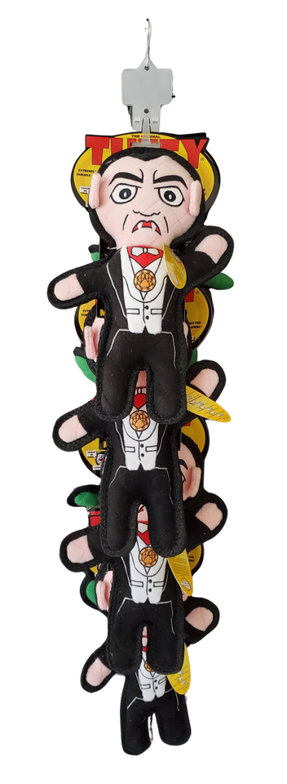
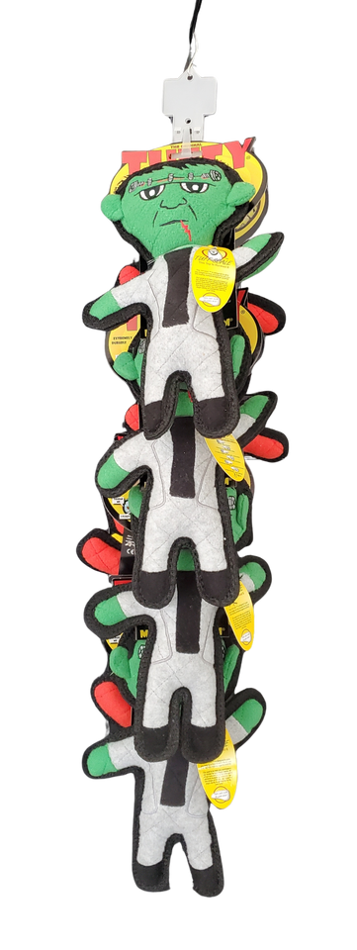
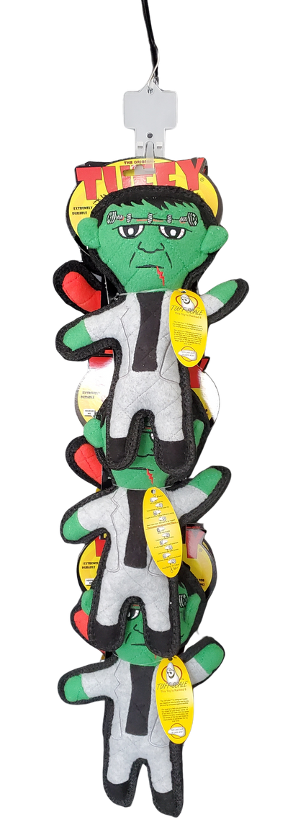
TUFFY HOLIDAY CLIP STRIPS 2025
T-H-Drac-Frnk-CP-6
Tuffy Holiday Dracula & Frankenstein - Clip Strip
6 units
180181032387
H: 31" W: 8" D:8"
$77.73
T-H-Drac-Frank-CP
Tuffy Holiday Dracula & Frankenstein - Clip Strip
8 units
180181031670
H: 33" W: 8" D: 11"
$103.64

Slide 7
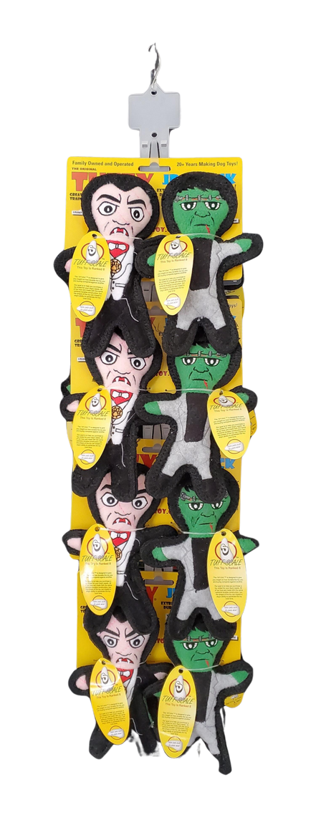
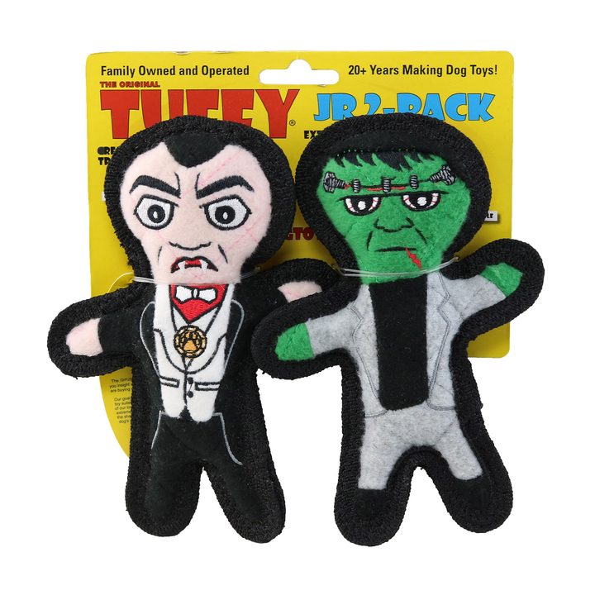
TUFFY HOLIDAY CLIP STRIPS 2025
T-JR-H-Drac-Frnk-2PK-CP-8
Tuffy Jr Holiday Dracula & Frankenstein 2 Pack - Clip Strip
8 units
180181032691
H: 29" W: 8" D: 5"
$92.72

Slide 8
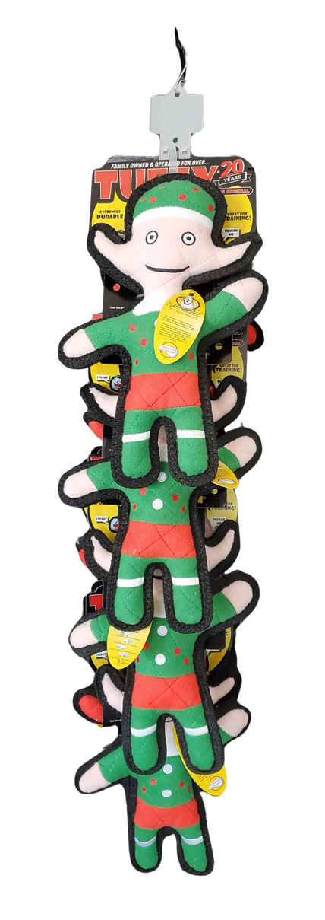
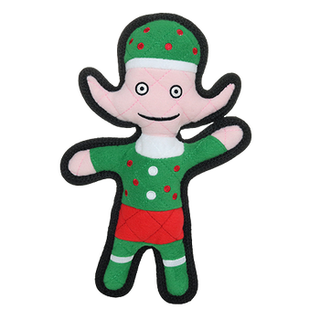
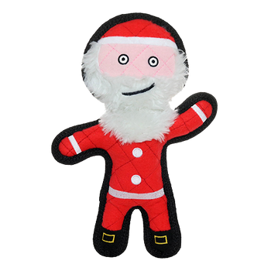
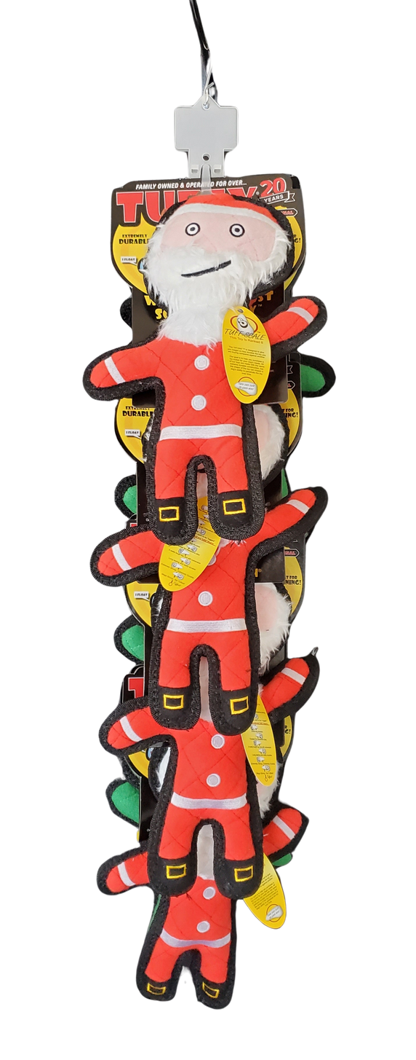
TUFFY HOLIDAY CLIP STRIPS 2025
T-H-Elf-San-CP
Tuffy Holiday Elf & Santa - Clip Strip
8 units
180181031663
H: 33" W: 8" D: 10.5"
$105.84

Slide 9
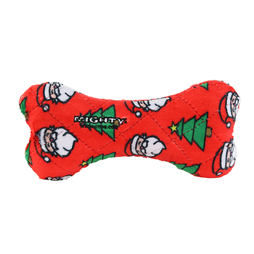
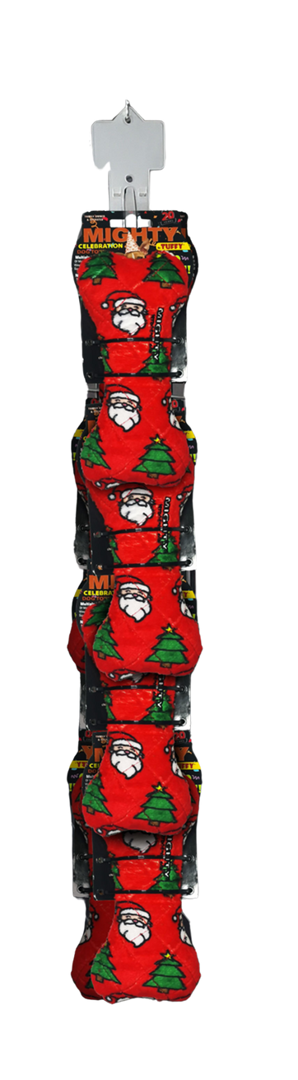
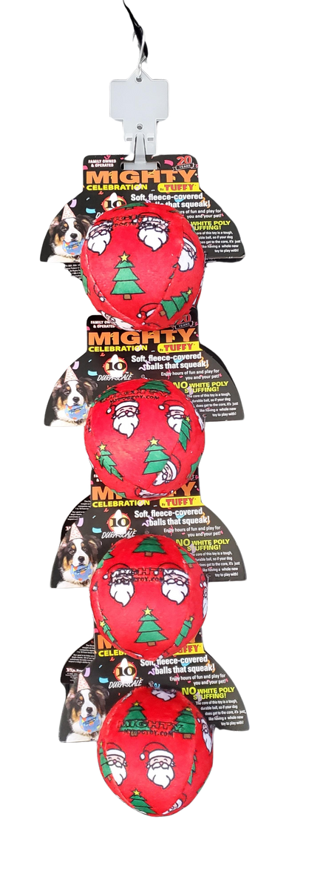
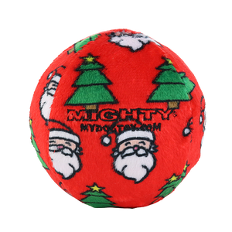
MIGHTY HOLIDAY CLIP STRIPS 2025
MT-Ball-M-CF1-CP-8
Mighty Med Ball Christmas Fleece - Clip Strip
8 units
180181033162
H: 27.5" W: 7" D: 8"
$51.12
MTNS-Bone-M-CF1-CP-8
Mighty Med Bone Christmas Fleece - Clip Strip
8 units
180181033087
H: 29" W: 6.5" D: 4"
$55.60

Slide 10
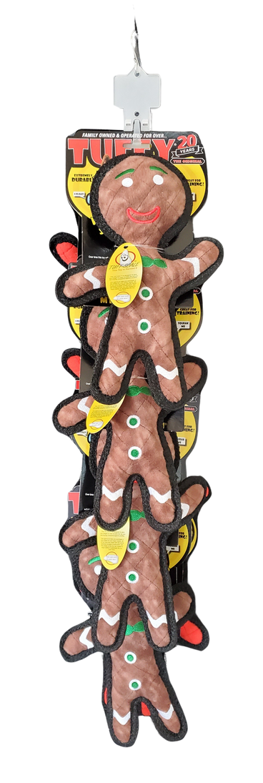
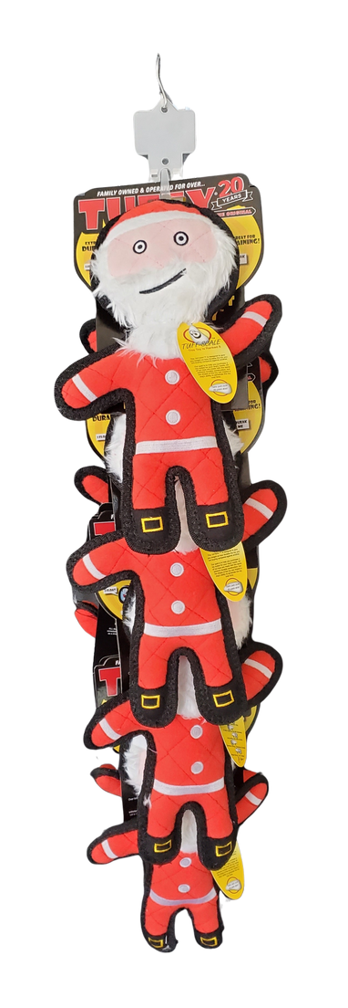
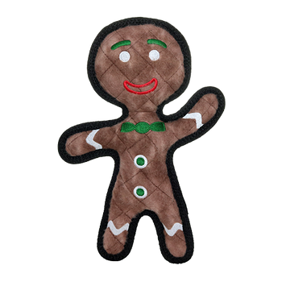
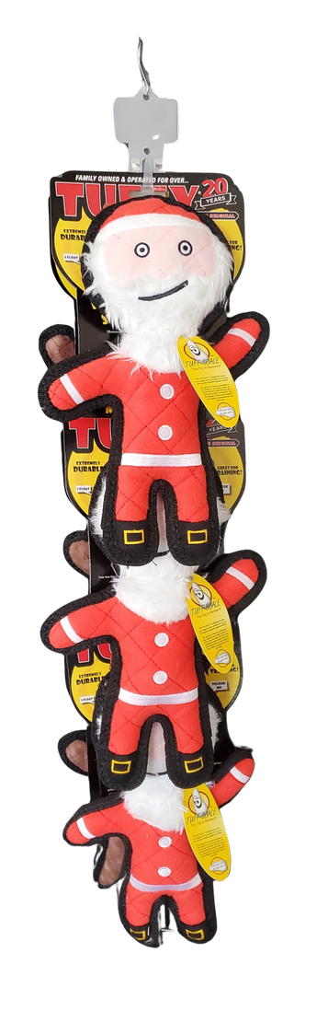
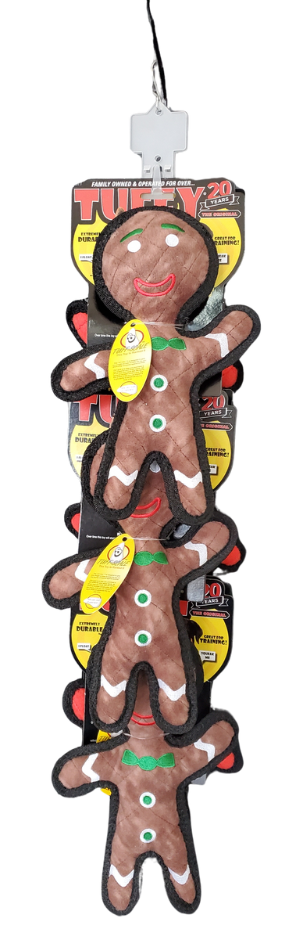
TUFFY HOLIDAY CLIP STRIPS 2025
T-H-Gin-San-CP
Tuffy Holiday Gingerbread Man & Santa - Clip Strip
8 units
180181033056
H: 33.5" W: 8" D: 11"
$105.56
T-H-Gin-Santa-CP
Tuffy Holiday Gingerbread Man & Santa - Clip Strip
6 units
180181024566
H: 31.5" W: 8" D: 8"
$79.17

Slide 11
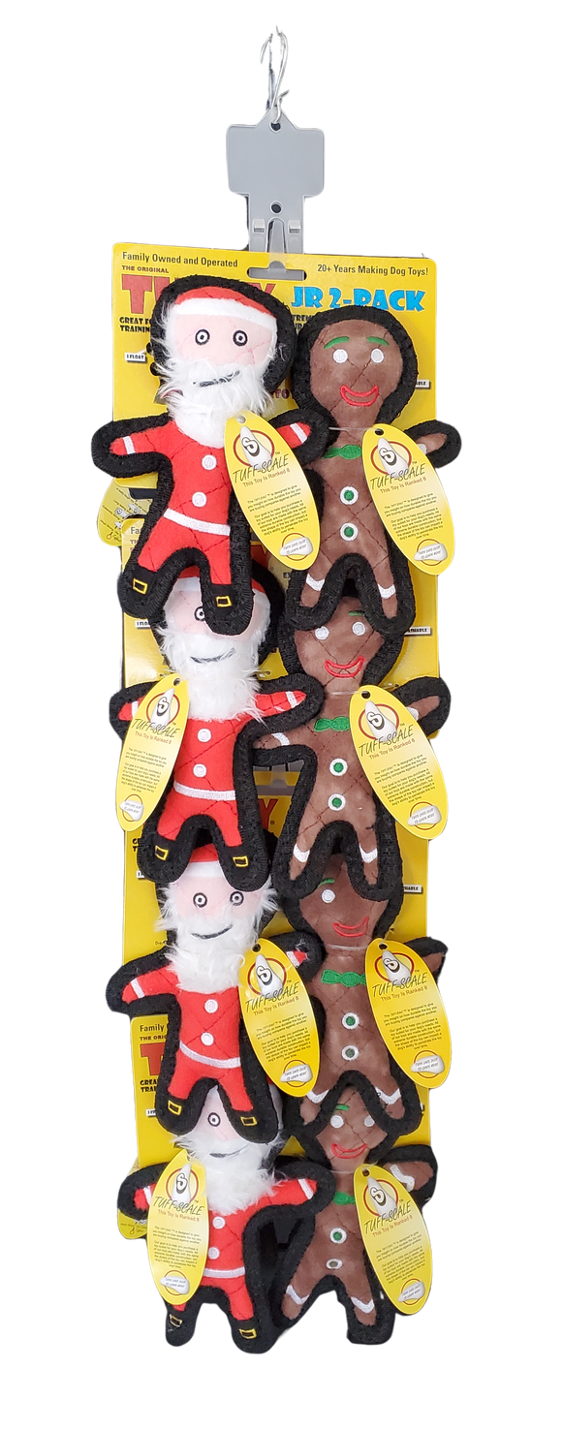
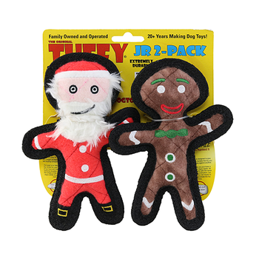
TUFFY HOLIDAY CLIP STRIPS 2025
T-H-Santa-CP
Tuffy Holiday Santa - Clip Strip
8 units
180181024382
H: 33.5" W: 8" D: 11"
$107.68
T-JR-H-Gin-San-2PK-CP-8
Tuffy Jr Holiday Gingerbread Man & Santa 2 Pack - Clip Strip
8 units
180181032684
H: 29" W: 8" D: 5"
$91.92

Slide 12
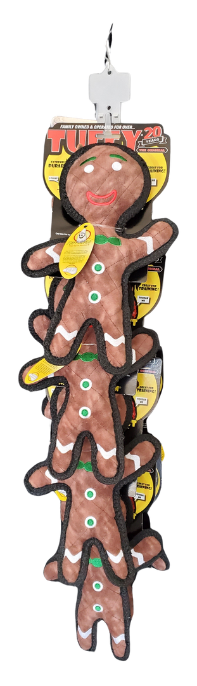
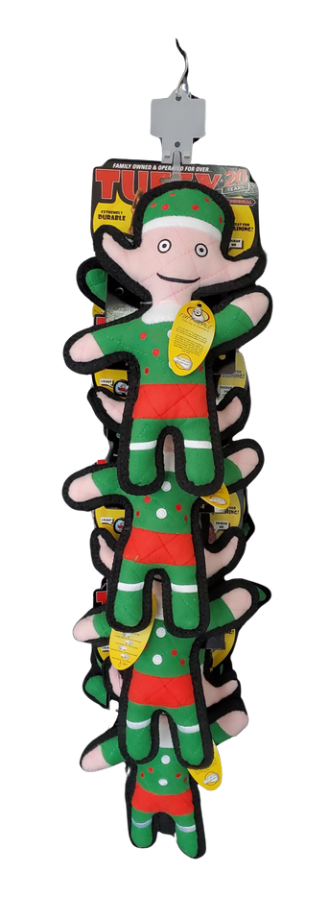
TUFFY HOLIDAY CLIP STRIPS 2025
T-H-Gingerbread-CP
Tuffy Holiday Gingerbread Man - Clip Strip
8 units
180181024375
H: 33" W: 8" D: 11"
$103.44
T-H-Elf-CP
Tuffy Holiday Elf - Clip Strip
8 units
180181024399
H: 33" W: 8" D: 10"
$104.00

Slide 13
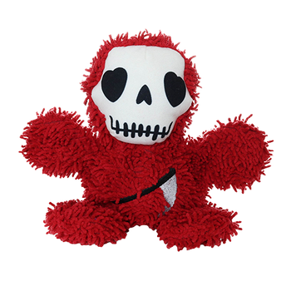
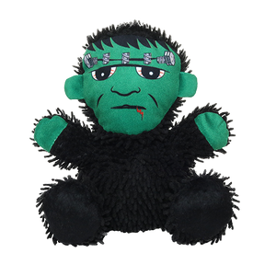
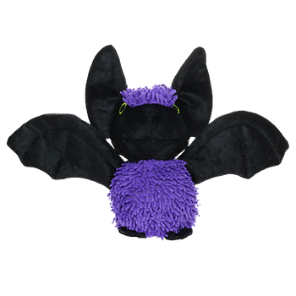
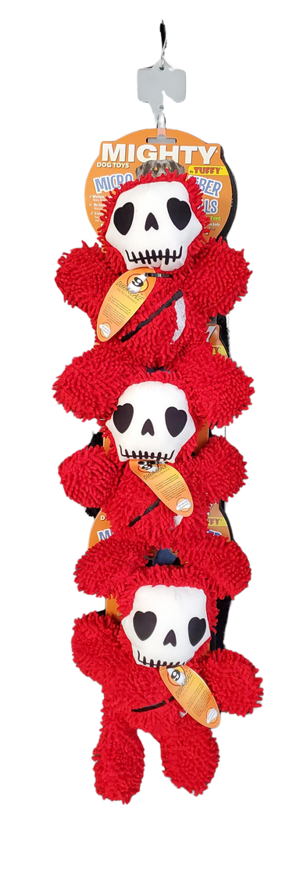
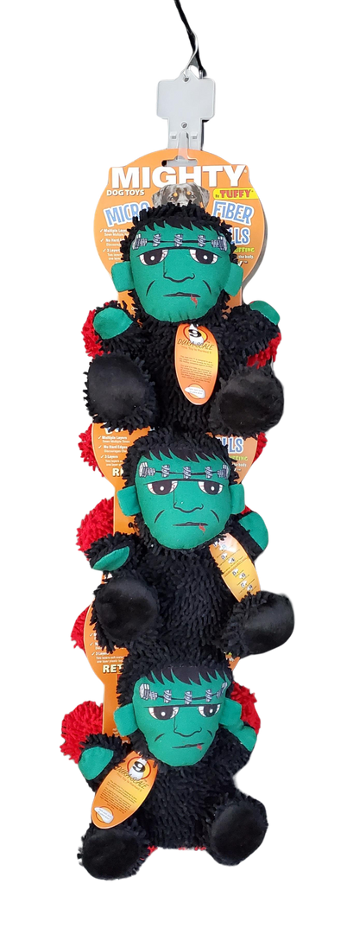
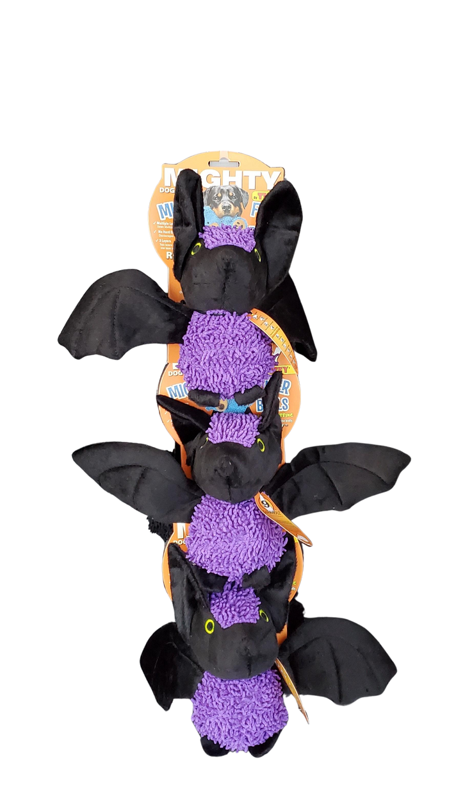
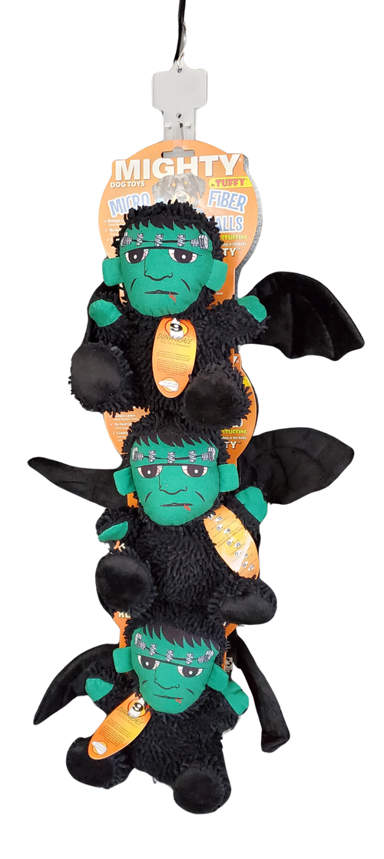
MIGHTY MICROFIBER HOLIDAY
CLIP STRIPS 2025
MT-MB-Frnk-GrmR-CP
Mighty MicroBall Frankenstein &
Grim Reaper - Clip Strip
6 units
180181031847
H: 32.5" W: 8" D: 9"
$85.56
MT-MB-Bat-Frnk-CP
Mighty MicroBall Bat & Frankenstein - Clip Strip
6 units
180181032660
H: 29" W: 14" D: 10.5"
$85.56

Slide 14
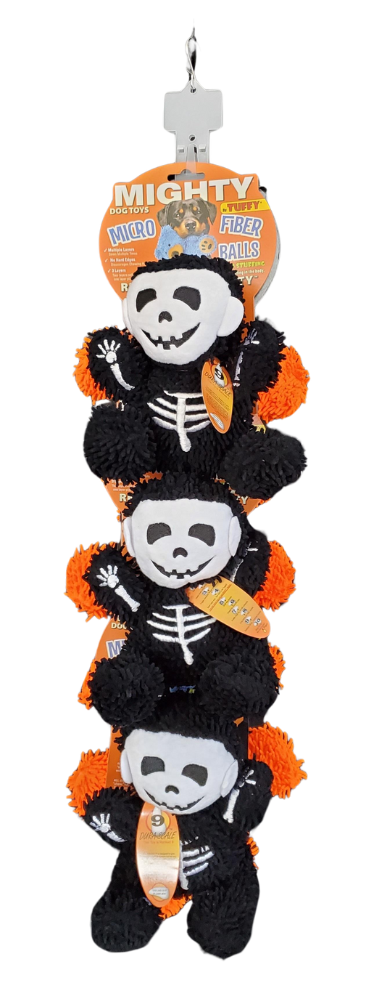
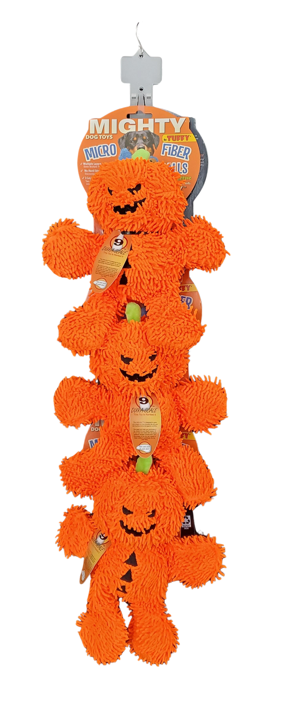


MIGHTY MICROFIBER HOLIDAY CLIP STRIPS 2025
MT-MB-Pum-Skel-CP
Mighty MicroBall Pumpkin Man & Skeleton - Clip Strip
6 units
180181031694
H: 32" W: 9" D: 10"
$85.56

Slide 15







MIGHTY MICROFIBER HOLIDAY
CLIP STRIPS 2025
MT-MBM-GBM-Pen-BK-CP-6
Mighty Microfiber Ball Med Gingerbread Man Hat
& Penguin BK - Clip Strip
6 units
180181033063
H: 32" W: 9" D: 9"
$85.56
MT-MB-Snw-PenBK-CP-6
Mighty MicroBall Snowman &
Penguin Black - Clip Strip
6 units
180181031854
H: 32" W: 8" D: 8"
$85.29

Slide 16






MIGHTY MICROFIBER HOLIDAY
CLIP STRIPS 2025
MT-MB-Rndr-San-CP
Mighty MicroBall Reindeer & Santa - Clip Strip
6 units
180181031687
H: 32" W: 8: D: 10"
$85.56
MT-MBM-Rndr-Gngbrd-CP-6
Mighty Microfiber Ball Med Reindeer &
Gingerbread Man - Clip Strip
6 units
180181032400
H: 32" W: 9" D: 10.5"
$85.56

Slide 17


MIGHTY MICROFIBER HOLIDAY CLIP STRIPS 2025
MT-MBM-Snw-Gngbrd-CP-6
Mighty Microfiber Ball Med Snowman & Gingerbread Man Clip Strip
6 units
180181032677
H: 34" x W: 8" x D: 8"
$85.29

